Slide 1
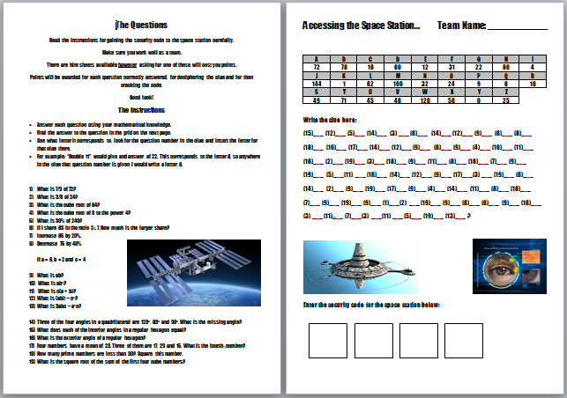
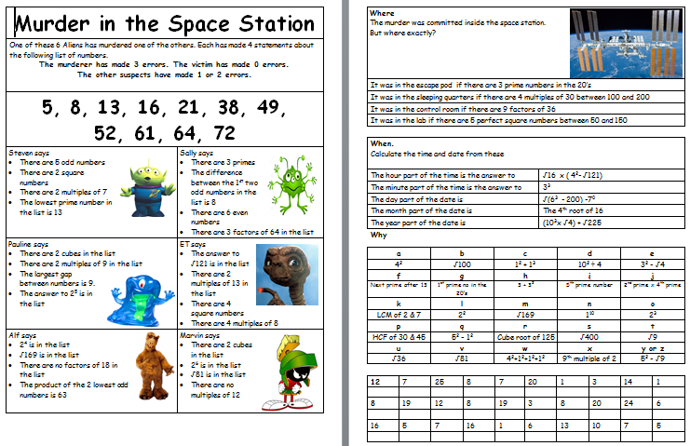
Welcome to the Tameside Year 7 Maths Challenge
You first challenge is to enter the mathematically protected space station.
Your team must crack ciphers to work out the security code that will allow you entry.
Be careful. One incorrect number could lose you valuable points….
When you have entered the space station you will find a murder scene – solve the murder mystery to award your team further points.
Good luck.
This message will now self destruct.

Slide 2
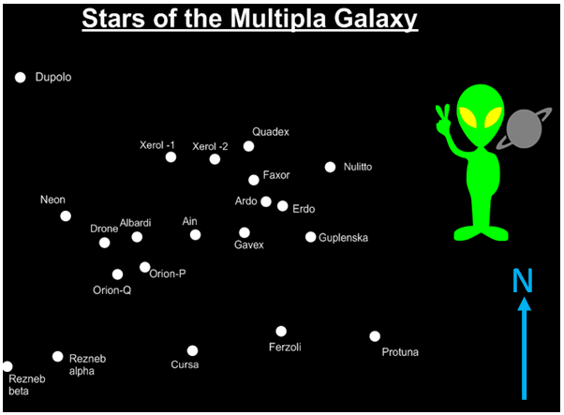
Your next challenge involves you locating certain planets and stars that your space station needs to travel to using your knowledge of Mathematics.
Remember to show any construction lines you use clearly.

Slide 3
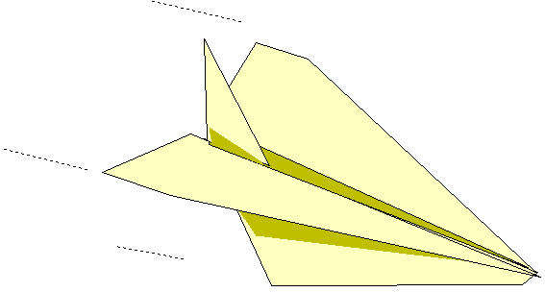
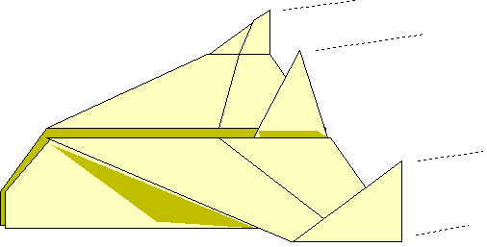
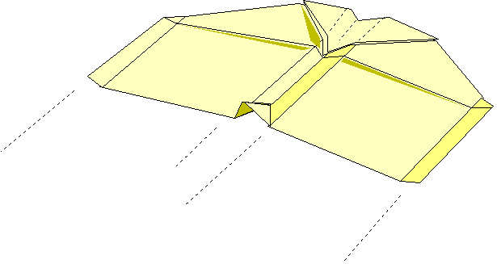
Now that you have located the stars and planets you’ll need to travel to, you’ll need a mode of transport to get there. Your next challenge is to design the ultimate prototype – from an A4 piece of paper.
The further your team’s plane goes, the more points you’ll score.
Make sure to label your team’s plane clearly with your team name and school.
You will have 40 minutes to build and test different designs before you pick your final design.

Slide 4
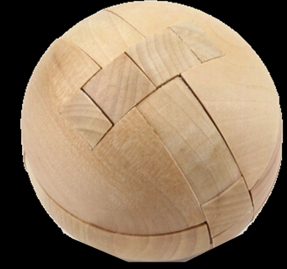
Your final challenge in your teams is to construct two different space stations – one using a wooden puzzle and one using origami.
Inside the plastic sphere you will find your wooden puzzle.
You will also receive instructions on how to build your space station using paper.
Time keeping will be key – make sure that you divide up responsibilities in your team so that you have the best chance of completing both tasks in the hour.

