Slide 1
Numeracy
“Maths for Life!”

Slide 2
Number Magic No 2
You have an ability to read people’s minds!
Impress your friends with your amazing mental powers!

Slide 3
Think of a number in your head between 1 and 10
Multiply this number by 9 (the hardest sum you will do!)
Add the digits of your number. Eg, if it is 38, 3+8 = 11
Subtract 5 from YOUR answer (here, 11 – 5 = 6)
If 1=A, 2=B, 3=C etc .. CHANGE your number to a letter
(keep everything in your head!!!
Think of a Country beginning with the letter in your head
Think of an animal beginning with the second letter of your
Country
Finally, think of the colour of your animal
Notes:
Ask pupils to stand up facing you and to look into your eyes – not around the eyes, but into my eyes!! Etc. Explain they have to listen very carefully to your instructions and NOT to say anything or tell anyone their own individual number ….

Slide 4
You are thinking of ...

Slide 5
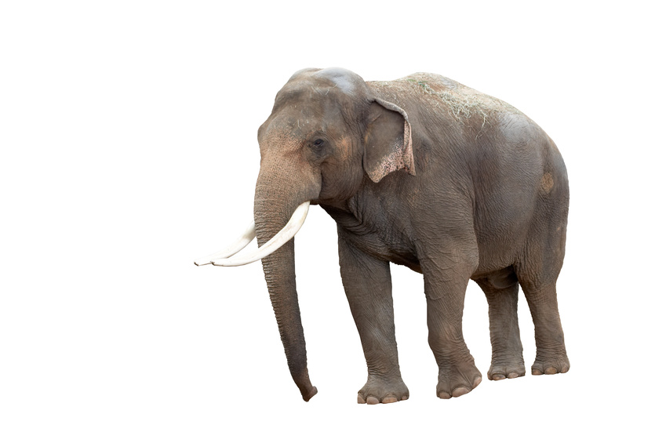
DENMARK
Notes:
Don’t project this slide – you will spoil the fun!

