Slide 1

Payslips and Overtime

Slide 2
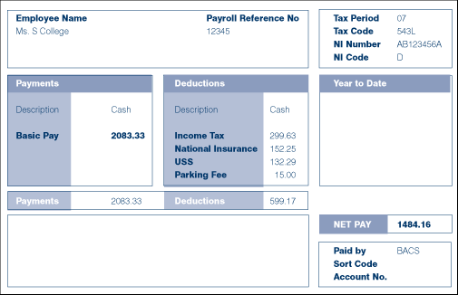

Slide 3
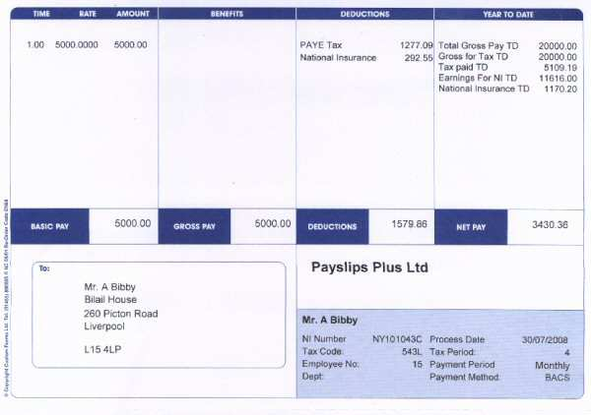

Slide 4
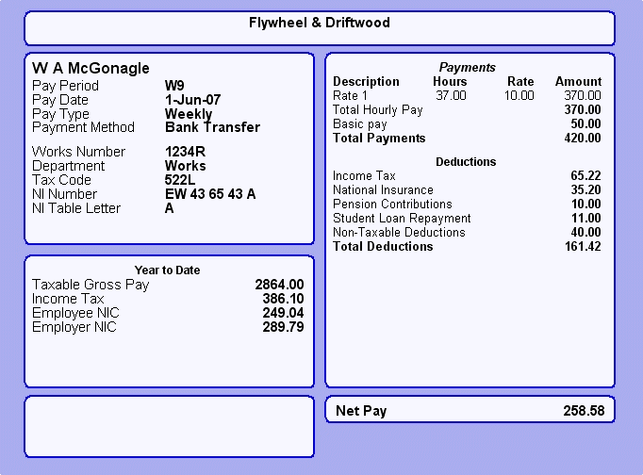

Slide 5

Basic Pay
This is what you earn before any additions or deductions
Joe earns £6.50 p.h.
He works 40 hours per week
How much does he earn in a week?
40 × 6.50
£260
How much does he earn in a year?
£260 × 52
£13520
This is his annual salary.

Slide 6
Overtime
Sometimes you might get paid extra for working more hours
This might be at “time and a half” or “double time”
When Joe works over 40 hours, the overtime is paid at “time and a half” of £6.50
Calculate his overtime pay if he works an extra 6 hours.
1½ × £6.50 × 6
1.5 × £6.50 × 6
£58.50

Slide 7
Gross Pay
Gross pay is the total of your basic pay + any overtime
This is the amount of pay before anything is deducted
What is Joe’s gross weekly pay?
£260 basic + £58.50 overtime
£318.50

Slide 8
Net Pay
Net pay is the amount of pay you actually receive
Sometimes called “take home pay”
This is what you receive after deductions are taken off your Gross Pay
Deductions are things like Income Tax, National Insurance and Pension Contributions
What is Joe’s Net weekly pay if his tax is £57.33 and NI is £42.30?
£318.50 - £57.33 - £42.30 =
£218.87

Slide 9
Mark is a joiner. His basic pay is £12.00 an hour. He is paid time and a half for any overtime. Calculate his gross pay when he works a basic 40 hour week plus an additional 11 hours overtime.
Basic pay
40 × £12.00
£480
Overtime
1½ × £12 × 11
1.5 × £12 × 11
£198
Gross Pay = £480 + £198 = £678

Slide 10
Louise is an admin assistant. Her basic pay is £8.00 an hour. She is paid time and a half for any overtime. Calculate her gross pay when she works a basic 35 hour week plus an additional 5 hours overtime.
Basic pay
35 × £8.00
£280
Overtime
1½ × £8 × 5
1.5 × £8 × 5
£60
Gross Pay = £280 + £60 = £340

Slide 11
Zoe is a nursery nurse. Her basic pay is £7.50 an hour. She is paid double time for any overtime. Calculate her gross pay when she works a basic 30 hour week plus an additional 4 hours overtime.
Basic pay
30 × £7.50
£225
Overtime
2 × £7.50 × 4
£60
Gross Pay = £225 + £60 = £285

