Slide 1
MAC - Estimation
“MAC – Maths Across the Curriculum”

Slide 2
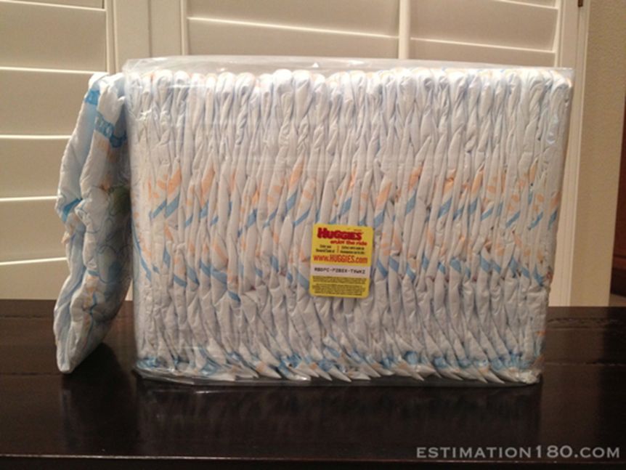
Estimate how many nappies in the package?

Slide 3
Answer

Slide 4
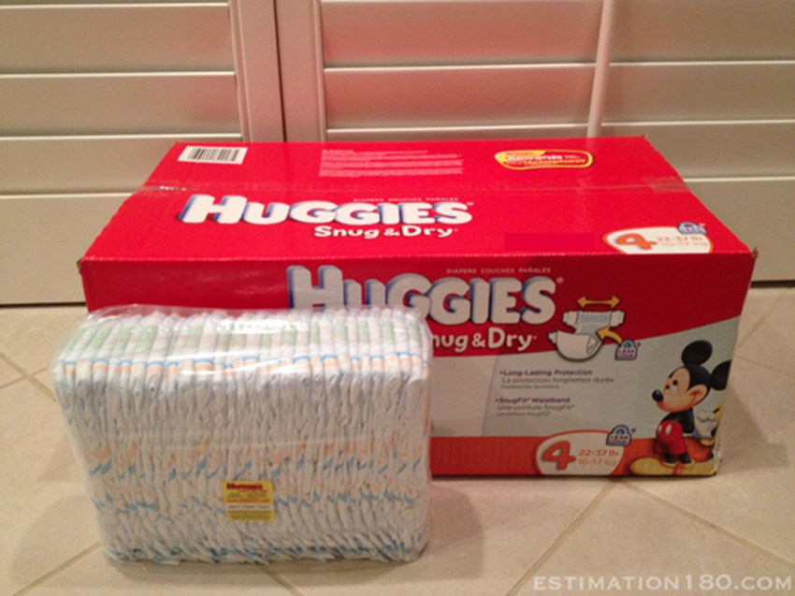
Estimate how many nappies in the box?

Slide 5
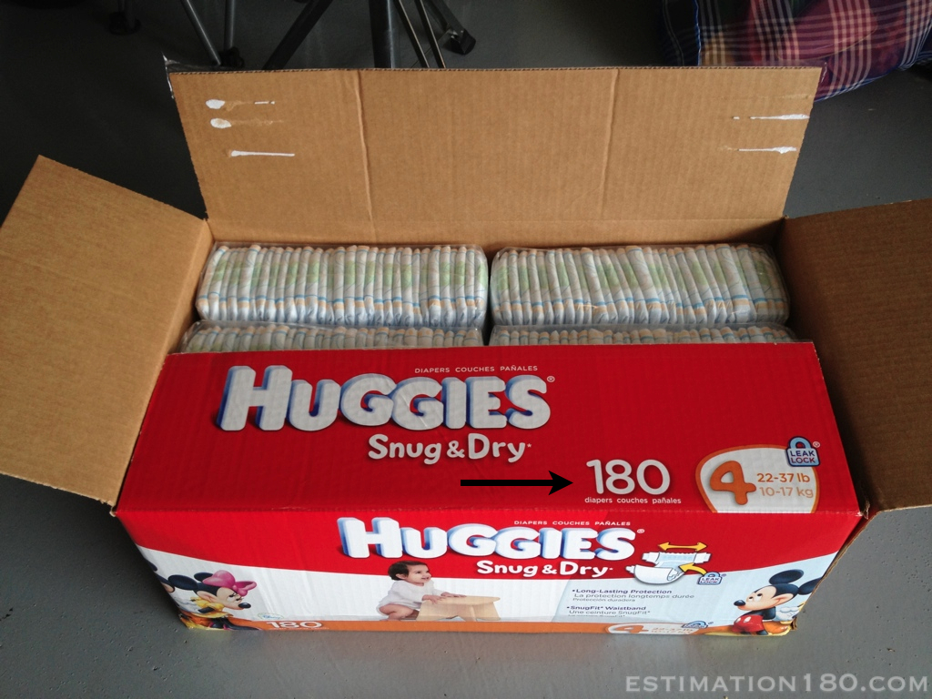

Slide 6
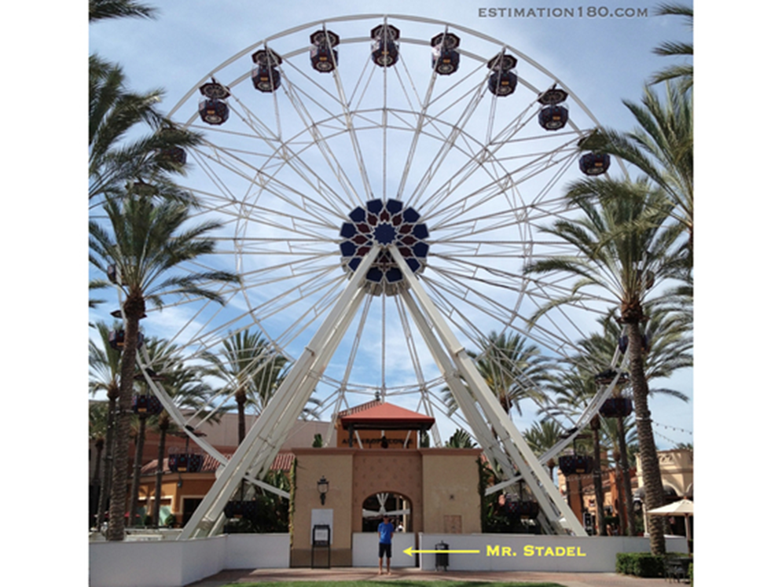
Estimate how high is the giant wheel?

Slide 7
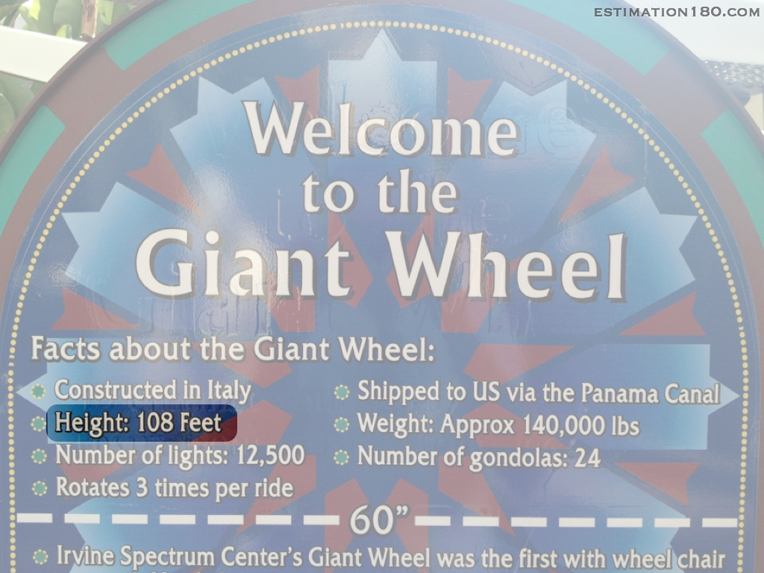

Slide 8
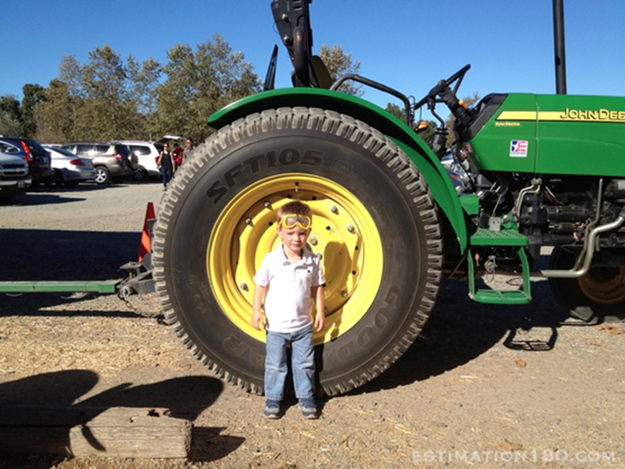
Estimate the height of the tractor tyre

Slide 9


Slide 10
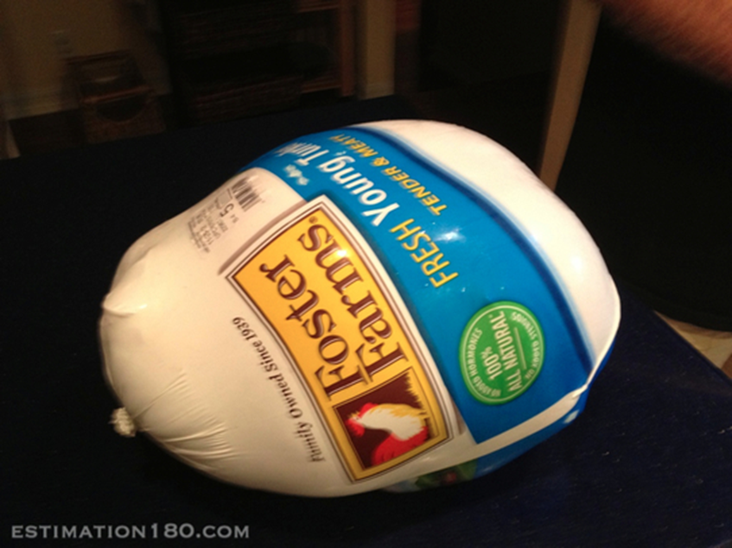
Estimate the weight of the Turkey joint

Slide 11
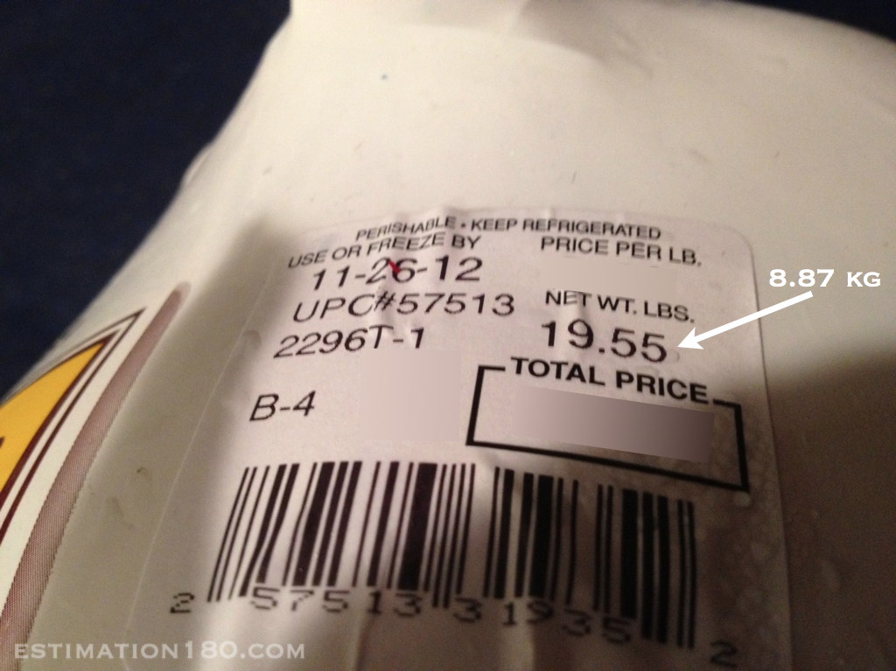

Slide 12
Estimate the cost of the Turkey joint

Slide 13
£12.99

Slide 14
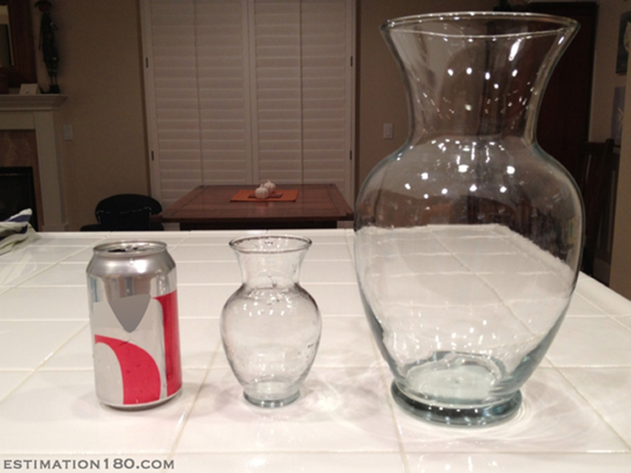
Estimate how many of the smaller vases it takes to
fill the larger vase?

Slide 15
http://Answer

Slide 16
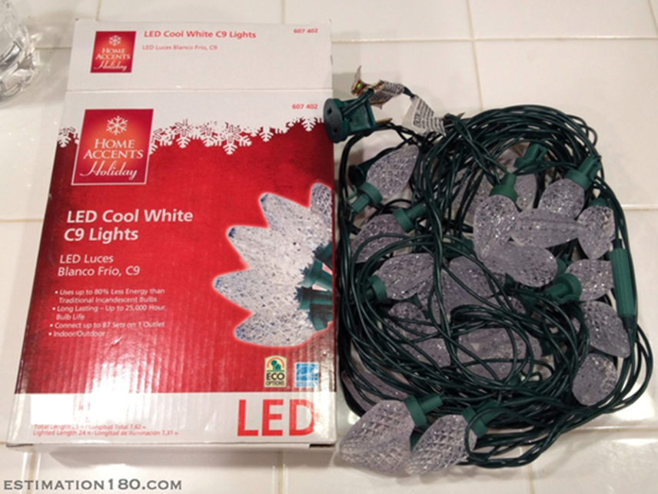
Estimate how many lights come in the box?

Slide 17


Slide 18
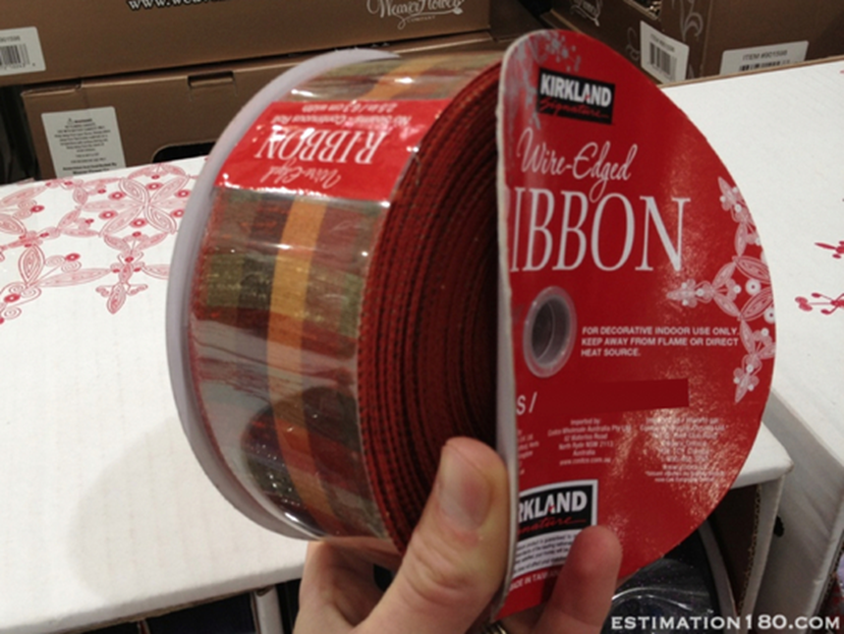
Estimate how long is the roll of ribbon?

Slide 19
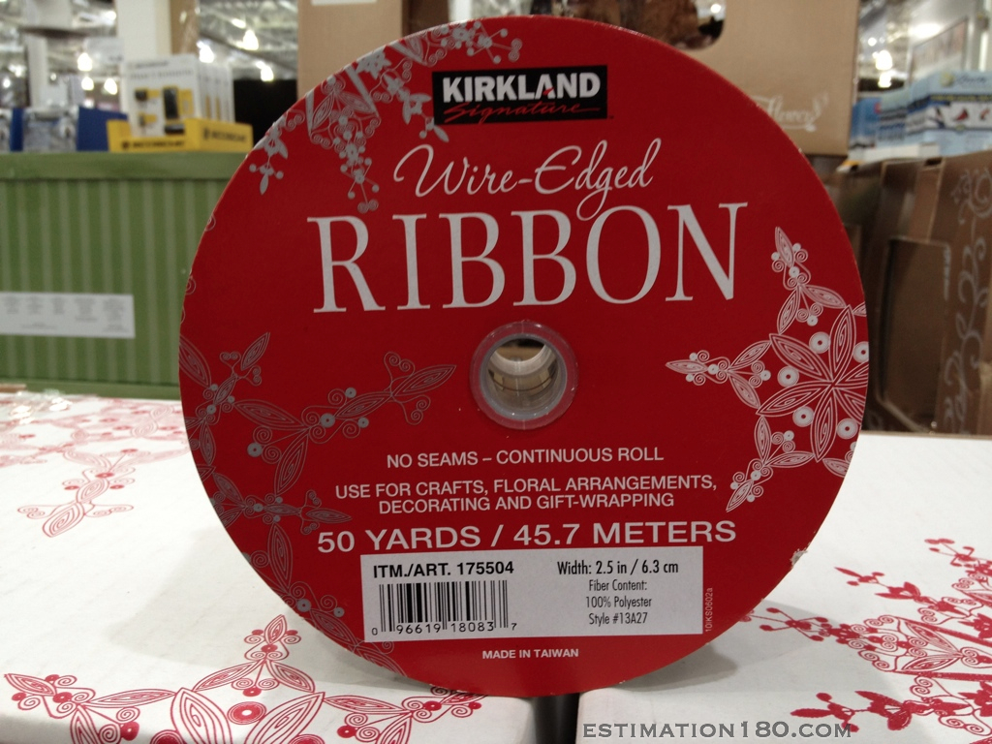

Slide 20
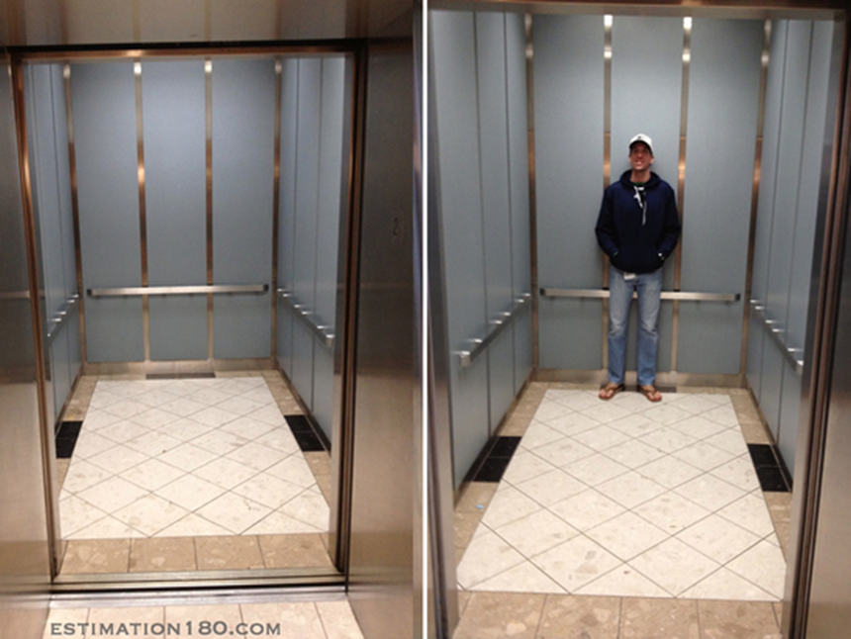
Estimate the weight capacity of the hospital
elevator

Slide 21
