Slide 1
MAC - Estimation
“MAC – Maths Across the Curriculum”

Slide 2
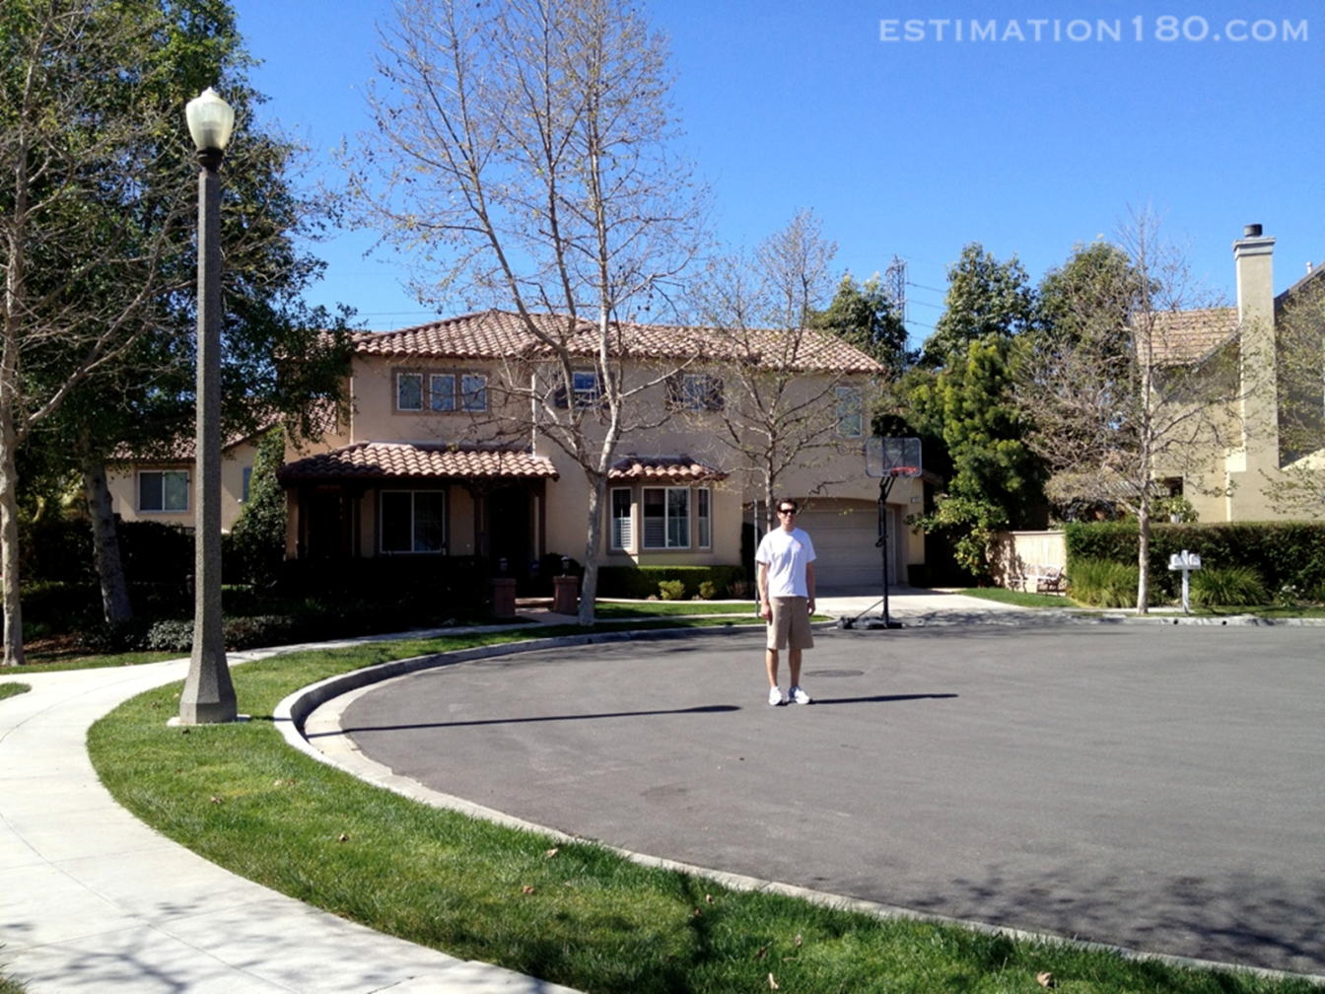
Estimate the height of the lamp post from what you see?

Slide 3
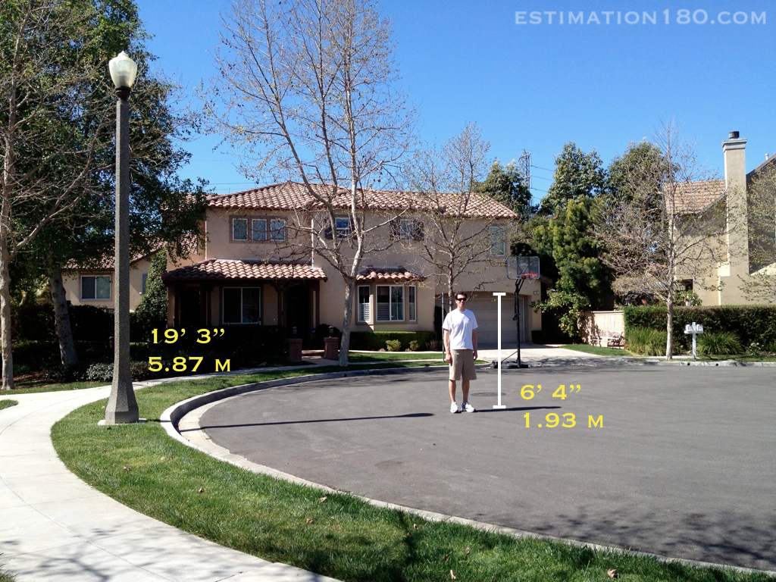

Slide 4
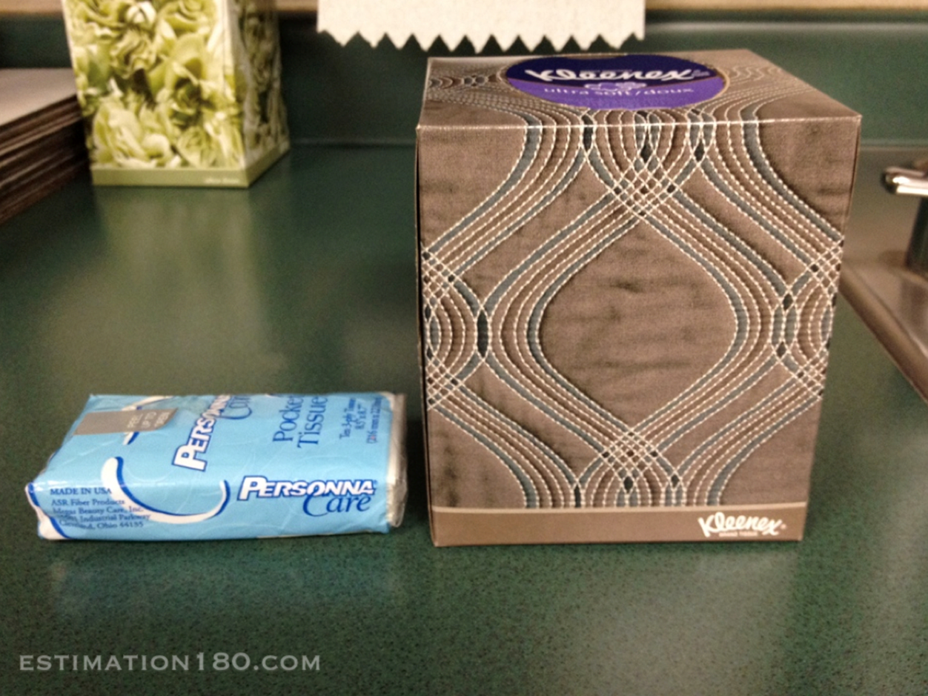
Estimate how many tissues in the packages?

Slide 5
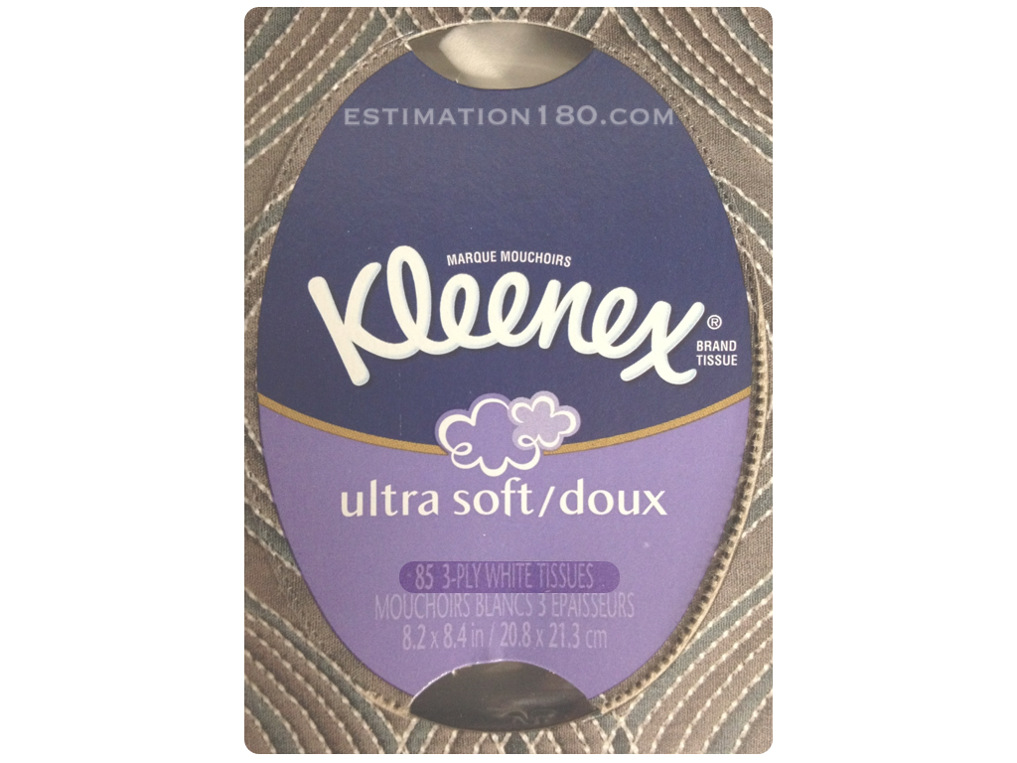
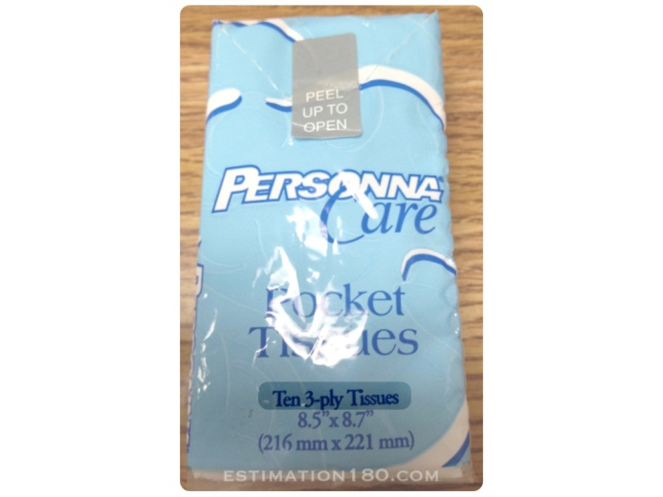

Slide 6
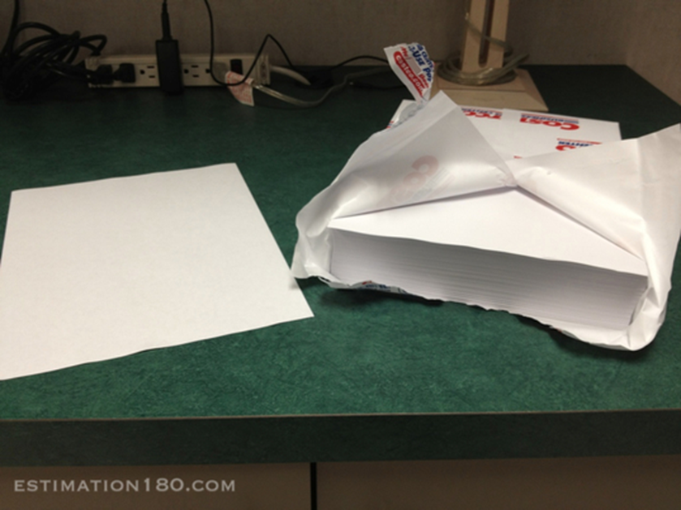
Estimate how many sheets of paper in a ream?

Slide 7
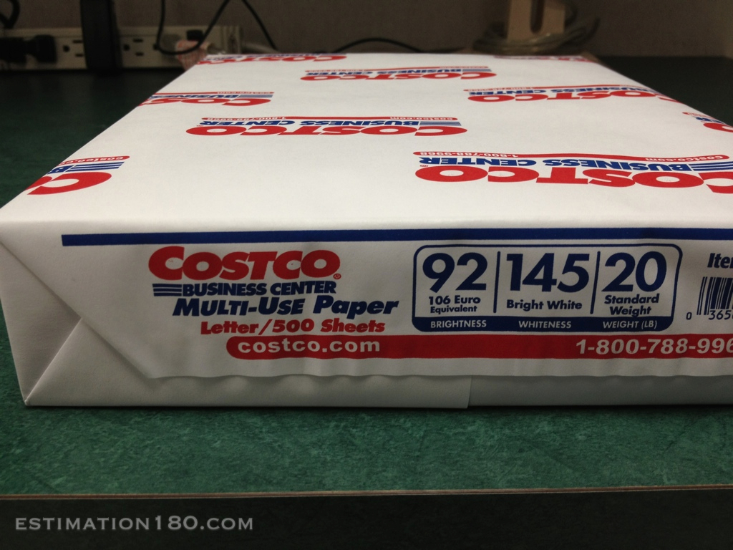

Slide 8
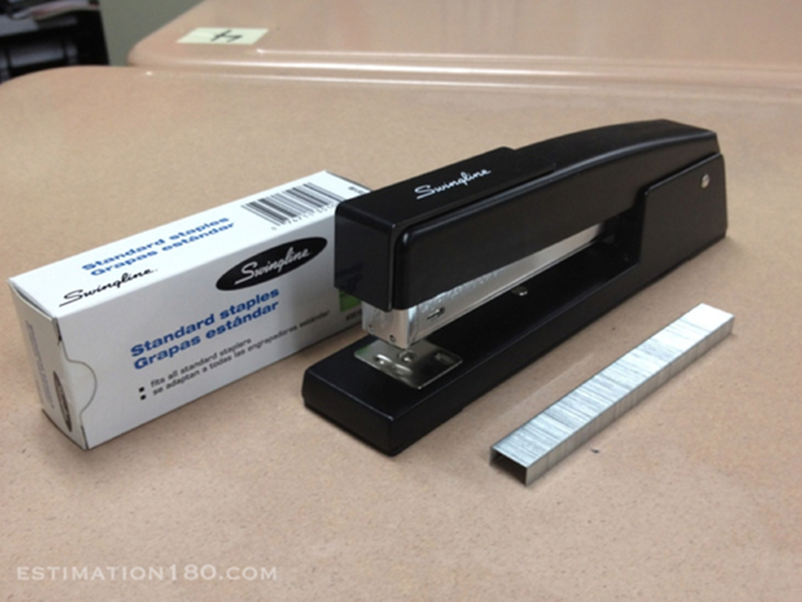
Estimate how many staples in a strip?

Slide 9
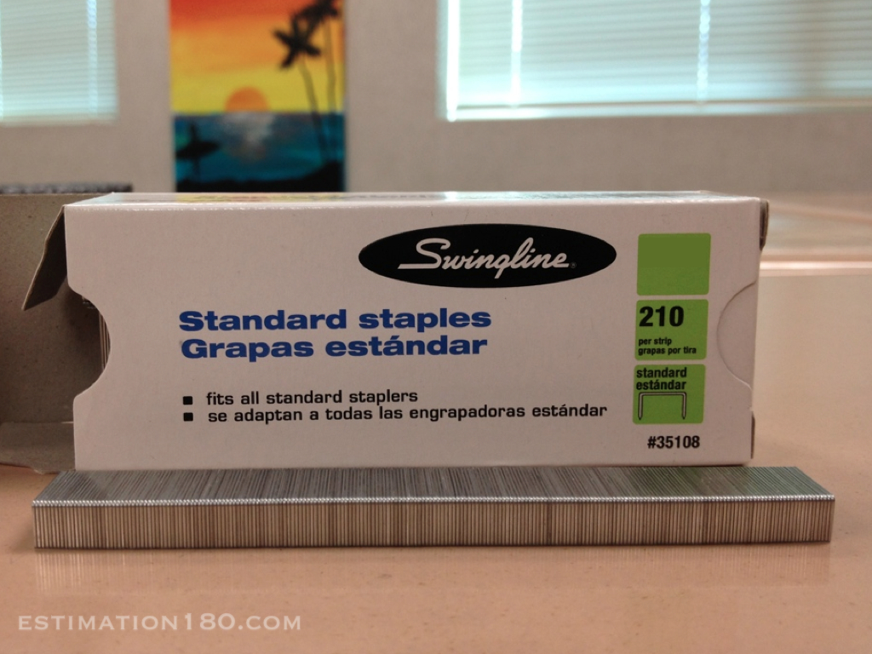

Slide 10
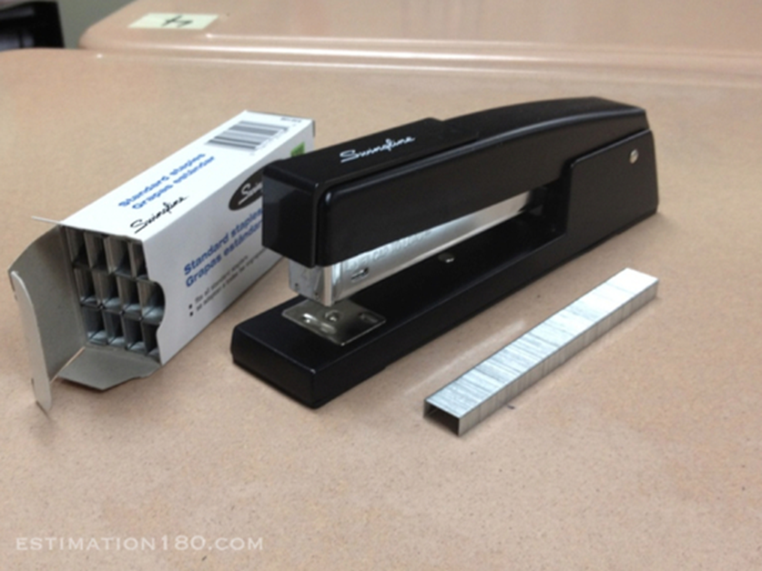
Estimate how many staples come in a box?

Slide 11
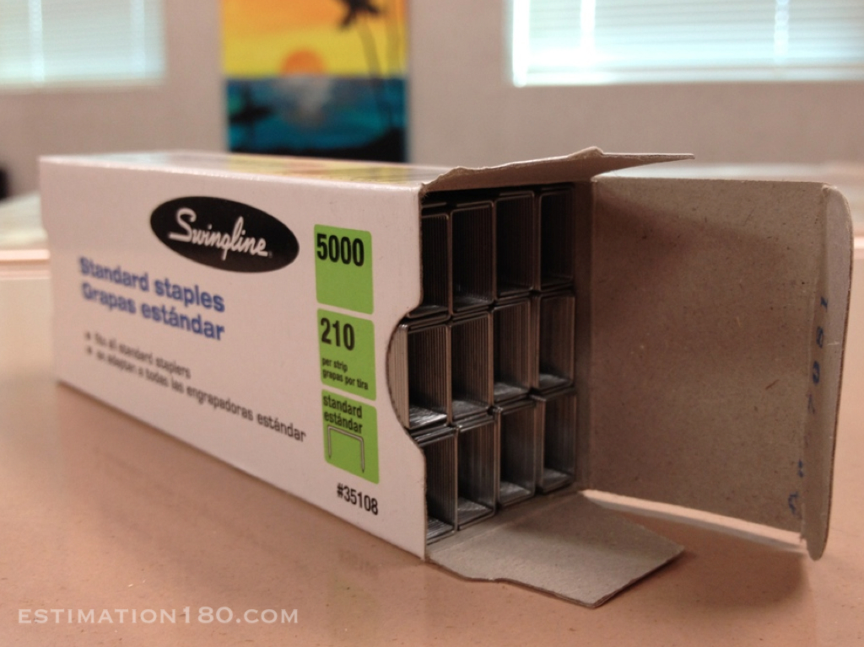

Slide 12
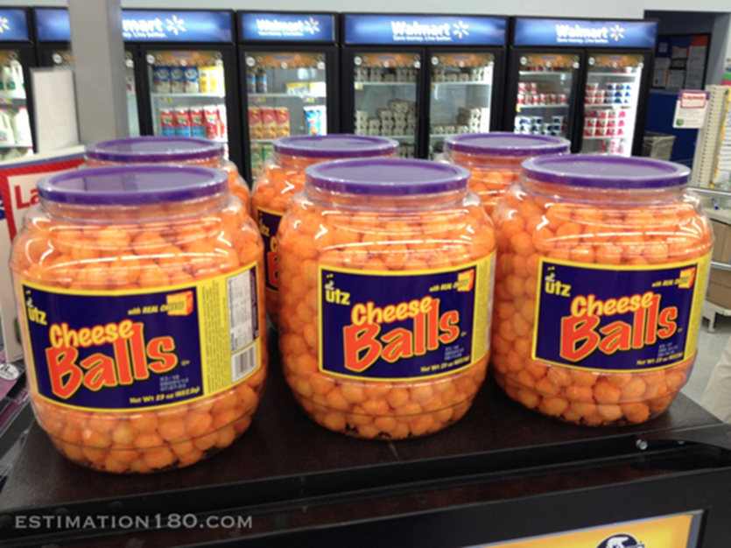
Estimate how many cheese balls in six containers?

Slide 13
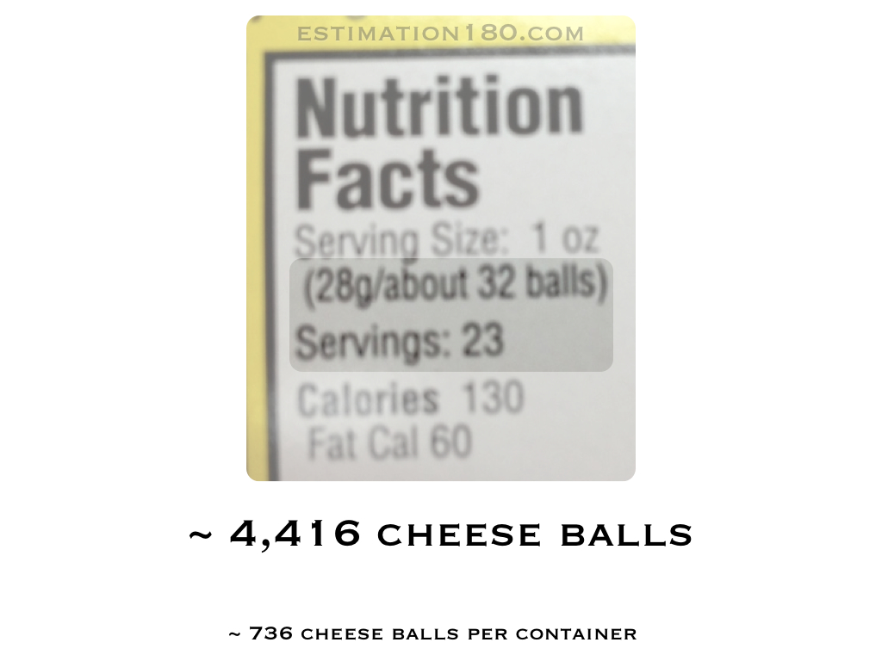

Slide 14
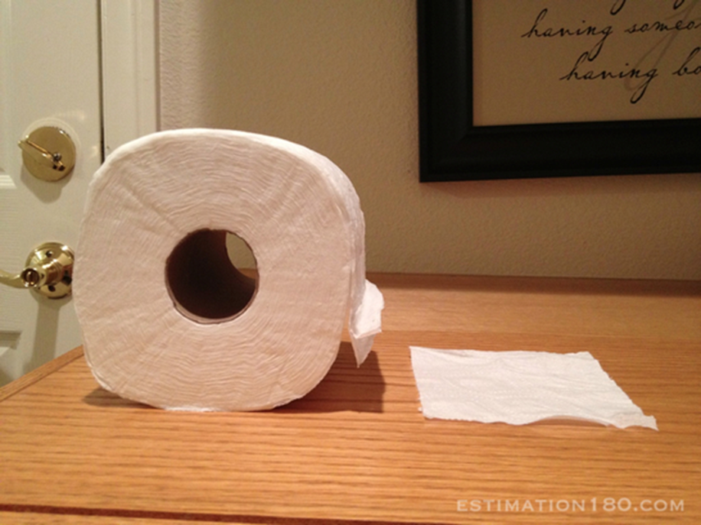
Estimate how many sheets on a roll of toilet paper?

Slide 15
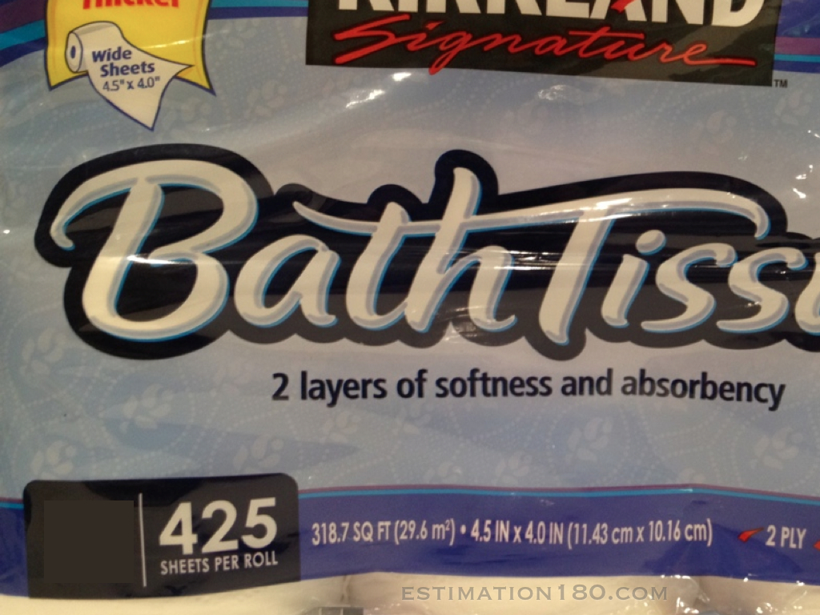

Slide 16
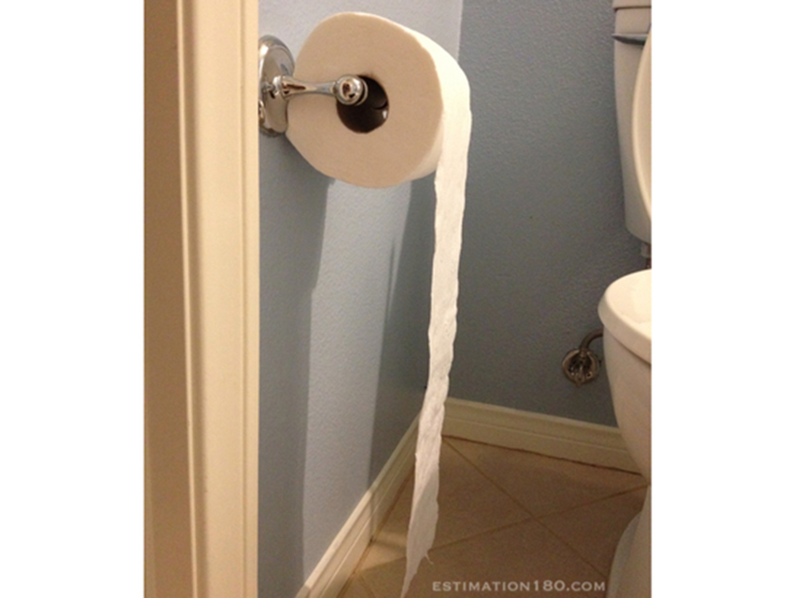
Estimate how long is a complete roll of toilet paper?

Slide 17
