Slide 1

Year 10…
You have been selected based on your exceptional mathematical, scientific, technological and engineering skills.
We have a mission for you to complete.
This mission will consist of 4 main tasks and will require you to work together to solve a series of problems.
You will be judged on both speed and the quality of your work. If you complete a task please bring it to the front to be judged.

Slide 2

Task 1 – Radioactive decay
Task 2 – The escape vehicle
Task 3 – Finding the safe house
Task 4 – The great eggscape
Your time for your first task starts now:

Slide 3

Task 2 – The escape vehicle
You have your radioactive isotope ready to transport, but how will you get away? Time to design your escape vehicle…
Your time for your next task starts now:

Slide 4
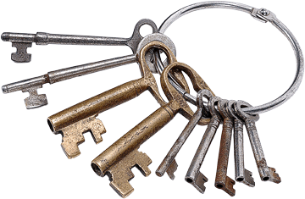
Task 3 – Finding the safe house
Now you have your getaway vehicle, it’s time to find the London safe house. It’s not going to be easy, as some of the agents keep insisting on writing in code.
Crack the final clue to get the combination lock that will release the keys to the safe house.
Your time for your next task starts now:

