Slide 1
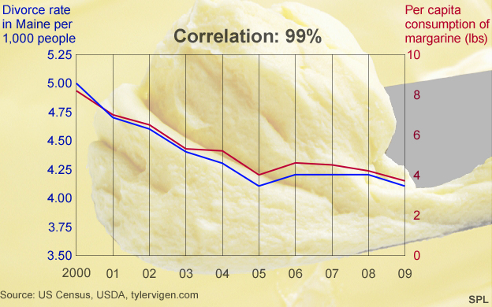
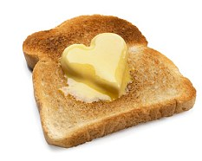

Margarine Consumption Linked to Divorce!
The more margarine you eat the more likely you are to get divorced!
But just because there seems to be a correlation between two variables – doesn’t mean one causes the other.
Correlation means that there is a connection between two variables.
Don’t just believe things because they seem to be backed up by statistics…

Slide 2
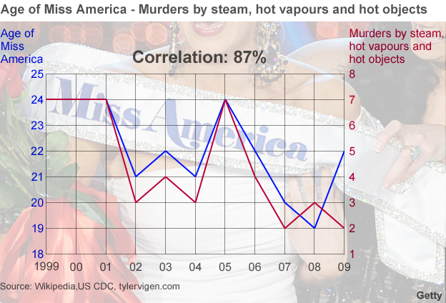
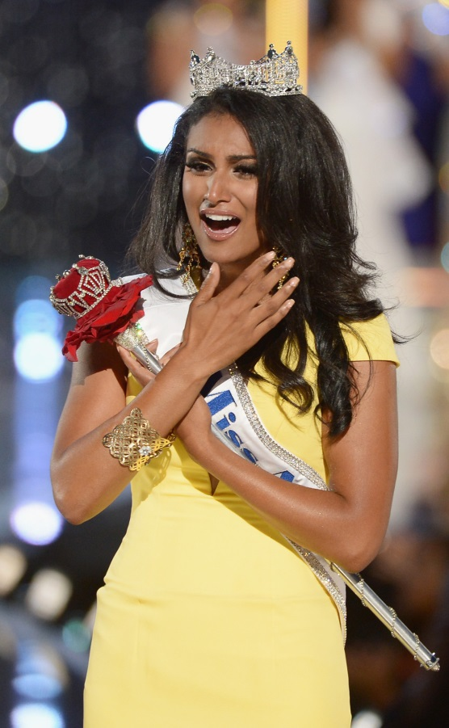

What does this graph appear to show?
Is this likely?
Why?
Why is this graph not enough to show that one variable causes the other?

Slide 3


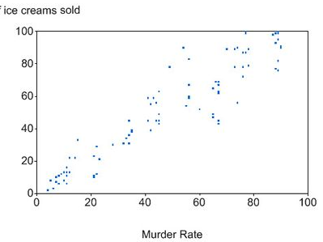
In summer ice cream sales and murder rates rise!
The sale of ice creams and murder rates seem to correlate.
It’s almost certain that one does not cause the other – so what might be responsible for the apparent connection?

Slide 4
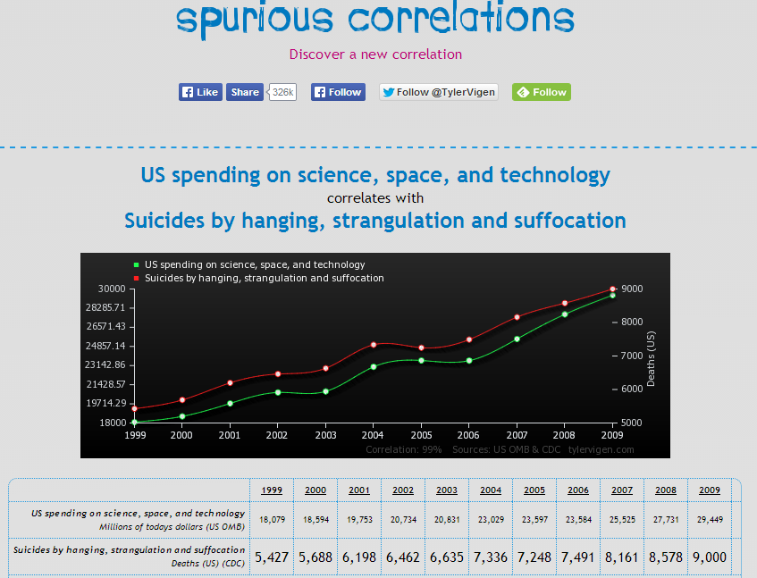
Any idea of what other variables appear to have a correlation?
Check out the website.
http://www.tylervigen.com/

