Slide 1
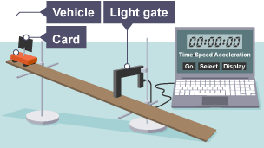


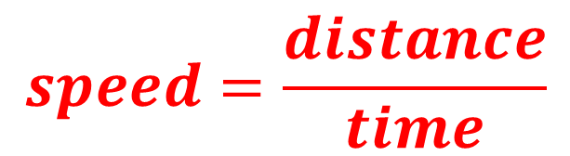

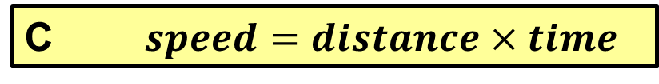
Numeracy in Science – Rearranging equations and formulae
Equations and formulae are used in Physics, Chemistry and Biology. Sometimes you will need to rearrange them to work something out.
To rearrange them, you need to understand what they mean.
The formula for calculating speed is shown on the right. What does it mean?
$$speed=\frac{distance}{time}$$
A $speed=distance−time$
Experiment to measure the speed of an object
B $speed=distance÷time$
C $speed=distance×time$
D $speed=distance+time$

Slide 2
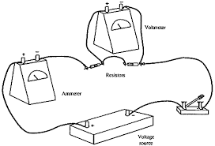




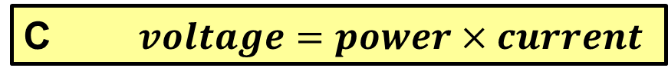
Numeracy in Science – Rearranging equations and formulae
You rearrange an equation when what you want to work out is not the subject. In the equation below, “power” is the subject. If I wanted to work out “voltage” or “current”, I would need to rearrange it.
$$power=voltage×current$$
What calculation do you think you would need to do to work out the voltage? (Remember, dividing is the reverse of multiplying).
A $voltage=current÷power$
B $voltage=power÷current$
C $voltage=power×current$
Experiment to measure the current in an electrical circuit and the voltage across resistors
D $voltage=power+current$

Slide 3




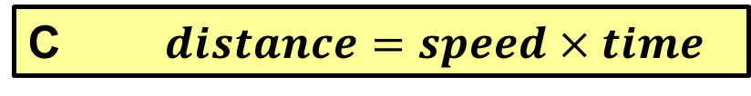
Numeracy in Science – Rearranging equations and formulae
The formula for calculating speed is shown on the right.
It can also be written as:
Speed = distance ÷ time
How could this be rearranged to calculate distance?
$$speed=\frac{distance}{time}$$
A $distance=speed−time$
Experiment to measure the speed of an object
B $distance=time÷speed$
C $distance=speed×time$
D $distance=speed÷time$

Slide 4
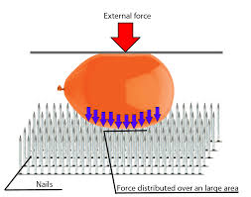
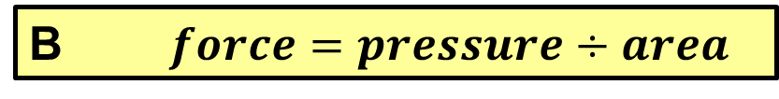



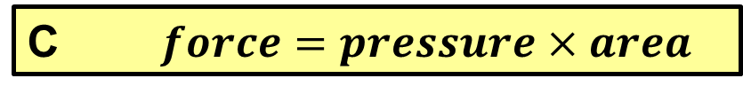
Numeracy in Science – Rearranging equations and formulae
The formula for calculating the pressure on a surface is shown on the right.
It can also be written as:
pressure = force ÷ area
How could this be rearranged to calculate force?
$$pressure=\frac{force}{area}$$
A $force=area÷pressure$
B $force=pressure÷area$
C $force=pressure×area$
Experiment to examine the effect of applying a force over different areas
D $force=area+pressure$

Slide 5
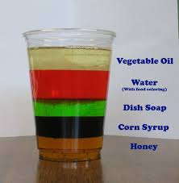


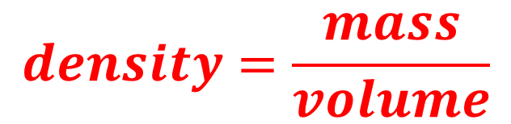

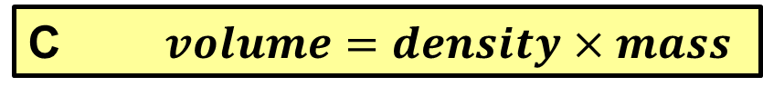
Numeracy in Science – Rearranging equations and formulae
The formula for calculating density is shown on the right.
It can also be written as:
density = mass ÷ volume
How could this be rearranged to calculate volume?
$$density=\frac{mass}{volume}$$
A $volume=mass÷density$
B $volume=density÷mass$
C $volume=density×mass$
D $volume=mass+density$
Experiment to compare the densities of different liquids

Slide 6
Numeracy in Science – Rearranging equations and formulae
Equations and formulae are used in Physics, Chemistry and Biology. Sometimes you will need to rearrange them to work something out.
To rearrange them, you need to understand what they mean.
The formula for calculating speed is shown on the right. What does it mean?
$$speed=\frac{distance}{time}$$
A $speed=distance−time$
Experiment to measure the speed of an object
B $speed=distance÷time$
ANSWER
C $speed=distance×time$
D $speed=distance+time$

Slide 7
Numeracy in Science – Rearranging equations and formulae
You rearrange an equation when what you want to work out is not the subject. In the equation below, “power” is the subject. If I wanted to work out “voltage” or “current”, I would need to rearrange it.
$$power=voltage×current$$
What calculation do you think you would need to do to work out the voltage? (Remember, dividing is the reverse of multiplying).
ANSWER
A $voltage=current÷power$
B $voltage=power÷current$
C $voltage=power×current$
Experiment to measure the current in an electrical circuit and the voltage across resistors
D $voltage=power+current$

Slide 8
Numeracy in Science – Rearranging equations and formulae
The formula for calculating speed is shown on the right.
It can also be written as:
Speed = distance ÷ time
How could this be rearranged to calculate distance?
$$speed=\frac{distance}{time}$$
A $distance=speed−time$
Experiment to measure the speed of an object
B $distance=time÷speed$
ANSWER
C $distance=speed×time$
D $distance=speed÷time$

Slide 9
Numeracy in Science – Rearranging equations and formulae
The formula for calculating the pressure on a surface is shown on the right.
It can also be written as:
pressure = force ÷ area
How could this be rearranged to calculate force?
$$pressure=\frac{force}{area}$$
A $force=area÷pressure$
B $force=pressure÷area$
C $force=pressure×area$
Experiment to examine the effect of applying a force over different areas
D $force=area+pressure$
ANSWER

Slide 10
Numeracy in Science – Rearranging equations and formulae
The formula for calculating density is shown on the right.
It can also be written as:
density = mass ÷ volume
How could this be rearranged to calculate volume?
$$density=\frac{mass}{volume}$$
ANSWER
A $volume=mass÷density$
B $volume=density÷mass$
C $volume=density×mass$
D $volume=mass+density$
Experiment to compare the densities of different liquids

