Slide 1

Numeracy in Science – Percentages
Percentages are used in Physics, Chemistry and Biology to compare amounts and describe change.
Percent means parts out of 100. If you scored ½ marks on an exam, what percentage would this be?
A 20%
B 50%
C 0.2%
D 100%

Slide 2
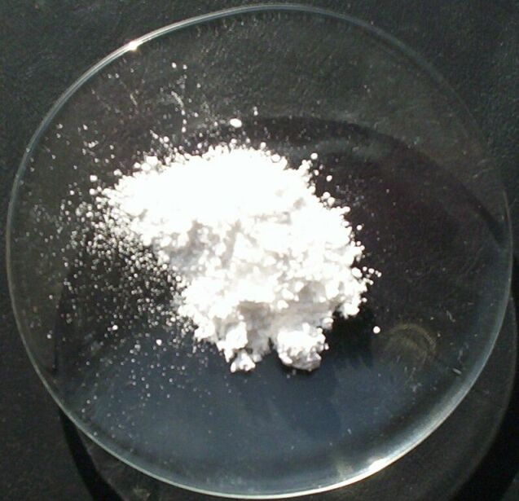


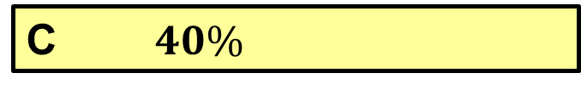
Numeracy in Science – Percentages
In Chemistry you learn about how compounds are made up of different elements. The percentage composition tells you what percentage, by weight, each element is of the total weight.
Percentages must add up to 100%. If the percentage by mass of oxygen in Magnesium oxide is 40%, what is the percentage of Magnesium?
A $60\%$
B $100\%$
C $40\%$
D 20%

Slide 3
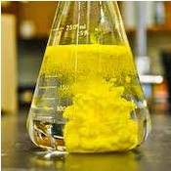




Numeracy in Science – Percentages
In Chemistry you may be asked to work out the “percentage yield” from an experiment. To do this you need to work out what percentage one amount is of another.
Which of these calculations does NOT tell you how to work out what percentage 15 is out of 20?
A $\frac{15}{20}×100$
B $15÷20×100$
C $100÷20×15$
D $100÷15×20$

Slide 4
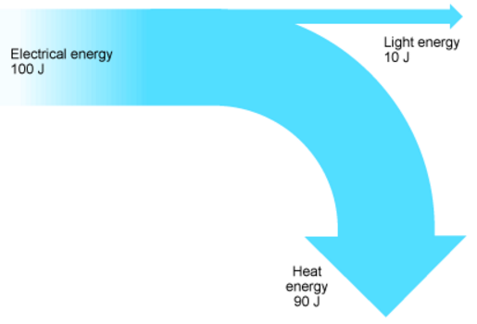





Numeracy in Science – Percentages
In Physics you could be asked to calculate the efficiency of a device as a percentage.
The efficiency is how much useful energy you get out as a percentage of how much energy you put in.
Look at the diagram for a lamp.
Which calculation would let you calculate the efficiency?
Electrical energy 100 J
Light energy
10 J
Heat energy
90 J
A $\frac{100}{90}×100$
B $\frac{90}{100}×100$
C $\frac{10}{100}×100$
D $\frac{10}{90}×100$

Slide 5
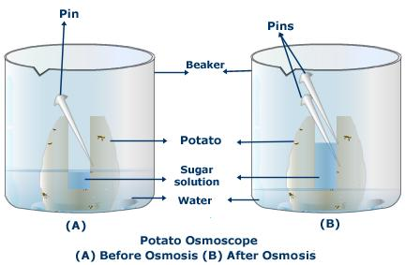




Numeracy in Science – Percentages
Osmosis is the diffusion (movement) of water molecules.
In an experiment to observe osmosis, a piece of potato has a mass of 2.5 g at the start and 2.0 g at the end.
How could you calculate the percentage change in mass of the potato?
A $\frac{2.0}{2.5}×100$
B $\frac{2.5}{2.0}×100$
C $\frac{0.5}{2.0}×100$
D $\frac{0.5}{2.5}×100$

Slide 6
Numeracy in Science – Percentages - ANSWERS
Percentages are used in Physics, Chemistry and Biology to compare amounts and describe change.
Percent means parts out of 100. If you scored ½ marks on an exam, what percentage would this be?
A 20%
B 50%
C 0.2%
D 100%

Slide 7
Numeracy in Science – Percentages - ANSWERS
In Chemistry you learn about how compounds are made up of different elements. The percentage composition tells you what percentage, by weight, each element is of the total weight.
Percentages must add up to 100%. If the percentage by mass of oxygen in Magnesium oxide is 40%, what is the percentage of Magnesium?
A $60\%$
B $100\%$
C $40\%$
D 20%

Slide 8
Numeracy in Science – Percentages - ANSWERS
In Chemistry you may be asked to work out the “percentage yield” from an experiment. To do this you need to work out what percentage one amount is of another.
Which of these calculations does NOT tell you how to work out what percentage 15 is out of 20?
A $\frac{15}{20}×100$
B $15÷20×100$
C $100÷20×15$
D $100÷15×20$

Slide 9

Numeracy in Science – Percentages - ANSWERS
In Physics you could be asked to calculate the efficiency of a device as a percentage.
The efficiency is how much useful energy you get out as a percentage of how much energy you put in.
Look at the diagram for a lamp.
Which calculation would let you calculate the efficiency?
Electrical energy 100 J
Light energy
10 J
Energy in
Useful energy out
Heat energy
90 J
A $\frac{100}{90}×100$
B $\frac{90}{100}×100$
C $\frac{10}{100}×100$
D $\frac{10}{90}×100$

Slide 10

Numeracy in Science – Percentages - ANSWERS
Osmosis is the diffusion (movement) of water molecules.
In an experiment to observe osmosis, a piece of potato has a mass of 2.5 g at the start and 2.0 g at the end.
How could you calculate the percentage change in mass of the potato?
Change in mass = 2.5 – 2.0
= 0.5 g
A $\frac{2.0}{2.5}×100$
B $\frac{2.5}{2.0}×100$
C $\frac{0.5}{2.0}×100$
D $\frac{0.5}{2.5}×100$

