Slide 1
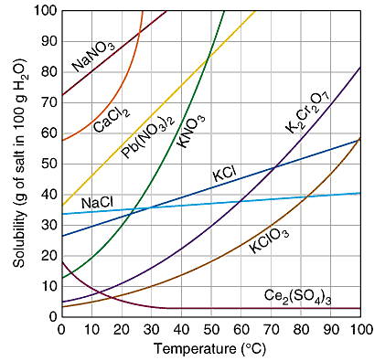
Numeracy in Science – Interpreting data
This graph shows how solubility in water changes as the temperature increases for different compounds.
For most compounds, as the temperature increases, solubility….
A …decreases (goes down).
An important skill in science is being able to interpret data (understand information) from charts and graphs.
B …stays the same.
C …increases (goes up).
D …drops suddenly.

Slide 2
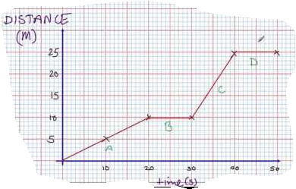
Numeracy in Science – Interpreting data
This graph shows how the distance of an object from a point changes over time.
For the horizontal (flat) sections B and D, what is happening to the distance of the object from the point?
A It’s decreasing (going down)
An important skill in science is being able to interpret data (understand information) from charts and graphs.
B It’s constant (staying the same)
C It’s increasing (going up)
D It’s making the velocity increase

Slide 3
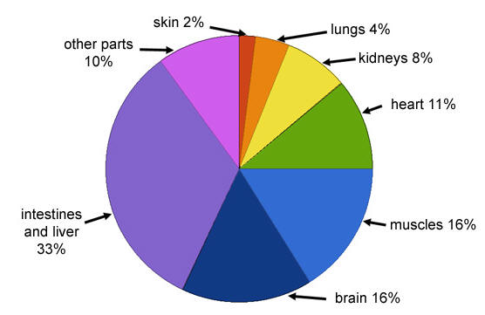
Numeracy in Science – Interpreting data
This pie chart shows the percentage of heat produced by different parts of our bodies.
Which part(s) of our body produces the least heat?
A Intestines and liver
An important skill in science is being able to interpret data (understand information) from charts and graphs.
B Muscles
C Skin
D Lungs

Slide 4
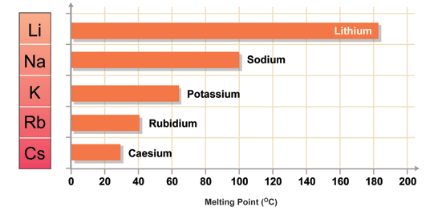
Numeracy in Science – Interpreting data
This bar chart shows the melting points of different elements.
What is an estimate of the difference between the melting points of Sodium and Lithium?
A 40ºC
An important skill in science is being able to interpret data (understand information) from charts and graphs.
B 80ºC
C 100ºC
D 180ºC

Slide 5
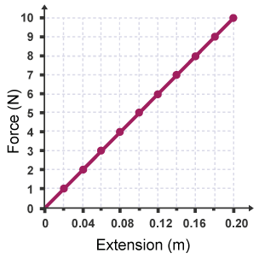
Numeracy in Science – Interpreting data
This line graph shows how the extension of a spring varies with the force applied to it.
If a force of 9 Newtons is applied, what extension is observed?
A 0.16 m
An important skill in science is being able to interpret data (understand information) from charts and graphs.
B 0.17 m
C 0.18 m
D 0.19 m

Slide 6
Numeracy in Science – Interpreting data - ANSWERS
This graph shows how solubility in water changes as the temperature increases for different compounds.
For most compounds, as the temperature increases, solubility….
A …decreases (goes down).
An important skill in science is being able to interpret data (understand information) from charts and graphs.
B …stays the same.
C …increases (goes up).
D …drops suddenly.

Slide 7
Numeracy in Science – Interpreting data - ANSWERS
This graph shows how the distance of an object from a point changes over time.
For the horizontal (flat) sections B and D, what is happening to the distance of the object from the point?
A It’s decreasing (going down)
An important skill in science is being able to interpret data (understand information) from charts and graphs.
B It’s constant (staying the same)
C It’s increasing (going up)
D It’s making the velocity increase

Slide 8
Numeracy in Science – Interpreting data - ANSWERS
This pie chart shows the percentage of heat produced by different parts of our bodies.
Which part(s) of our body produces the least heat?
A Intestines and liver
An important skill in science is being able to interpret data (understand information) from charts and graphs.
B Muscles
C Skin
D Lungs

Slide 9
Numeracy in Science – Interpreting data - ANSWERS
This bar chart shows the melting points of different elements.
What is an estimate of the difference between the melting points of Sodium and Lithium?
A 40ºC
An important skill in science is being able to interpret data (understand information) from charts and graphs.
B 80ºC
C 100ºC
D 180ºC

Slide 10
Numeracy in Science – Interpreting data - ANSWERS
This line graph shows how the extension of a spring varies with the force applied to it.
If a force of 9 Newtons is applied, what extension is observed?
A 0.16 m
An important skill in science is being able to interpret data (understand information) from charts and graphs.
B 0.17 m
C 0.18 m
D 0.19 m

