Slide 1
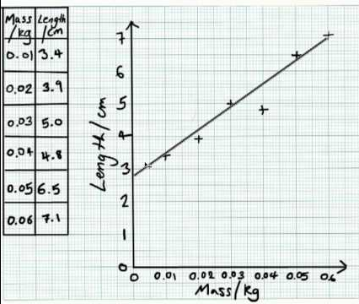
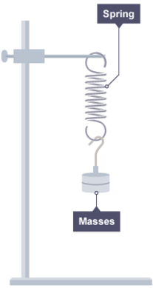
Numeracy in Science – Lines of best fit
Scatter graphs can be plotted to show the relationship between different things.
This is a scatter graph showing how the length of spring varies with the mass hung from it.
Which of the following sentences describes the relationship between the mass and length?
A As the mass increases, the length decreases
C As the mass decreases, the length increases
B As the mass increases, the length increases
D As the mass increases, the length doubles

Slide 2
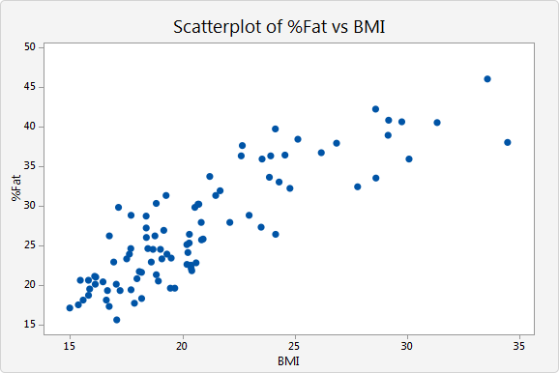
Numeracy in Science – Lines of best fit
Scatter graphs can be plotted to show the relationship between different things.
A line of best fit is used to show the general trend.
Which of these is NOT true about a line of best fit?
A It should have roughly as many points above it as below it
B It should always go through (0, 0)
C It should go through as many of the points as possible
D It should be either a straight line or a smooth curve

Slide 3
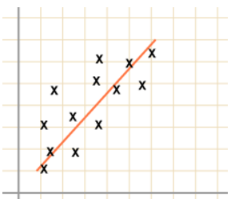
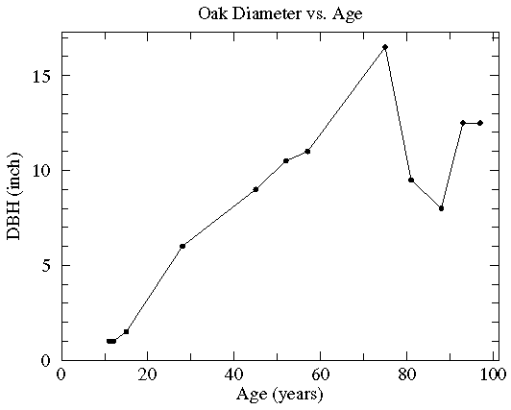
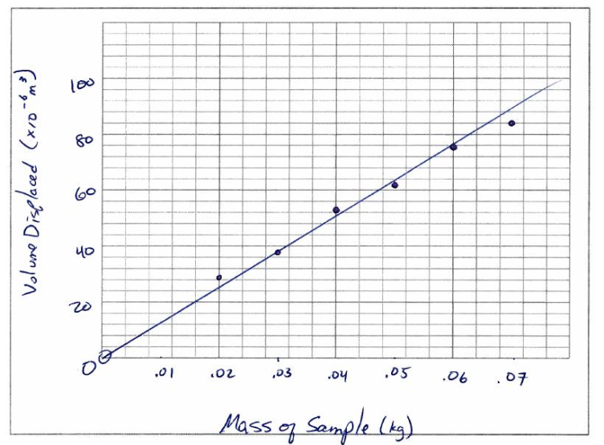
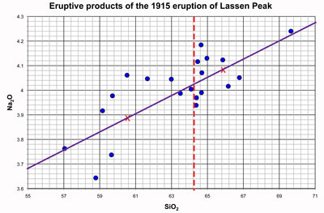
Numeracy in Science – Lines of best fit
A line of best fit is used to show the general trend.
Which of these is NOT a good line of best fit?
A
B
C
D

Slide 4
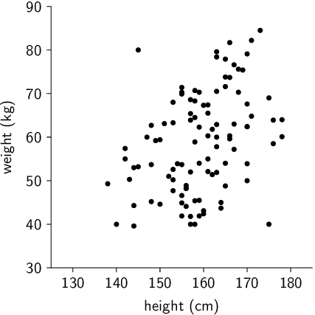
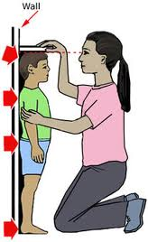
Numeracy in Science – Lines of best fit
Sometimes you will have points on your scatter graph that look out of place – they don’t seem to fit into the general pattern.
These are called outliers.
Which of these points is an outlier?
A
B
D
C

Slide 5
Numeracy in Science – Lines of best fit
This scatter graph has one or more outliers.
Which of these would be the most accurate line of best fit?
D
A
B
C

Slide 6
Numeracy in Science – Lines of best fit - ANSWERS
Scatter graphs can be plotted to show the relationship between different things.
This is a scatter graph showing how the length of spring varies with the mass hung from it.
Which of the following sentences describes the relationship between the mass and length?
A As the mass increases, the length decreases
C As the mass decreases, the length increases
B As the mass increases, the length increases
D As the mass increases, the length doubles

Slide 7
Numeracy in Science – Lines of best fit - ANSWERS
Scatter graphs can be plotted to show the relationship between different things.
A line of best fit is used to show the general trend.
Which of these is NOT true about a line of best fit?
A It should have roughly as many points above it as below it
B It should always go through (0, 0)
C It should go through as many of the points as possible
D It should be either a straight line or a smooth curve

Slide 8
Numeracy in Science – Lines of best fit - ANSWERS
A line of best fit is used to show the general trend.
Which of these is NOT a good line of best fit?
A
B
C
D

Slide 9
Numeracy in Science – Lines of best fit - ANSWERS
Sometimes you will have points on your scatter graph that look out of place – they don’t seem to fit into the general pattern.
These are called outliers.
Which of these points is an outlier?
A
B
D
C

Slide 10
Numeracy in Science – Lines of best fit - ANSWERS
This scatter graph has one or more outliers.
Which of these would be the most accurate line of best fit?
D
A
B
C

