Slide 1
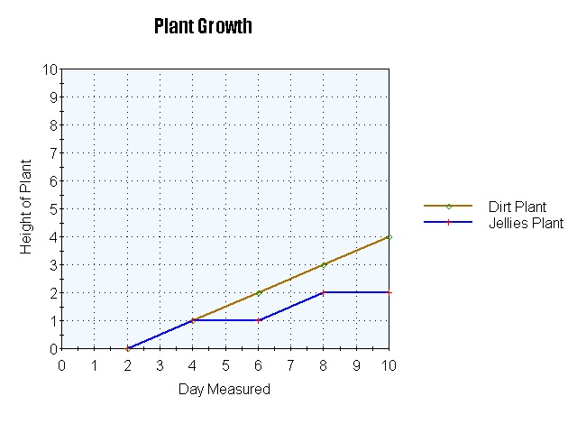

Numeracy in Science – Scales on axes
In science you often need to draw graphs. Graphs are drawn on a set of axes. Each axes has a scale on it.
It is important that you can read scales accurately.
Look at the graph.
How high was the dirt plant on Day 9?
(cm)
A 3 cm
B 3.5 cm
C 3.1 cm
D 4 cm

Slide 2
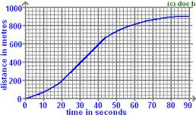

Numeracy in Science – Scales on axes
This is a distance time graph for a car journey.
How far had the car travelled after 40 seconds?
A 200 m
B 400 m
C 600 m
D 800 m

Slide 3
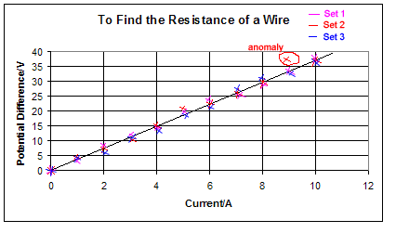
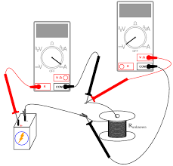
Numeracy in Science – Scales on axes
This graph shows how the potential difference across a wire varied with current.
Which of these is the best estimate for the potential difference when the current is 6 Amps?
A 20 Volts
B 25 Volts
C 23 Volts
D 21 Volts

Slide 4
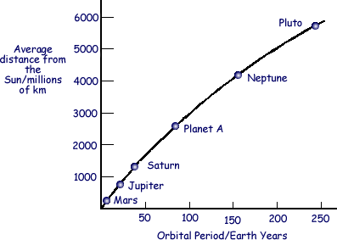
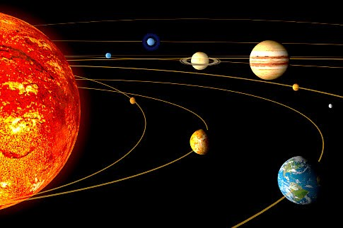
Numeracy in Science – Scales on axes
This graph shows how the distance from the sun varies with the orbital period of a planet.
Which planet is located approximately 4200 million kilometres from the Sun?
A Mars
B Neptune
C Pluto
D Jupiter

Slide 5
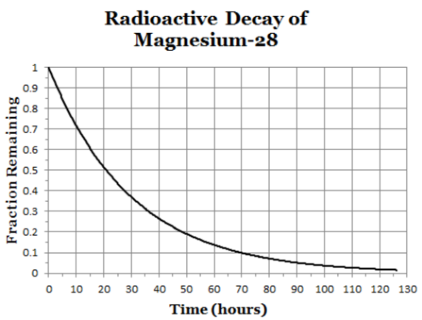
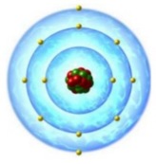
Numeracy in Science – Scales on axes
This graph shows the radioactive decay of Magnesium-28.
How many hours does it take for the amount of radioactive material to halve?
(This is known as the half-life)
A 50 hours
B 65 hours
C 0.5 hours
D 20 hours

Slide 6
Numeracy in Science – Scales on axes - ANSWERS
In science you often need to draw graphs. Graphs are drawn on a set of axes. Each axes has a scale on it.
It is important that you can read scales accurately.
Look at the graph.
How high was the dirt plant on Day 9?
(cm)
A 3 cm
B 3.5 cm
C 3.1 cm
D 4 cm

Slide 7
Numeracy in Science – Scales on axes - ANSWERS
This is a distance time graph for a car journey.
How far had the car travelled after 40 seconds?
A 200 m
B 400 m
C 600 m
D 800 m

Slide 8
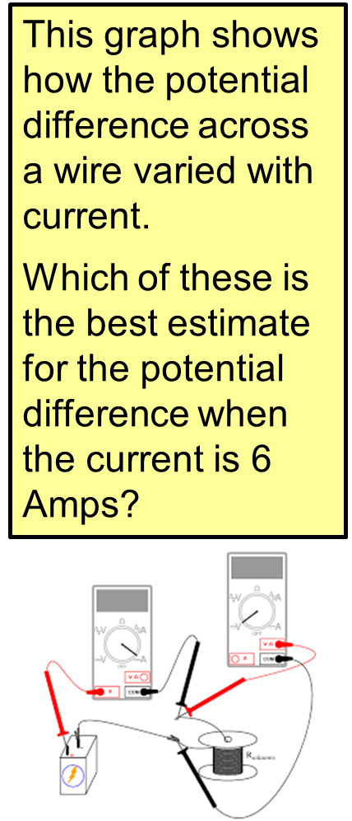
Numeracy in Science – Scales on axes - ANSWERS
A 20 Volts
B 25 Volts
C 23 Volts
D 21 Volts

Slide 9
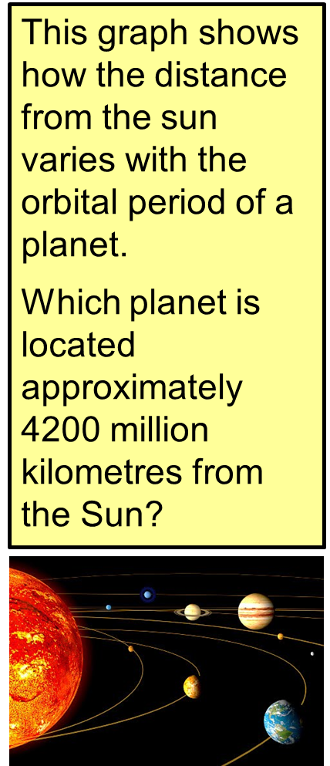
Numeracy in Science – Scales on axes - ANSWERS
A Mars
B Neptune
C Pluto
D Jupiter

Slide 10

Numeracy in Science – Scales on axes - ANSWERS
This graph shows the radioactive decay of Magnesium-28.
How many hours does it take for the amount of radioactive material to halve?
(This is known as the half-life)
A 50 hours
B 65 hours
C 0.5 hours
D 20 hours

