Slide 1
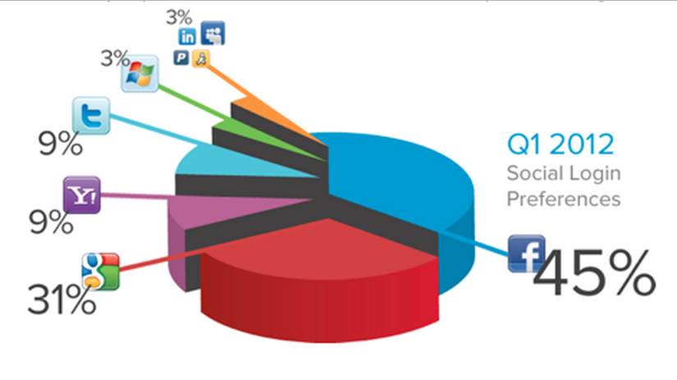
What are the advantages and disadvantages of using pie charts to display data?
You are now going to create your own pie chart(s) to show information about your day.
Remember to check how many sectors each chart is divided into – think about what each sector is worth.
Main advantages
Visually simple.
Can be used for large amounts of data.
Main disdvantage
Hard to work out exact values.

Slide 2
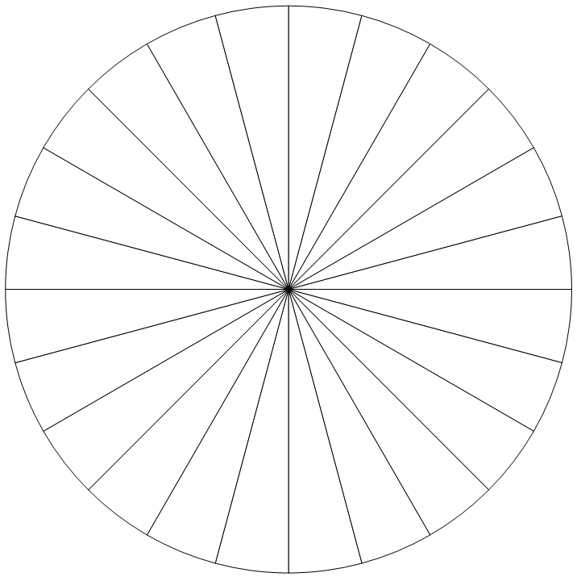
My day
Key
There are _____sectors so each sector is worth ________________

Slide 3
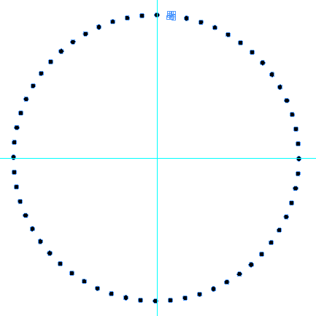
My ______ lesson
Key
There are _____sectors so each sector is worth ________________

Slide 4
My form time
Key
There are _____sectors so each sector is worth ________________

Slide 5
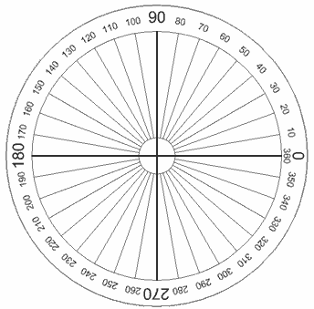
A full turn is 360º.
If you want 15 sectors,
Degrees per sector = 360 ÷ 15 = 24º.
Key

