Slide 1
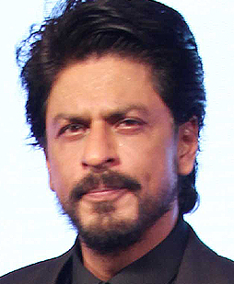
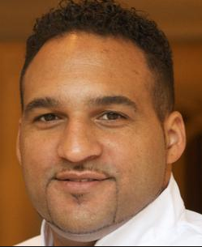
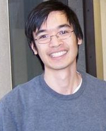
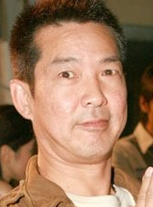
Famous Mathematicians
This half-term the numeracy activities will test what you know about some famous mathematicians.
Week 5’s mathematician is known as the most famous living mathematician.
But which one of these people is he?
A
Shah Rukh Khan
B Michael Caines
C
Terence Tao
D
Yuen Biao

Slide 2
Question 2
Where is Terence Tao from?
A) The Phillipines
Australia
Pakistan
Malaysia

Slide 3
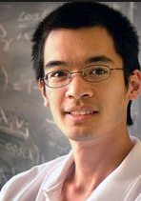
Question 3
Terence Tao carried out research with Ben Green a British mathematician. What does their “Green-Tao theorem” examine?
A) Sequences of cube numbers
Sequences of triangle numbers
Sequences of square numbers
Sequences of prime numbers

Slide 4
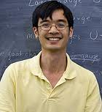
Question 4
In 2012 Tao proved that every odd integer greater than 1 is the sum of at most five primes.
Which of these is an example of this theory?
16 = 1 + 2 + 3 + 5 + 5
15 = 2 + 3 + 4 + 6
17 = 2 + 3 + 5 + 7
3.5 = 1.5 + 2

Slide 5
Answers
C – Terence Tao. Did you recognise any of the others?
Shah Rukh Khan
Bollywood superstar
Michael Caines
2-star British Mitchellin chef
Yuen Biao
Hong-Kong martial arts movie star

Slide 6
Answers
B – Terence Tao was born in Australia in 1975. He was a child prodigy. His father told the press that at the age of two, during a family gathering, Tao attempted to teach a 5-year-old child arithmetic. By the age of nine he was already attending University lectures.
D – The Green-Tao theorem examines progressions of prime numbers – that is numbers with exactly two factors. Their research resulted in Tao being awarded one of his many medals – the Australian Mathematical Society medal of 2004.
C – The theorem states that every odd integer greater than 1 is the sum of at most five primes. It can’t be the first example, since 16 is even. It can’t be the second example, since 4 and 6 are NOT prime numbers. It can’t be the last example, since 3.5 is NOT an integer. It must therefore be example C:
17 = 2 + 3 + 5 + 7

