Slide 1
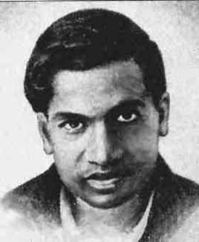

Famous Mathematicians
This half-term the numeracy activities will test what you know about some famous mathematicians.
Week 4’s mathematician is….
Srinivasa Ramanujan

Slide 2
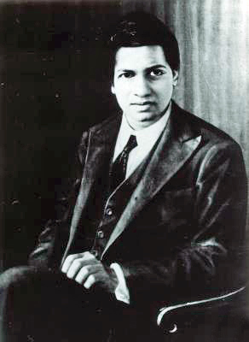
Question 1
Where was Ramanujan from?
A) The Phillipines
India
Pakistan
Malaysia

Slide 3
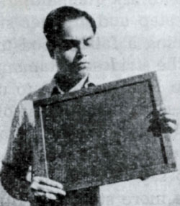
Question 2
How old was he when he died?
A) 17
32
78
103

Slide 4
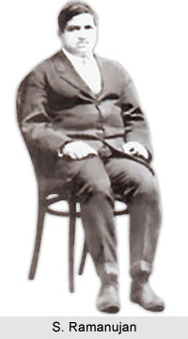
Question 3
To which country did Ramanujan move to continue his mathematical research?
The USA
England
China
Canada

Slide 5
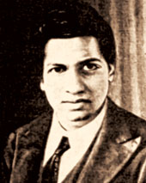
Question 4
Which of these is NOT true about Ramanujan?
He developed most of his mathematical theories completely on his own.
As a young boy he had no access to formal education.
He developed nearly 4000 mathematical identities and equations.
In his home country his birthday is celebrated every year as National Mathematics Day.

Slide 6
Answers
B – Ramanujan was born in Erode, India in 1887.
B – Ramanujan died at the age of 32 from illness, malnutrition and possibly a liver infection in 1920.
B – In 1912-1913, Ramanujan sent samples of his work to Cambridge University, England. The British mathematician Hardy was extremely impressed and invited Ramanujan to come and work with him. Ramanujan went on to become a fellow of Trinity College.
B – Ramanujan excelled at school and had already completed his own mathematical research by the age of 17. Until 1912 Ramanujan had carried out his research almost in complete isolation from the wider mathematical community. Not only had he discovered many new formulas, he had also discovered some that had already been found. During his short lifetime he compiled nearly 3900 results. In 2011, India declared that in honour of his contribution to mathematics, his birthday (22nd December) should be celebrated as National Mathematics Day.

