Slide 1
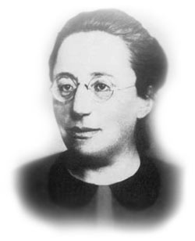

Famous Mathematicians
This half-term the numeracy activities will test what you know about some famous mathematicians.
Week 3’s mathematician is….
Emmy Noether

Slide 2
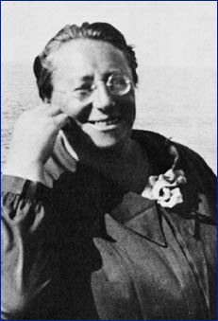
Question 1
What year did Emmy Noether die?
A) 1852
1901
1935
1957

Slide 3
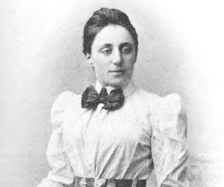
Question 2
Where was Emmy Noether from?
A) Germany
France
England
Scotland

Slide 4
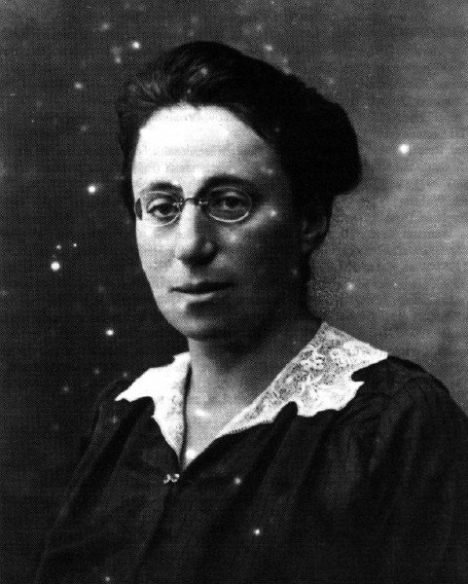
Question 3
Which of these famous mathematicians, in 1935, described Emmy Noether as,
“the most significant creative mathematical genius thus far produced since the higher education of women began.”
Albert Einstein
Isaac Newton
Leonhard Euler
Carl Gauss

Slide 5
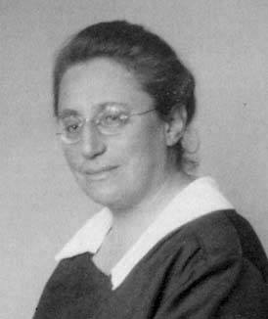
Question 4
Which area of mathematics is Emmy Noether known best for?
Statistics
Algebra
Geometry
Number

Slide 6
Answers
C –In 1935 Emmy Noether underwent surgery for an ovarian cyst and, despite signs of a recovery, died four days later at the age of 53.
A – Emmy Noether was born to a Jewish Family in Bavaria, Germany, in 1882. She was one of the countries leading mathematicians but was forced out of her job in 1933 at the University where she worked when Hilter’s Nazi party came to power. As a result she moved to the USA where she continued her research until her death.
A – Albert Einstein, he was the only one of the mathematicians to live at the same time as Emmy Noether. Newton, Euler and Gauss died before she was born. Many mathematicians have described her as the most important female mathematician to have ever lived.
B – Algebra. Emmy Noether made significant advances in the field of algebra and developed many of the mathematical foundations for Einstein’s general theory of relativity.

