Slide 1
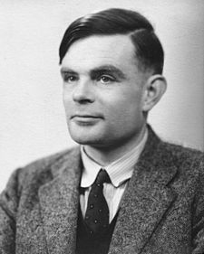
Famous Mathematicians
This half-term the numeracy activities will test what you know about some famous mathematicians.
Week 2’s mathematician is….
Alan Turing

Slide 2
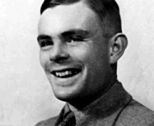
Question 1
Which century did Alan Turing live in?
A) 18th Century
19th Century
20th Century
21st Century

Slide 3
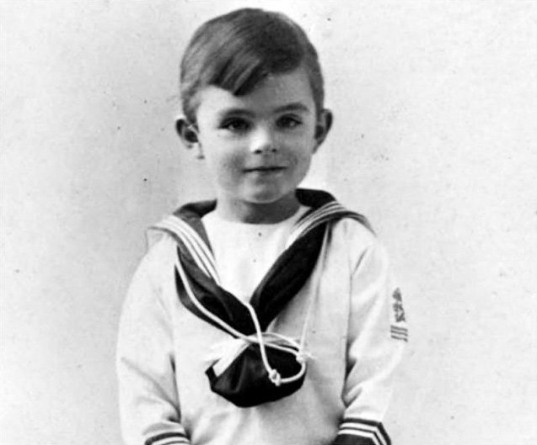
Question 2
Where was Alan Turing from?
A) Germany
France
England
Scotland

Slide 4
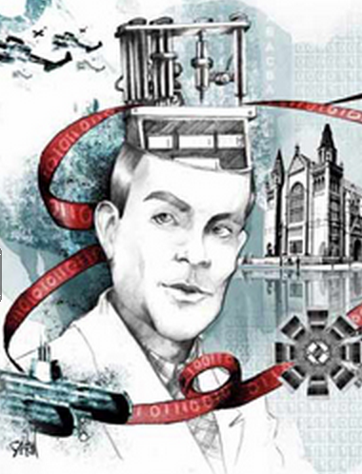
Question 3
Which of these did Alan Turing NOT do?
Worked for the government during World War II at their code breaking centre in Bletchley Park.
Assisted in the development of the “Manchester Computers.”
Wrote papers on Mathematical Biology whereby biological processes are modelled mathematically.
Designed the floppy disc – the earliest form of storage for computers before memory sticks and CDs were available.

Slide 5
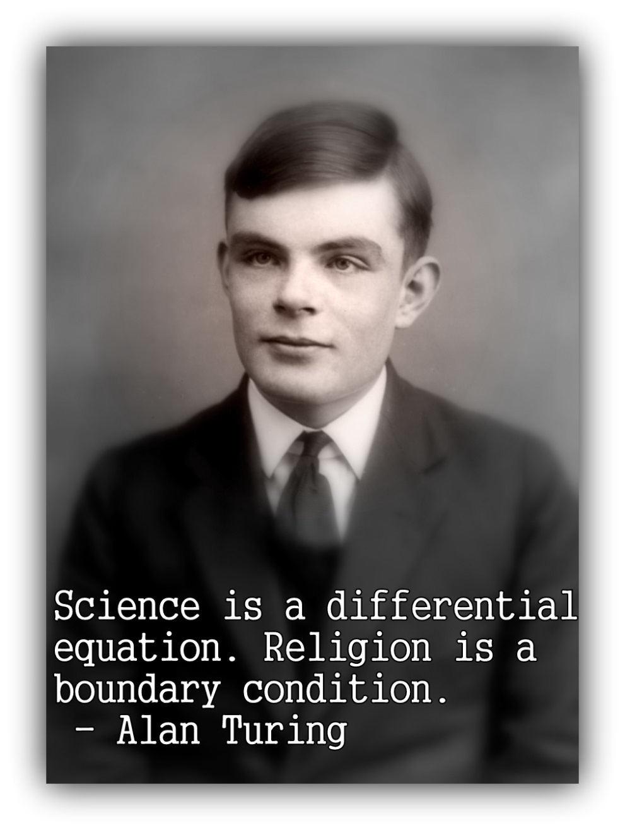
Question 4
Alan Turing was prosecuted for which criminal act in 1952?
Theft
Arson
Homosexuality
Euthanasia

Slide 6
Answers
C – Alan Turing lived between 1912 and 1954, in the 20th Century. He died from Cyanide poisoning at the age of 41. Although it was ruled a suicide some, including his mother, believed it to be an accident.
C – Alan Turing was British, born in Paddington, London. He went to University at Kings College, Cambridge where he became a fellow at the age of 22.
D - During World War II, Turing worked for the Government at Bletchley Park, Britain's code-breaking centre. He devised a number of techniques for breaking German ciphers. In 1948 he joined a laboratory at Manchester University where he worked on the “Manchester Computers” and researched biomathematics. He is considered to be the father of theoretical computer science and artificial intelligence. He was not responsible for the design of the floppy disk – which only started being developed in the 1960s.
Alan Turing was prosecuted and “treated for” homosexuality in 1952, then a criminal act. In 2009 the British Prime Minister Gordon Brown made a public apology on behalf of the government for the way he was treated. The Queen officially pardoned him in 2013.

