Slide 1
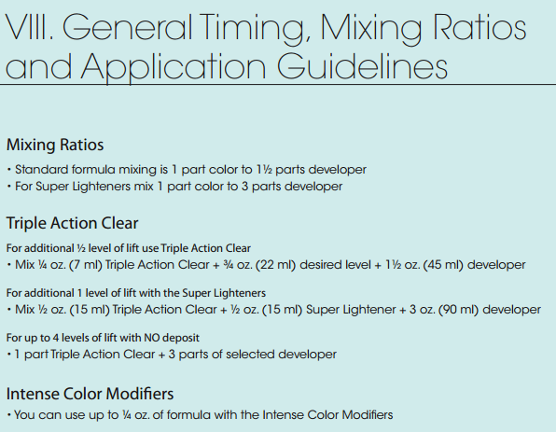
Hair stylists and the importance of ratio
When hair stylists dye peoples hair, they need to mix the colour they are using with something called “developer”.
To make up the right mixture of colour and developer, hair stylists use ratios.
If you use too much developer and not enough hair dye the result will be “brassy” as you have diluted the colouring agents. Use too little developer and you’ll end up with a much darker shade than you want.

Slide 3
If you were mixing 40 ml of standard colour, how much developer would you need?
If you were using 50 ml of Super Lightener, how much developer would you need?
If you wanted to make 100 ml of mixture with a Super Lightener, how much colour and how much developer would you need?
If you wanted to make 100 ml of a standard formula mixture, how much colour and how much developer would you need?

Slide 4
If you were mixing 40 ml of standard colour, how much developer would you need? 60 ml
If you were using 50 ml of Super Lightener, how much developer would you need? 150 ml
If you wanted to make 100 ml of mixture with a Super Lightener, how much colour and how much developer would you need? 25 ml Colour, 75 ml Developer
If you wanted to make 100 ml of a standard formula mixture, how much colour and how much developer would you need? 40 ml Colour, 60 ml Developer

