Slide 1
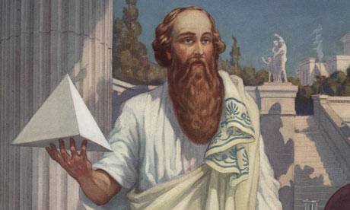
Famous Mathematicians
This half-term the numeracy activities will test what you know about some famous mathematicians.
Week 1’s mathematician is….
Pythagoras

Slide 2
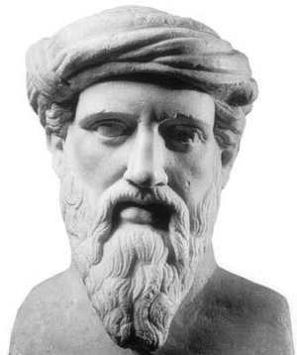
Question 1
Which years did Pythagoras live between?
A) c. 287 BC – c. 212 BC
570 BC – c. 495 BC
719 – 782
1012 - 1093

Slide 3
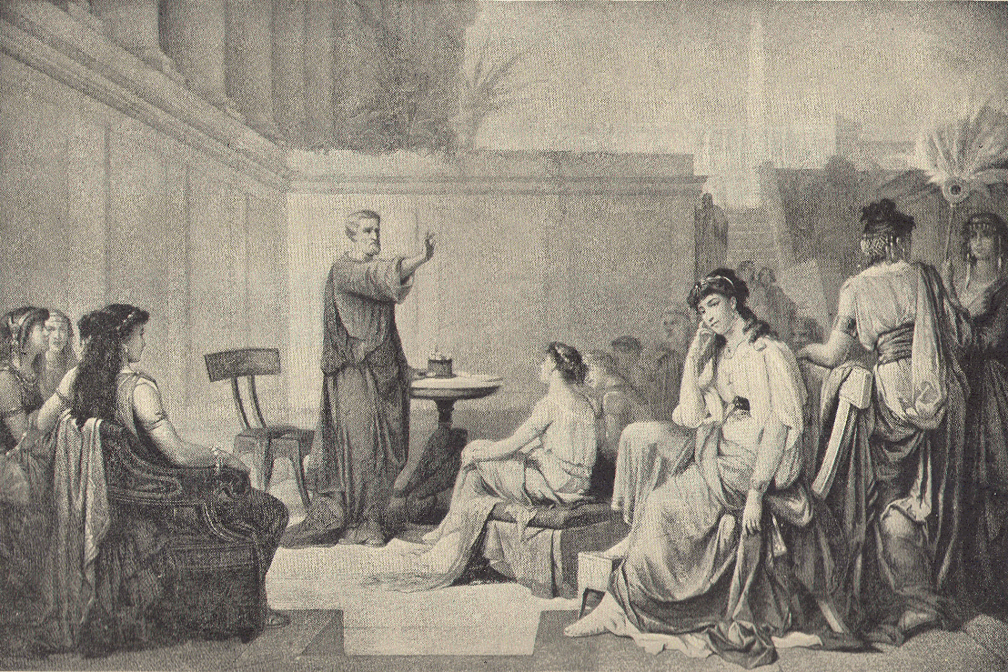
Question 2
Where was Pythagoras born?
A) Greece
Egypt
Algeria
Germany

Slide 4
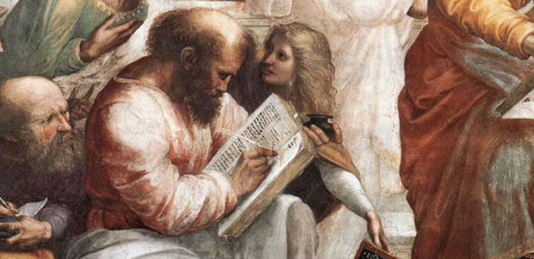
Question 3
Pythagoras is known for his contributions to mathematics, but which of these areas was Pythagoras NOT involved in?
A) Philosophy
Religion
Thermodynamics
Politics

Slide 5
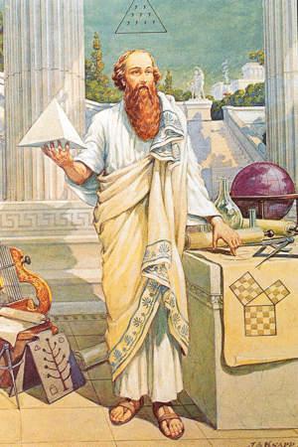
Question 4
Which of these mathematical theories is Pythagoras most famous for?
One that can be used to find the missing side of a right angled triangle
One that can be used to find missing angles in triangles
One that can be used to find the circumference of a circle.

Slide 6
Answers
B – Pythagoras lived between 570 BC and c. 495 BC, he lived to around 75 years of age.
A – Pythagoras was born on Samos, a Greek island in the Aegean Sea.
C – Pythagoras set up a school for his followers. Together they researched philosophy and science alongside mathematics. Pythagoras himself set up a religious movement called Pythagoreanism. The group’s involvement in local politics in the city of Croton where they were based ultimately led to Pythagoras being forced to flee the city. They were not involved in Thermodynamics – a branch of science concerned with heat and temperature and their relation to energy and work – which developed out of a desire to increase the efficiency of early steam engines.
A – Pythagoras’ theorem states that the square of the hypotenuse (the side opposite the right angle) is equal to the sum of the squares of the other two sides. [a² + b² = c²]

