Slide 1
Number puzzles in the paper
Did you know there’s a whole range of number puzzles you can try in most newspapers?
Click on the puzzles below to complete them as a class.
Sudoku
Kenken
Mind gym
Kakuro

Slide 2
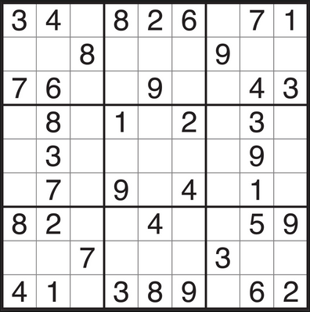
Sudoku
9
5
Sudoku is played over a 9x9 grid, divided to 3x3 sub grids called "regions“.
The object of Sudoku is to fill the other empty cells with numbers between 1 and 9 (1 number only in each cell) according the following guidelines:
A number can appear only once on each row.
A number can only appear once in each column.
A number can appear only once on each region
1
5
4
7
3
2
6
2
5
1
8
9
4
5
6
7
2
1
7
6
8
4
5
5
6
3
2
8
3
6
7
1
6
9
2
1
5
8
4
5
7

Slide 3
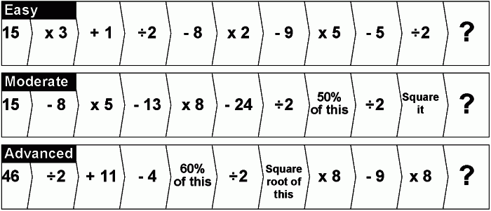
Mind gym
50
361
120
Simply choose the level you want to work out and follow through the calculation step-by-step.
Click on the slide to see the answers.

Slide 4
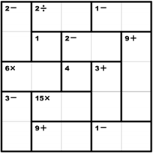
Kenken
1
5
4
The outlined groups of squares in each grid are called “cages.” In corner of each cage, there is a “target number” and a math operation (+, –, x, ÷).
Fill in each square of a cage with a number from 1 to 5. The numbers in a cage must combine (using only that cage’s math operation) to form that cage’s target number.
E.g. Your target number is 5, your operation is addition and the cage is made up of two squares. You could fill in 2 and 3 (because 2 + 3 = 5) or 1 and 4 (1 + 4 = 5).
You may not repeat a number in any row or column. You can repeat a number within a cage.
3
2
5
1
2
4
3
2
3
4
1
5
4
5
3
2
1
1
4
5
3
2
This is a 5x5 grid so you will only use the numbers one to five.
Click on the slide to see the answers.

Slide 5
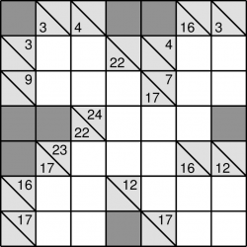
Kakuro
The aim of the game is to fill all the blank squares in the grid with only the numbers 1-9 so that the numbers you enter add up to the corresponding clues. When the grid is filled, the puzzle is complete.
You cannot duplicate a number in the same run (i.e. for the same clue) but you can use a number again elsewhere in the same row or column.
Click on the slide to see the answers.
2
1
3
1
1
3
5
5
2
9
7
8
6
8
9
9
7
7
4
1
8
9
9
8

