Slide 1
Percentages of amounts
These are the ones you need to know…
50% = ½
So to find 50%, divide by 2
25% = ¼
So to find 25%, divide by 4
10% = $\frac{1}{10}$
So to find 10%, divide by 10
75% = ¾
So to find 75%, ÷ 4 x 3
20% = $\frac{2}{10}$
So to find 20%, ÷ 10 x 2
No matter what you end up doing in life, being able to work out percentages of amounts is an extremely useful skill.
Key Facts
100% represents the whole amount.
Each percentage has an equivalent fraction.

Slide 2
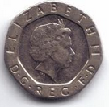
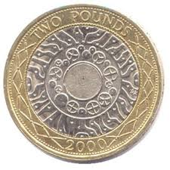
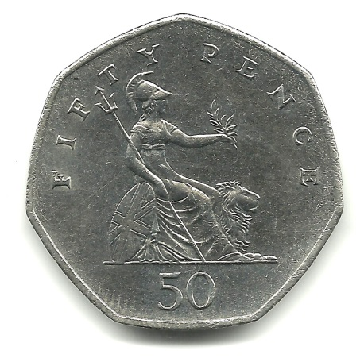
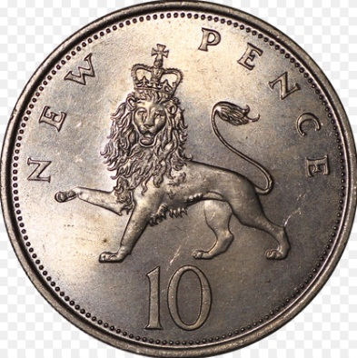
Would you rather….
…have 25% of £2.00
Or
50% of 80p ?
50% = ½ →40p
80p ÷ 2 = 40p
25% = ¼ → 50p
£2.00 ÷ 4 = 50p

Slide 3
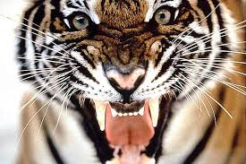
Would you rather…
…be attacked by
10% of 120 tigers
Or
25% of 64 lions?
10% = $\frac{1}{10}$ → 12 tigers
120 ÷ 10 = 12
25% = ¼ → 16 lions
64 ÷ 4 = 21

Slide 4
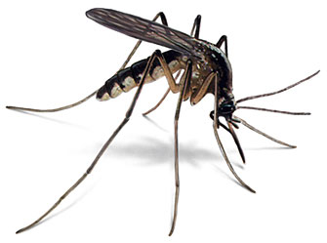
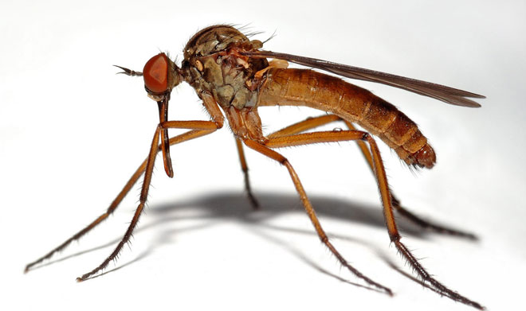
Would you rather…
…be bitten by
25% of 60 mosquitos
Or
10% of 150 midges?
25% = ¼ → 15 mosquitos
10% = $\frac{1}{10}$ → 15 midges
60 ÷ 4 = 15
150 ÷ 10 = 15

Slide 5
Would you rather…
…be given homework by
75% of 120 teachers or
50% of 140 teachers ?
75% = $\frac{3}{4}$ → 90 x homework
120 ÷ 4 x 3 = 90
50% = ½ →70 x homework
140 ÷ 2 = 70

Slide 6
Would you rather…
…have to do
25% of 200 detentions
Or
20% of 180 detentions?
25% = ¼ → 50 detentions
20% = $\frac{2}{10}$ → 36 detentions
200 ÷ 4 = 50
180 ÷ 10 x 2 = 36

