Slide 1
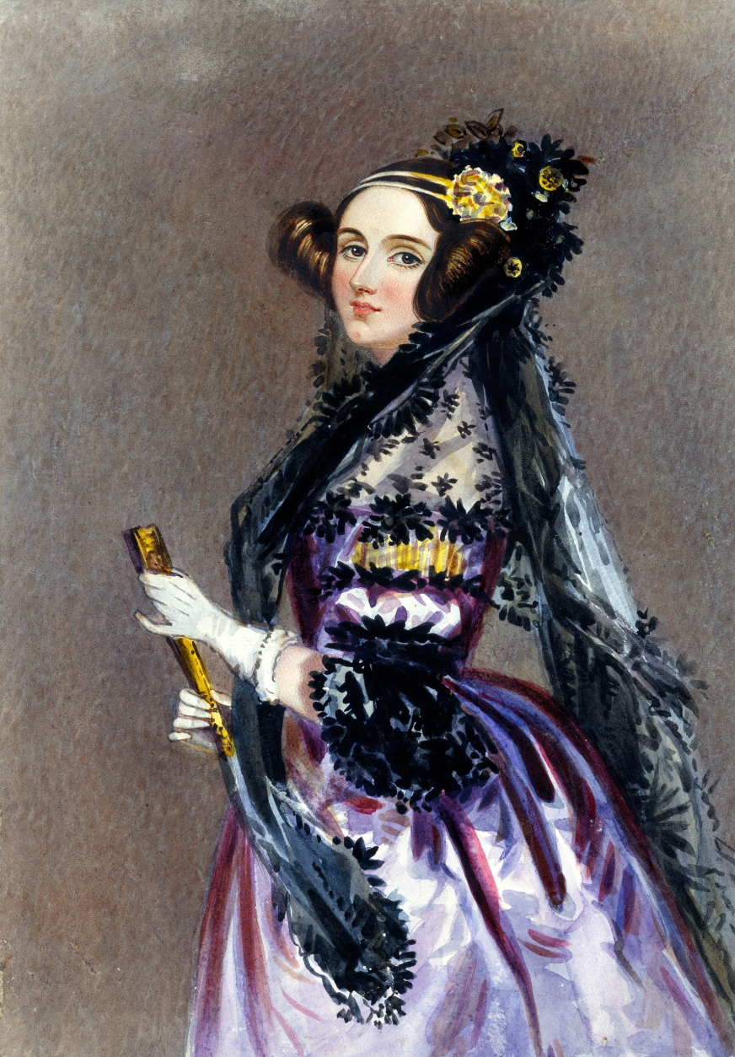
Famous Mathematicians
This half term our Numeracy activities will focus on famous Mathematicians and their work.
All the questions are multi-choice. This week’s quiz is on….
Ada Lovelace

Slide 2
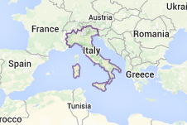
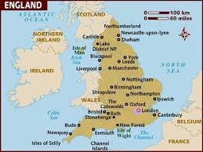
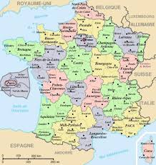
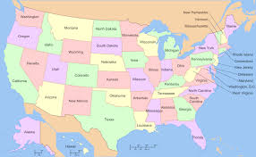
Q1 – Where was Ada Lovelace from?
A - Italy
B - England
C – The USA
D- France

Slide 3
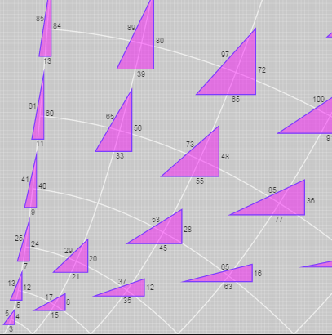
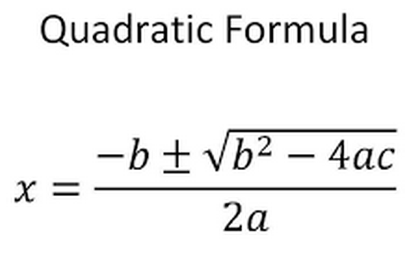
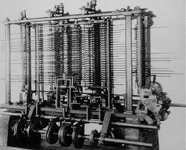
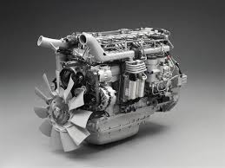
Q2 – What is Ada Lovelace best known for?
A
B
Her work investigating Pythagorian triples.
Her work solving quadratic equations.
C
D
Her work on Charles Babbage’s early general purpose computer
Her work on the combustion engine.

Slide 4
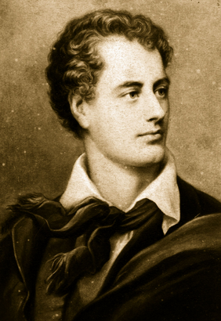
Q3 – Who was Ada Lovelace’s famous father?
A – Lord Byron (Poet)
B – Winston Churchill (Prime Minister)
C – Frank Sinatra (Singer)
D – Clark Gable (Actor)

Slide 5
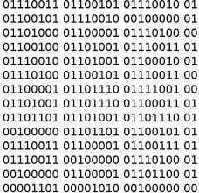
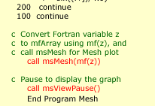
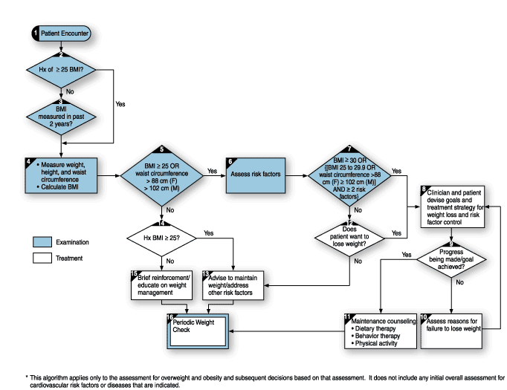
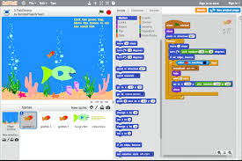
Q4 –Ada Lovelace is credited by some with creating the first computer program, in the form of an algorithm. Which of these is an example of an algorithm?
A
B
C
D

Slide 6
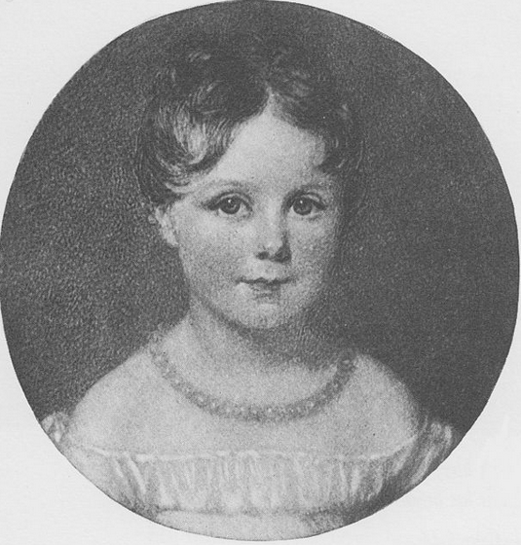
Q5 – When and how did Ada Lovelace die?
A – She died at the age of 33 of an opium overdose.
B – She died at the age of 98 of old age.
C – She died at the age of 36 from uterine cancer.
D – She died in a traffic accident, driving one of the first cars.

Slide 7
ANSWERS

Slide 8
Q1 – Where was Ada Lovelace from?
A - Italy
B - England
C – The USA
D- France

Slide 9
Q2 – What is Ada Lovelace best known for?
A
B
Her work investigating Pythagorian triples.
Her work solving quadratic equations.
C
D
Her work on Charles Babbage’s early general purpose computer
Her work on the combustion engine.

Slide 10
Q3 – Who was Ada Lovelace’s famous father?
A – Lord Byron (Poet)
B – Winston Churchill (Prime Minister)
C – Frank Sinatra (Singer)
D – Clark Gable (Actor)

Slide 11
Q4 –Ada Lovelace is credited by some with creating the first computer program, in the form of an algorithm. Which of these is an example of an algorithm?
A
B
C
D

Slide 12
Q5 – When and how did Ada Lovelace die?
A – She died at the age of 33 of an opium overdose.
B – She died at the age of 98 of old age.
C – She died at the age of 36 from uterine cancer.
D – She died in a traffic accident, driving one of the first cars.

