Slide 1
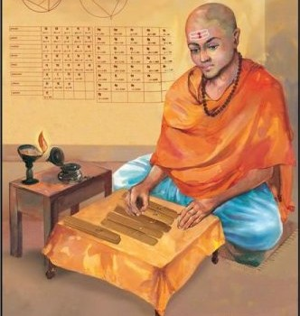
Famous Mathematicians
This half term our Numeracy activities will focus on famous Mathematicians and their work.
All the questions are multi-choice. This week’s quiz is on….
Brahmagupta

Slide 2
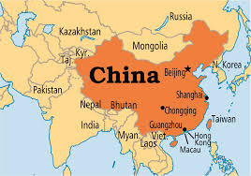
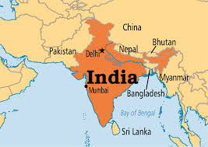
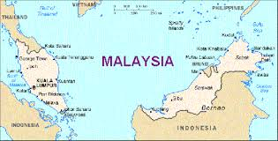
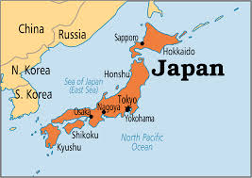
Q1 – Where was Brahmagupta from?
A - China
B - India
C - Malaysia
D- Japan

Slide 3
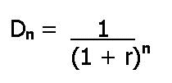
Q2 – Brahmagupta was famous for his work on algebra. He gave general solutions to the quadratic equation, one of which we use at GCSE. Which one of these is this “quadratic formula”?
A
B
C
D

Slide 4
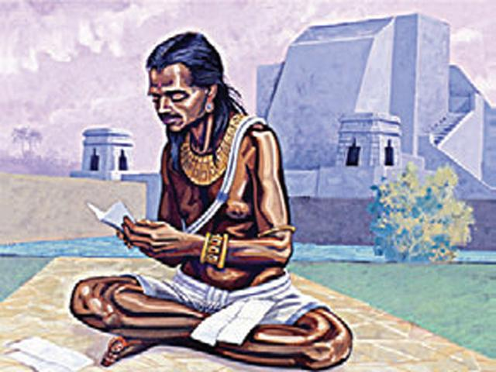
Q3 – The Brahmasphutasiddhanta was Brahmagupta’s most famous text. Apart from Mathematics, what was studied in it?
A – Religion
B – Politics
C – Geography
D – Astronomy

Slide 5
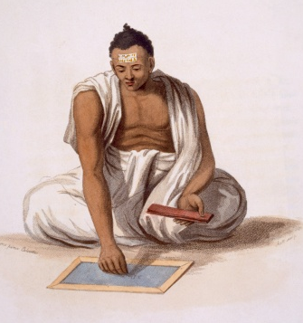
Q4 – In the Brahmasphutasiddhanta, Brahamagupta stated that, ”A positive divided by a positive or a negative divided by a negative is positive; a zero divided by a zero is zero; a positive divided by a negative is negative; a negative divided by a positive is negative.”
Based on this what is -3 ÷ -2?
A
-6
B
6
C
-1.5
D
1.5

Slide 6
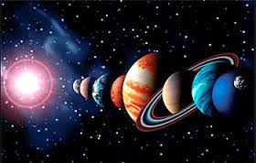
Q5 – Which of these did Brahmagupta NOT discuss in the Brahmasphutasiddhanta?
A
The fact that the sun must be further away from the Earth than the moon.
B
The fact that the Earth must be spherical.
C
The calculation of lunar and solar eclipses.
D
The creation of the astrological callander.

Slide 7
ANSWERS

Slide 8
Q1 – Where was Brahmagupta from?
A - China
B - India
C - Malaysia
D- Japan

Slide 9
Q2 – Brahmagupta was famous for his work on algebra. He gave general solutions to the quadratic equation, one of which we use at GCSE. Which one of these is this “quadratic formula”?
A
B
C
D

Slide 10
Q3 – The Brahmasphutasiddhanta was Brahmagupta’s most famous text. Apart from Mathematics, what was studied in it?
A – Religion
B – Politics
C – Geography
D – Astronomy

Slide 11
Q4 – In the Brahmasphutasiddhanta, Brahamagupta stated that, ”A positive divided by a positive or a negative divided by a negative is positive; a zero divided by a zero is zero; a positive divided by a negative is negative; a negative divided by a positive is negative.”
Based on this what is -3 ÷ -2?
A
-6
B
6
C
-1.5
D
1.5

Slide 12
Q5 – Which of these did Brahmagupta NOT discuss in the Brahmasphutasiddhanta?
A
The fact that the sun must be further away from the Earth than the moon.
B
The fact that the Earth must be spherical.
C
The calculation of lunar and solar eclipses.
D
The creation of the astrological callander.

