Slide 1
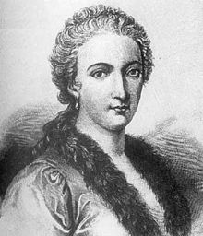
Famous Mathematicians
This half term our Numeracy activities will focus on famous Mathematicians and their work.
All the questions are multi-choice. This week’s quiz is on….
Maria Agnesi

Slide 2
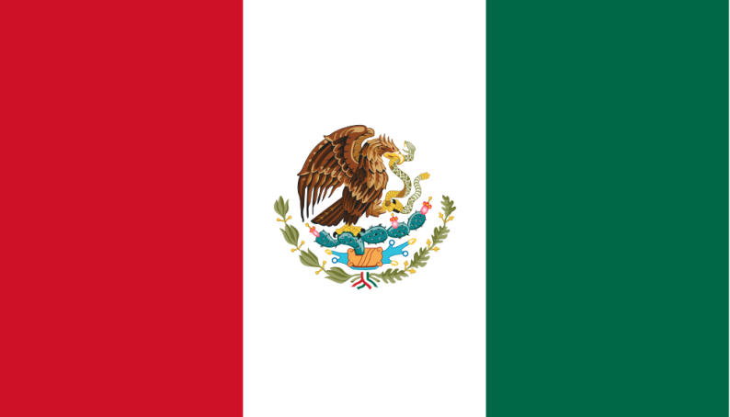
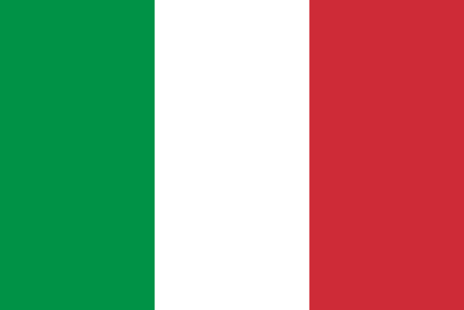
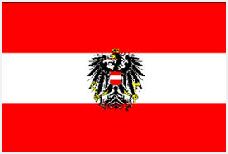
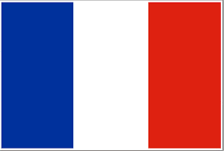
Q1 – Where was Maria Agnesi from?
A - Mexico
B - Italy
C - Austria
D- France

Slide 3
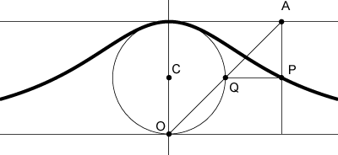
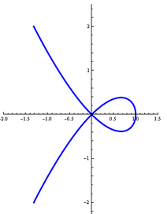
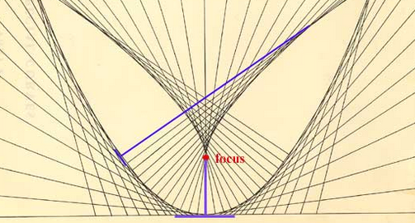
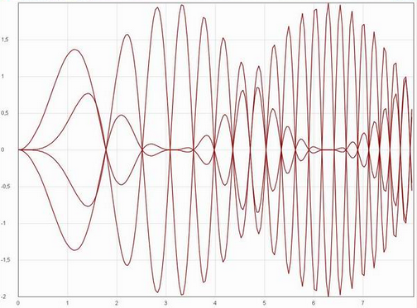
Q2 – Maria Agnesi was famous for investigating a curve, known as the “Witch of Agnesi.” Which of these is the curve in question?
A
B
C
D

Slide 4
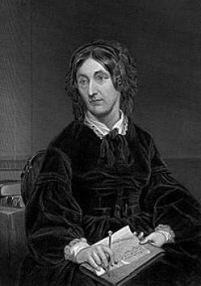
Q3 – Which of these is NOT true about Maria Agnesi?
A – She was the first woman to write a Mathematical handbook.
B – She was the first woman to become a Mathematics professor at a University.
C – She is credited with doing much of the ground work for Albert Einstein’s later research.
D – She spent the last 40 years of her live serving the poor, even setting up a hospital in her home.

Slide 5
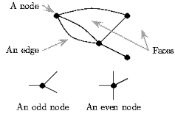
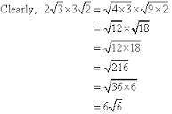
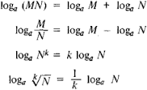
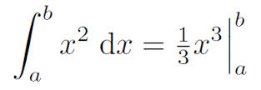
Q4 –Maria Agnesi is also credited with writing the first book discussing differentiation and integration. These are all examples of A-level maths, but which of them shows integration?
A
B
C
D

Slide 6
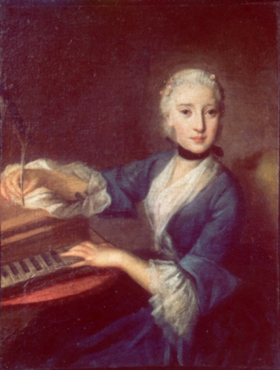
Q5 – Maria Agnesi was recognised as a child prodigy. By her 11th birthday, how many languages could she speak?
A
3
B
5
C
9
D
12.

Slide 7
ANSWERS

Slide 8
Q1 – Where was Maria Agnesi from?
A - Mexico
B - Italy
C - Austria
D- France

Slide 9
Q2 – Maria Agnesi was famous for investigating a curve, known as the “Witch of Agnesi.” Which of these is the curve in question?
A
B
C
D

Slide 10
Q3 – Which of these is NOT true about Maria Agnesi?
A – She was the first woman to write a Mathematical handbook.
B – She was the first woman to become a Mathematics professor at a University.
C – She is credited with doing much of the ground work for Albert Einstein’s later research.
D – She spent the last 40 years of her live serving the poor, even setting up a hospital in her home.

Slide 11
Q4 –Maria Agnesi is also credited with writing the first book discussing differentiation and integration. These are all examples of A-level maths, but which of them shows integration?
A
B
C
D

Slide 12
Q5 – Maria Agnesi was recognised as a child prodigy. By her 11th birthday, how many languages could she speak?
A
3
B
5
C
9
D
12.

