Slide 1
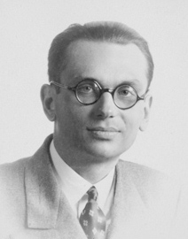
Famous Mathematicians
This half term our Numeracy activities will focus on famous Mathematicians and their work.
All the questions are multi-choice. This week’s quiz is on….
Kurt Godel

Slide 2

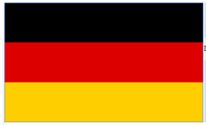


Q1 – Where was Kurt Godel from?
A - Switzerland
B - Germany
C - Austria
D- France

Slide 3
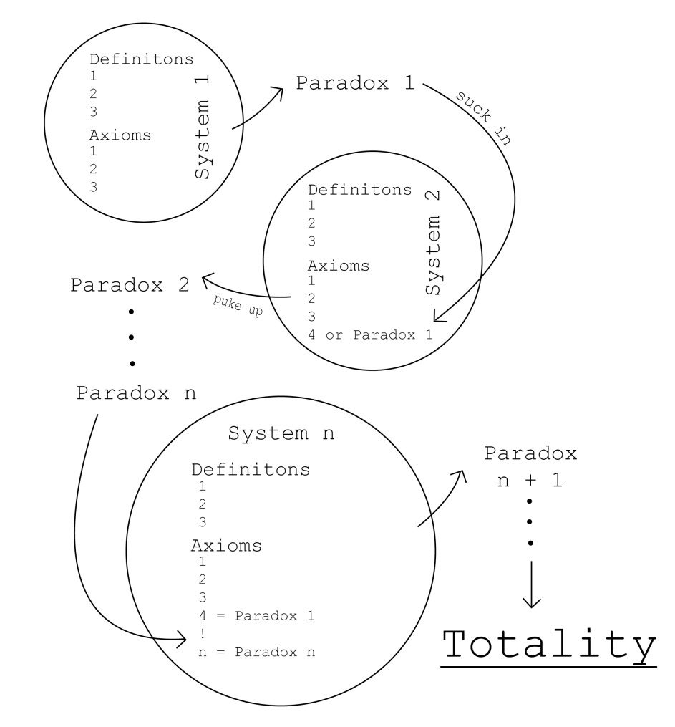
Q2 – Godel was famous for his work on Mathematical logic.
Which of these was one of his early theorems?
A – The never ending theorem
B – The incompleteness theorem
C – The self-solving theorem
D – The big bang theorem

Slide 4
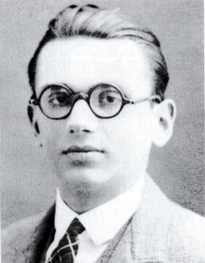
Q3 – Godel moved to the USA in 1939. Why did he do this?
A – To avoid conscription into the German army.
B – He was a Jew and needed to escape the Nazis.
C – He felt his research would be worth more overseas.
D – His fiancee was American.

Slide 5
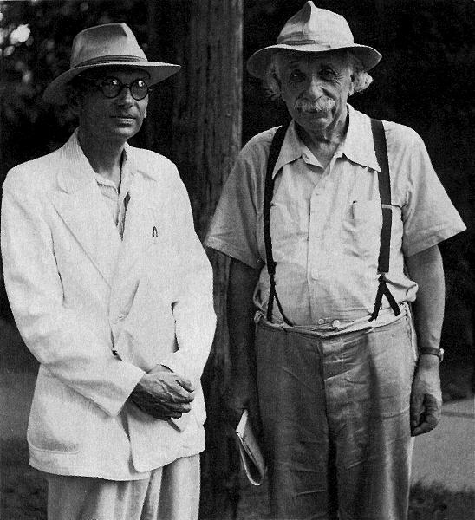
Q4 – Which famous Mathematician was Kurt Godel friends with?
A – Aristotle
B – Blaise Pascal
C – Stephen Hawking
D – Albert Einstien

Slide 6
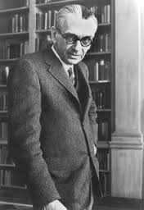
Q5 – How did Kurt Godel die?
A
After his wife died he refused to eat, believing any food offered him would be poisoned. He starved to death.
B
He was assassinated for the work he did during the Cold War against the USSR.
C
While demonstrating a practical application of one of his theorems, he accidently fell backwards off a podium hitting his head on the corner of a table. The blow proved fatal.
D
He took a heroin overdose.

Slide 7
ANSWERS

Slide 8
Q1 – Where was Kurt Godel from?
A - Switzerland
B - Germany
C - Austria
D- France

Slide 9
Q2 – Godel was famous for his work on Mathematical logic.
Which of these was one of his early theorems?
A – The never ending theorem
B – The incompleteness theorem
C – The self-solving theorem
D – The big bang theorem

Slide 10
Q3 – Godel moved to the USA in 1939. Why did he do this?
A – To avoid conscription into the German army.
B – He was a Jew and needed to escape the Nazis.
C – He felt his research would be worth more overseas.
D – His fiancee was American.

Slide 11
Q4 – Which famous Mathematician was Kurt Godel friends with?
A – Aristotle
B – Blaise Pascal
C – Stephen Hawking
D – Albert Einstien

Slide 12
Q5 – How did Kurt Godel die?
A
After his wife died he refused to eat, believing any food offered him would be poisoned. He starved to death.
B
He was assassinated for the work he did during the Cold War against the USSR.
C
While demonstrating a practical application of one of his theorems, he accidently fell backwards off a podium hitting his head on the corner of a table. The blow proved fatal.
D
He took a heroin overdose.

