Slide 1
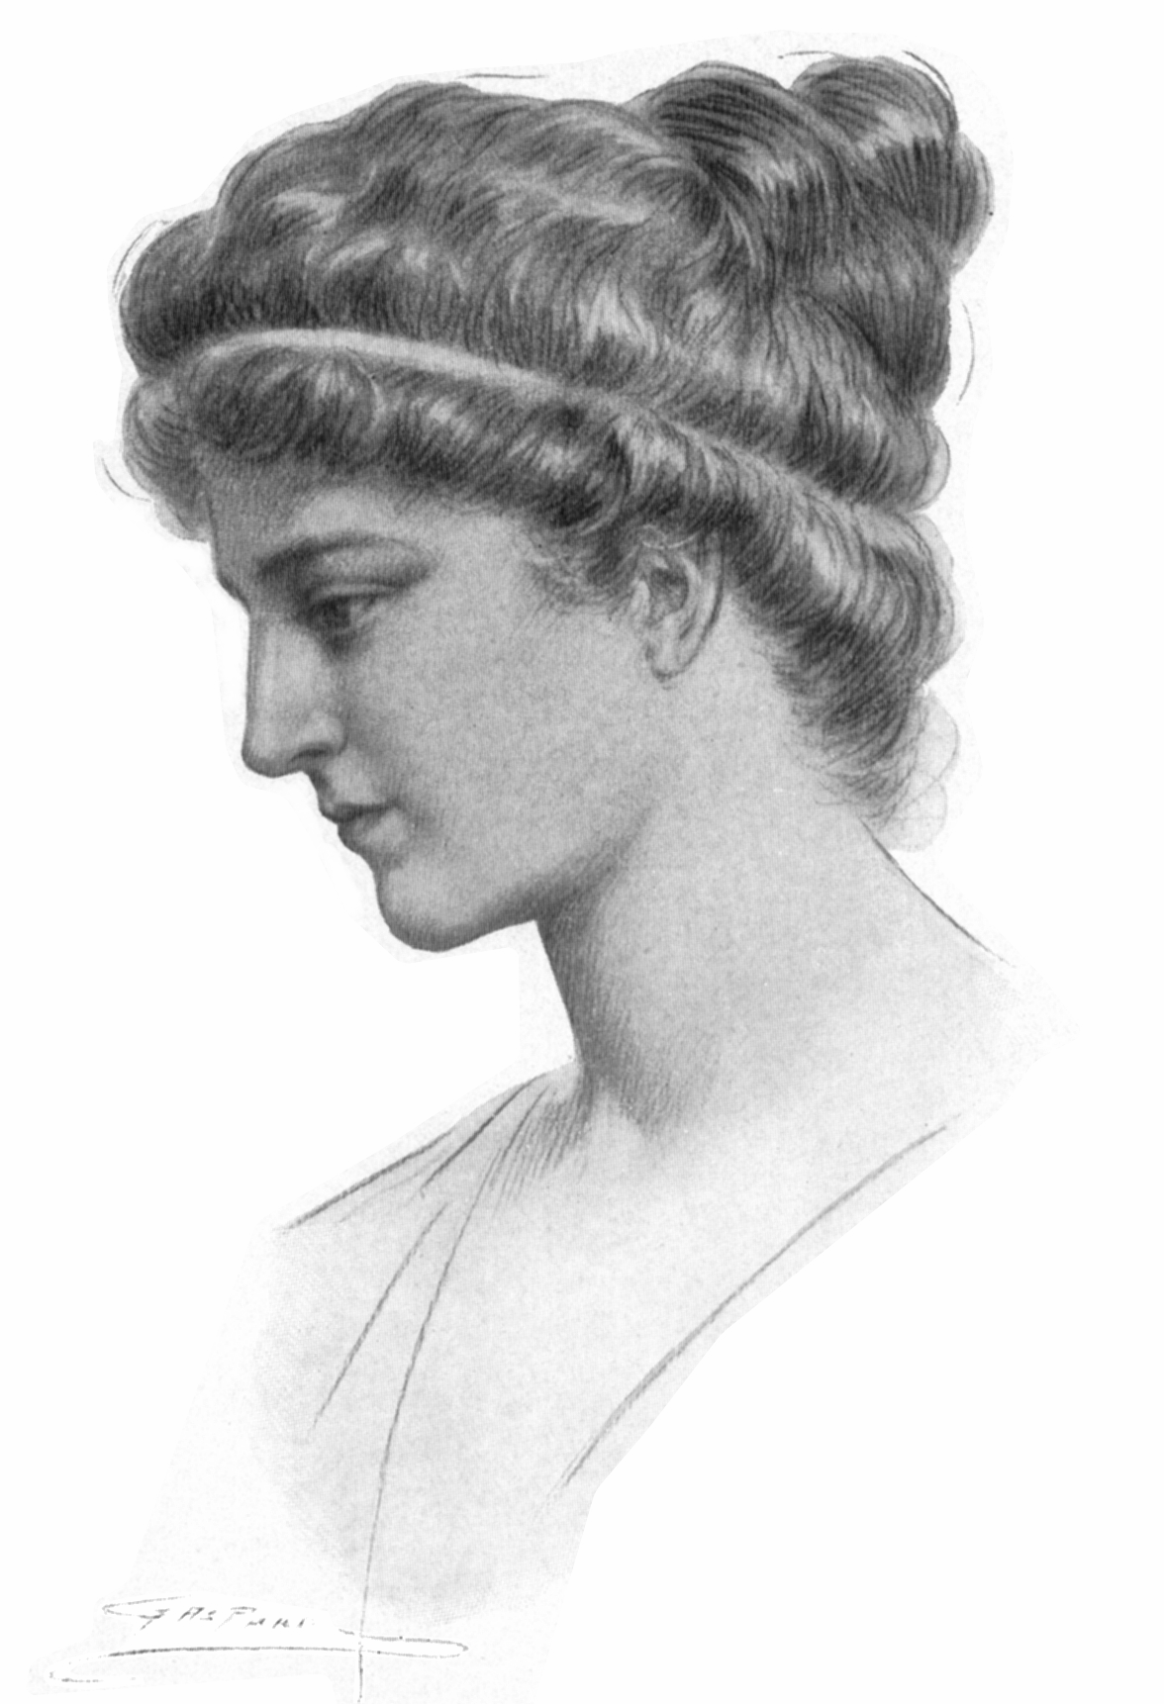
Famous Mathematicians
This half term our Numeracy activities will focus on famous Mathematicians and their work.
All the questions are multi-choice. This week’s quiz is on….
Hypatia

Slide 2
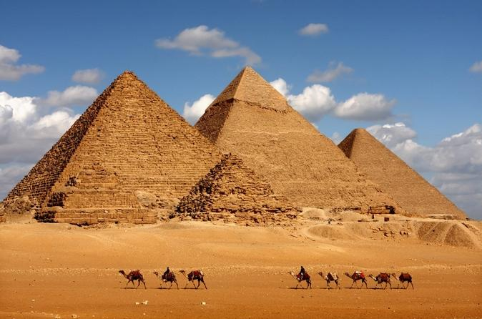
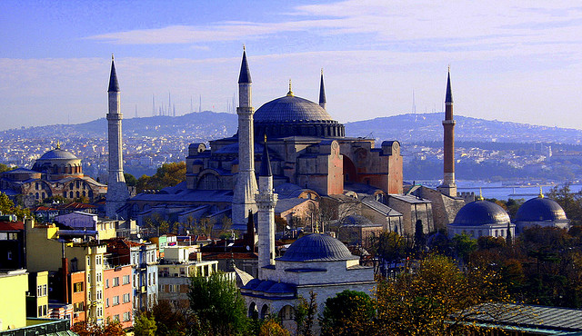
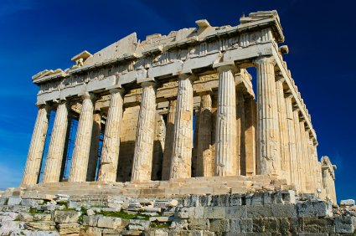
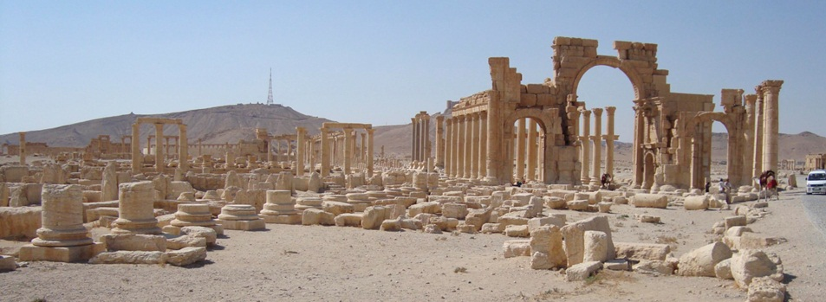
Q1 – Where was Hypatia from?
A - Egypt
B - Turkey
C - Syria
D- Greece

Slide 3
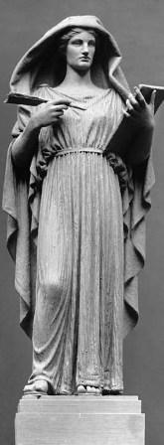
Q2 – Hypatia was the head of the Neoplatonic school at Alexandria. What did she teach?
A – Philosophy and Astronomy
B – Politics and Art
C – Religion and Mathematics
D - History

Slide 4
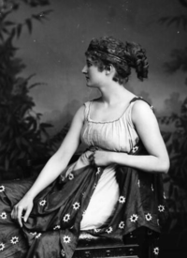
Q3 – It is possible that Hypatia was involved in the invention of a hydroscopium. What is a hydroscopium?
A – A pulley system
B – An ancient calculator
C – A clock that works with water and gears.
D – A device used to determine the relative density of liquids.

Slide 5
Q4 – Not a lot of Mathematical work is credited to Hypatia. Why is this?
A – She was more famous for her philosophical quotes.
B – All her work was destroyed in a fire.
C – It was normal at the time for women not to be credited for their research.
D – She wished her work to remain anonymous.

Slide 6
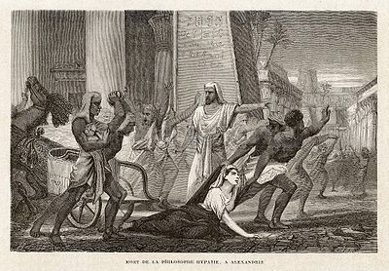
Q5 – Hypatia was murdered. What was she murdered for?
A – For adultery
B – For witchcraft
C – For refusing to convert to Christianity
D – For worsening a conflict between a religious and a political figure

Slide 7
ANSWERS

Slide 8
Q1 – Where was Hypatia from?
A - Egypt
B - Turkey
C - Syria
D- Greece

Slide 9
Q2 – Hypatia was the head of the Neoplatonic school at Alexandria. What did she teach?
A – Philosophy and Astronomy
B – Politics and Art
C – Religion and Mathematics
D - History

Slide 10
Q3 – It is possible that Hypatia was involved in the invention of a hydroscopium. What is a hydroscopium?
A – A pulley system
B – An ancient calculator
C – A clock that works with water and gears.
D – A device used to determine the relative density of liquids.

Slide 11
Q4 – Not a lot of Mathematical work is credited to Hypatia. Why is this?
A – She was more famous for her philosophical quotes.
B – All her work was destroyed in a fire.
C – It was normal at the time for women not to be credited for their research.
D – She wished her work to remain anonymous.

Slide 12
Q5 – Hypatia was murdered. What was she murdered for?
A – For adultery
B – For witchcraft
C – For refusing to convert to Christianity
D – For worsening a conflict between a religious and a political figure

