Slide 1
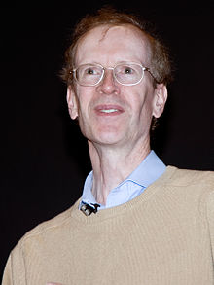
Famous Mathematicians
This half term our Numeracy activities will focus on famous Mathematicians and their work.
All the questions are multi-choice. This week’s quiz is on….
Andrew Wiles

Slide 2
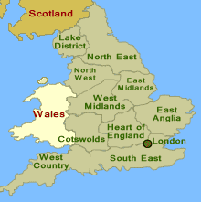
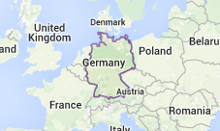
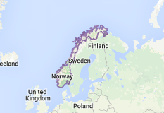
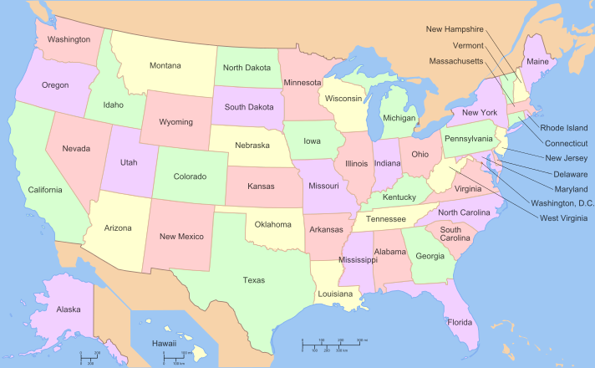
Q1 – Where is Andrew Wiles from?
A - Germany
B - England
C - Norway
D- USA

Slide 3
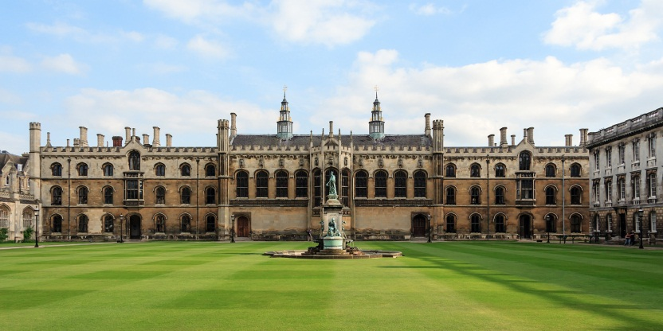
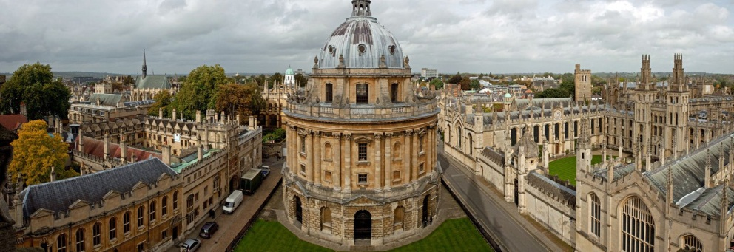
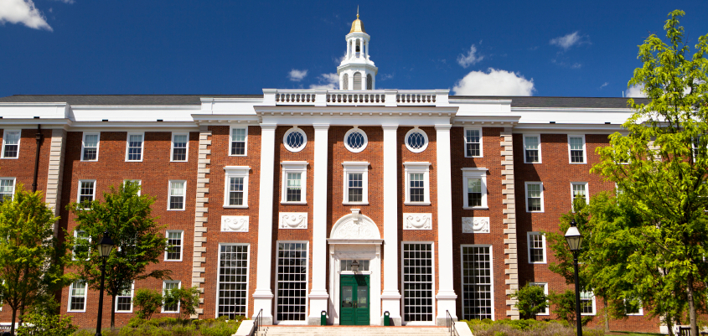
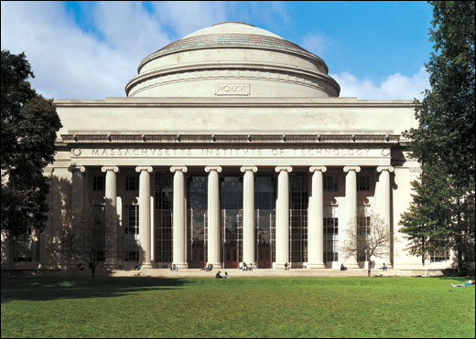
Q2 – Where is Andrew Wiles currently based?
A – Oxford University
B – Cambridge University
C - Harvard
D- MIT

Slide 4
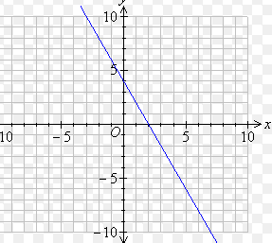
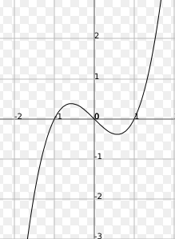
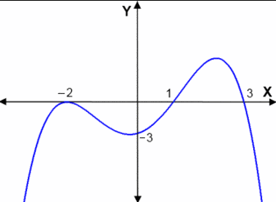
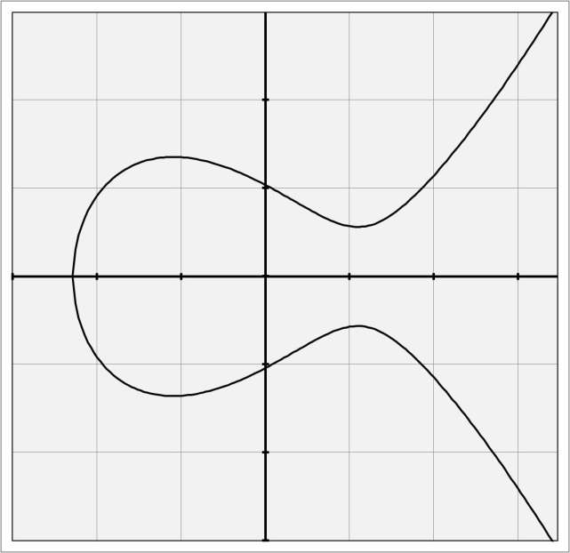
Q3 – Wiles research has focussed on the mathematics of elliptic curves. Which of these is an elliptic curve?
A
B
C
D

Slide 5
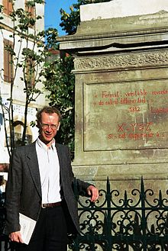
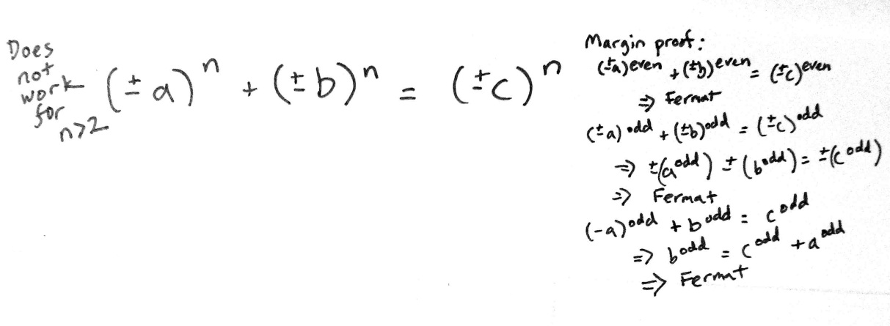
Q4 –Andrew Wiles’ most famous Mathematical achievement is his proof of Fermat’s last theorem. In which popular series is this theorem mentioned?
A – The Big Bang Theory
B – Star Trek: The Next Generation
C – Doctor Who
D – Heroes

Slide 6
Q5 – A rock band called BATS wrote a song describing Andrew Wile’s career. What is the missing word?
I describe my life in mathematics As a darkened mansion I stumble into furniture seeking the switch To cast a feeble light on my secret ____________
A black raptor's feather
A – Mission
B – Passion
C – Endeavour
D – Itch

Slide 7
ANSWERS

Slide 8
Q1 – Where is Andrew Wiles from?
A - Germany
B - England
C - Norway
D- USA

Slide 9
Q2 – Where is Andrew Wiles currently based?
A – Oxford University
B – Cambridge University
C - Harvard
D- MIT

Slide 10
Q3 – Wiles research has focussed on the mathematics of elliptic curves. Which of these is an elliptic curve?
A
B
C
D

Slide 11
Q4 –Andrew Wiles’ most famous Mathematical achievement is his proof of Fermat’s last theorem. In which popular series is this theorem mentioned?
A – The Big Bang Theory
B – Star Trek: The Next Generation
C – Doctor Who
D – Heroes

Slide 12
Q5 – A rock band called BATS wrote a song describing Andrew Wile’s career. What is the missing word?
I describe my life in mathematics As a darkened mansion I stumble into furniture seeking the switch To cast a feeble light on my secret ____________
A black raptor's feather
A – Mission
B – Passion
C – Endeavour
D – Itch

