Slide 1
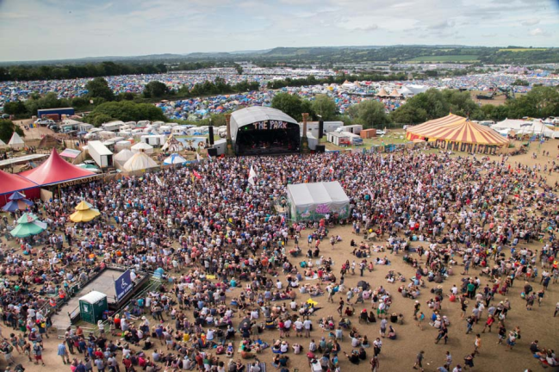
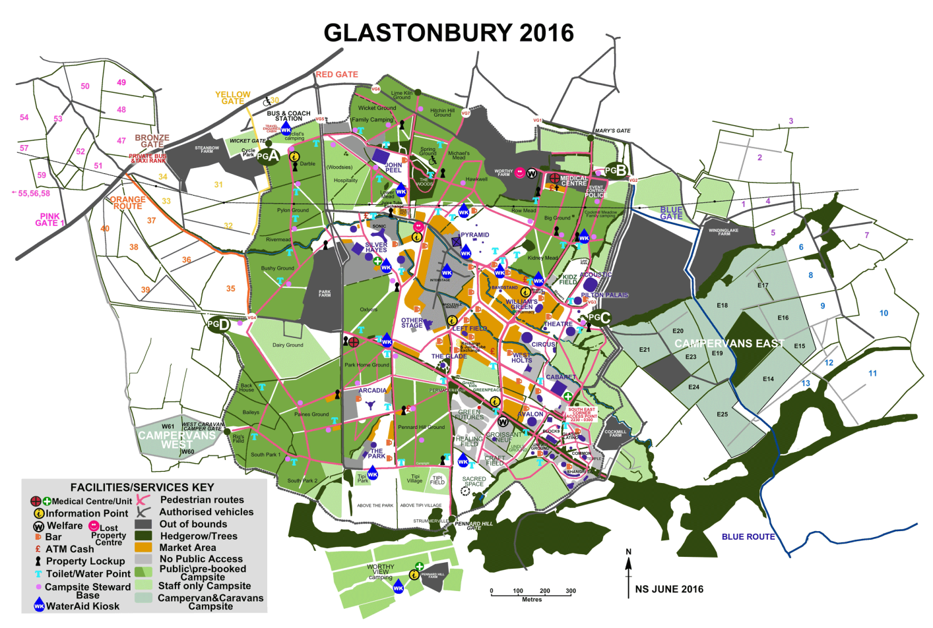
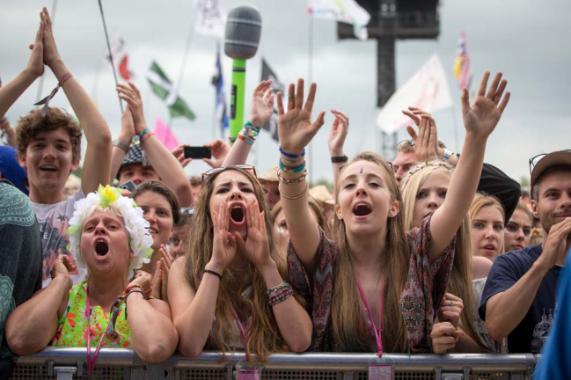
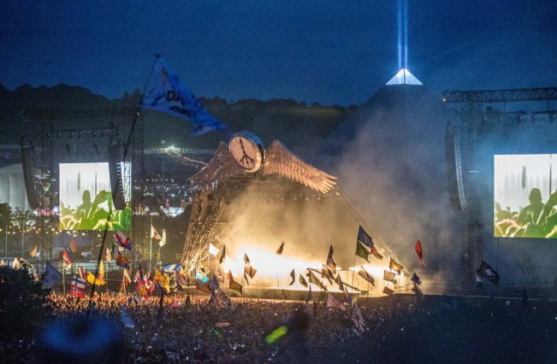
Activity 1 – The logistics of Glastonbury Festival
Glastonbury music festival has thousands of bands playing each year. Making sure you get to see the bands you want to can take some planning. This activity looks at how your numeracy skills around time can help you do this.

Slide 2
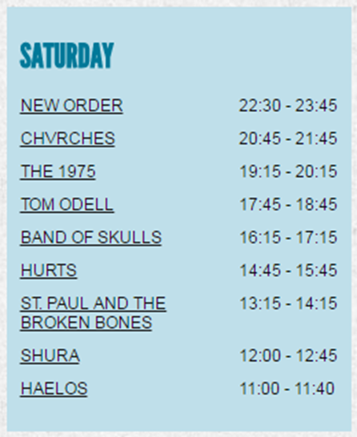
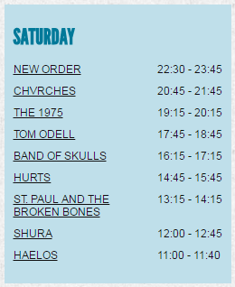
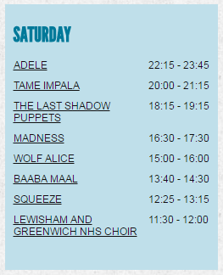
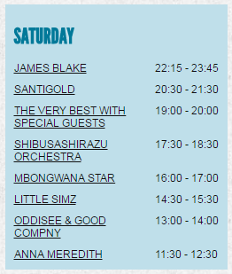
What is the range of set times on the other stage?
(Remember – the “range” is the difference between the highest and lowest values)
Range of set times
= 75 – 40 = 35 minutes
30 mins + 45 mins = 75 mins
22:30 23:00 23:45
Longest set time : 75 minutes
Walking times (Double the times if the conditions are muddy)
Other stage to Pyramid stage- 10 minutes if dry
Pyramid stage to West Holts stage – 12 minutes if dry
Other stage to West Holts stage – 14 minutes if dry
Shortest set time : 40 minutes

Slide 3
It’s muddy. What time do you need to set off from the West Holts stage to get to see Wolf Alice from the start of their set? How much of Little Simz set will you have to miss?
24 mins + 30 mins = 54 mins
14:36 15:00 15:30
You will miss 54 minutes of Little Simz set – most of it.
Wolf Alice start playing at 15:00
24 mins
14:36 15:00
It normally takes 12 minutes to walk between the stages, but you need to double this as it is muddy.
Walking times (Double the times if the conditions are muddy)
Other stage to Pyramid stage- 10 minutes if dry
Pyramid stage to West Holts stage – 12 minutes if dry
Other stage to West Holts stage – 14 minutes if dry
You will need to leave the West Holts stage at 14:36.

Slide 4
If you had been at Glastonbury in 2016, how would you have planned your Saturday?
Walking times (Double the times if the conditions are muddy)
Other stage to Pyramid stage- 10 minutes if dry
Pyramid stage to West Holts stage – 12 minutes if dry
Other stage to West Holts stage – 14 minutes if dry

Slide 5
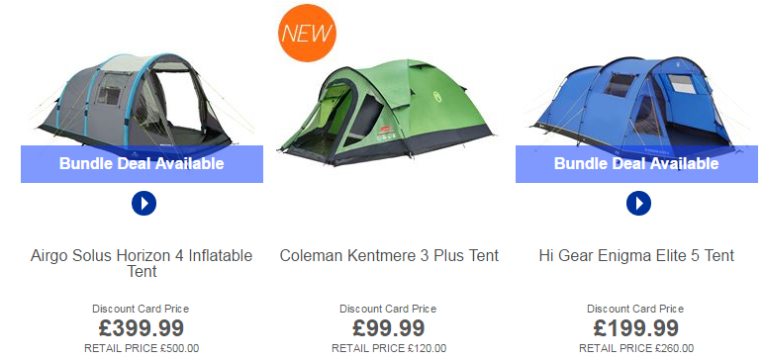
When estimating, remember to round numbers before doing your calculation:
Activity 2 – Budgeting for camping
If you go camping, whether at a festival or just to a campsite with a group of friends, there are various pieces of equipment you’ll need for your trip.
£399.99 ÷ 4
$≈$ £400 ÷ 4
= £100 per person
£99.99 ÷ 3
(No need to estimate)
= £33.33 per person
£199.99 ÷ 5
$≈$ £200 ÷ 5
= £40 per person
If you split the cost of the tent between the number of people it can hold, what is an estimate (or an exact value) for the cost per person for each tent?

Slide 6
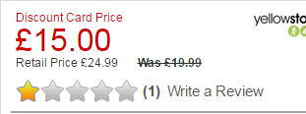
Activity 2 – Budgeting for camping
If you go camping, whether at a festival or just to a campsite with a group of friends, there are various pieces of equipment you’ll need for your trip.
First estimate the discount:
£24.99 - £15.00
≈ £25 - £15
= £10 discount
Now calculate the percentage discount
% discount = (discount ÷ original price) x 100
This tent is in the sale.
What is an estimate for the percentage discount the store is offering?
Why might you not choose to buy this tent, despite it being cheap?
= (£10 ÷ £25) x 100 = 40 %

Slide 7
Activity 3 – Buying party food
Often when shopping you are faced with a range of options for different items. It’s always worth looking out for a “best buy.”
Based on going for a “best buy”, which of these offers would you go for?
(Assume all the pizzas are the same weight)
Primo thins have the cheapest cost per pizza, so they are the best buy.
Palermo’s Primo Thin:
3 pizzas for £7.50
Pizza Express - Classic:
5 pizzas for £14
Amy’s pizza:
2 pizzas for £5.80
Cost per pizza
= £7.50 $÷$ 3 = £2.50
Cost per pizza
= £14 $÷$ 5 = £2.80
Cost per pizza
= £5.80 $÷$ 2 = £2.90

Slide 8
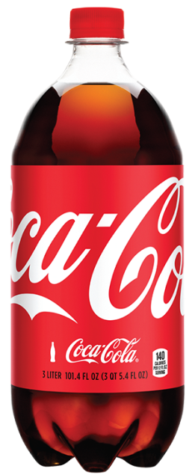
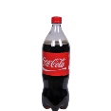
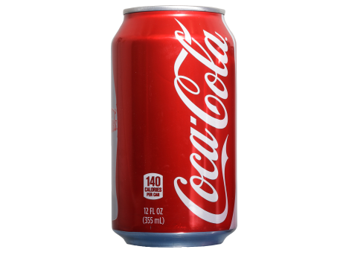
Activity 3 – Buying party food
Often when shopping you are faced with a range of options for different items. It’s always worth looking out for a “best buy.”
Based on going for a “best buy”, which of these offers would you go for?
The offer at Lidl is the best buy as it has the cheapest cost per litre of coke, 1.5 litre bottles for 98 pence.
Tesco’s:
3 litre bottle for £1.95
Lidl:
1.5 litre bottle for 98 p
Asda:
330 ml can for 42 p
Cost per litre
= £1.95 $÷$ 3 = £0.65
Cost per litre
= £0.98 $÷$ 1.5 = £0.63…
Cost per litre
= £0.42 $÷$ 0.33(0) = £1.27…

Slide 9
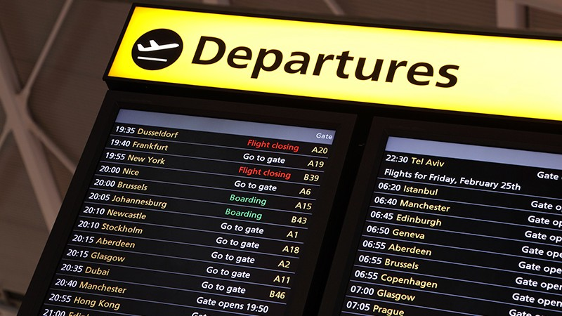
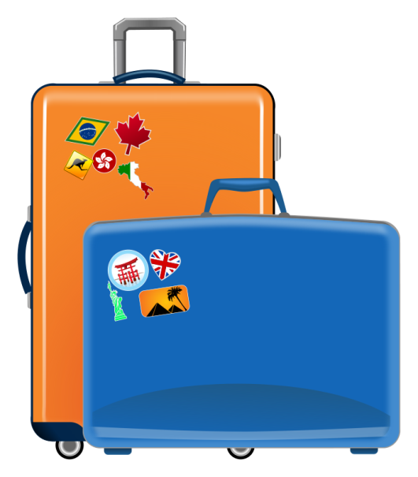
Activity 4 – The logistics of flights
If you choose to fly to another country, you will need to plan the timings of you journey carefully.
You have the following information:
Your flight departs at 09:25
You need to check in 2 hours before departure
It will take you 40 minutes in a taxi to get to the airport.
You need 35 minutes to get ready at home.
What time will you need to get up?
Get up Leave home Check in at airport Flight departs
09:25
35 mins 40 mins 2 hours
06:10
06:45
07:25
You’d have to get up at 06:10, or 6.10 am, to make sure you got your flight on time.

Slide 10
Activity 4 – The logistics of flights
If you choose to fly to another country, you will need to plan the timings of you journey carefully.
You have the following information:
Your flight departs at 18:35
You need to check in 3 hours before departure
It will take you 16 minutes in a taxi to get to the airport.
You estimate you need 45 minutes to pack your suitcase.
What time should you start packing?
Start packing Leave home Check in at airport Flight departs
18:35
45 mins 16 mins 3 hours
14: 34
15:19
15:35
You’d have to start packing at 14:34, or 2.34 pm.

Slide 11
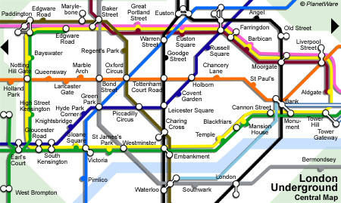
Activity 5 – Planning a trip on the underground
West Brompton to Earl’s Court, Earl’s Court to King’s Cross then King’s Cross to Old Street.
This map shows the central section of the London underground.
Kings Cross
What is the most direct route between West Brompton and Old Street?

Slide 12
Activity 5 – Planning a trip on the underground
Paddington to Embankment then Embankment to Monument.
This map shows the central section of the London underground.
Kings Cross
What is the most direct route between Paddington and Monument?
Why might this route be the quickest, even though it may look longer than other routes?

Slide 13
Activity 5 – Planning a trip on the underground
This map shows the central section of the London underground.
Kings Cross
Can you plan other journeys? What tourist attractions are at each stop?

Slide 14
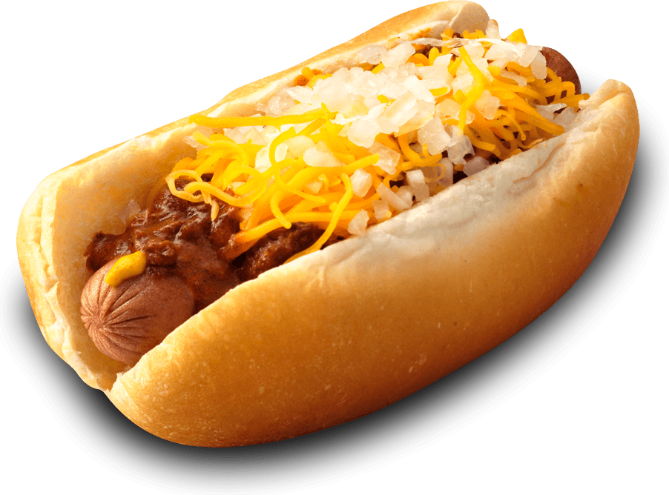
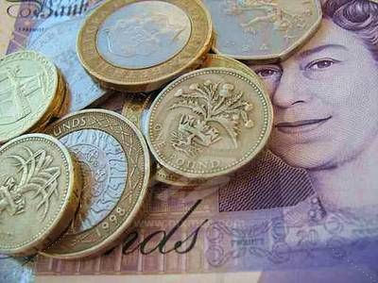
Activity 6 – Exchanging money
If you travel abroad, you often have to change your British money into a foreign currency. It is often cheaper to do this before you get to the airport.
You can look exchange rates up on the internet. The exchange rate showing 10-04-17
You are travelling to the United States and want to change £200 into US Dollars.
How many dollars will you get?
£1 : $1.24
x200
x200
£200 :
$248
You arrive in New York. On your first day of sightseeing you spent $34 visiting the Empire State Building, $29 on a 7 day metro pass, $14.50 on lunch and $2 on a hot dog. How much of the $248 do you have left?
$34 + $29 + $14.50 + $2 = $79.50
$248 - $79.50 = $168.50

Slide 15
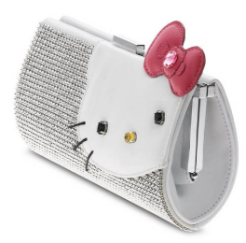
Activity 6 – Exchanging money
If you travel abroad, you often have to change your British money into a foreign currency. It is often cheaper to do this before you get to the airport.
You can look exchange rates up on the internet. The exchange rate showing 10-04-17
You are travelling to Japan and want to change £300 into Japanese Yen.
How many Yen will you get?
£1 : ¥137.85
x300
x300
£300 :
¥41355
You arrive in Tokyo. On your first day of sightseeing you spent ¥900 visiting the Tokyo Tower, ¥1200 on a 2 day subway pass, ¥1500 on lunch and ¥3000 on a Hello Kitty purse. How much of the ¥41355 do you have left?
¥900 + ¥1200 + ¥1500 + ¥3000
= ¥6600
¥41355 - ¥6600 = ¥34755

