Slide 1
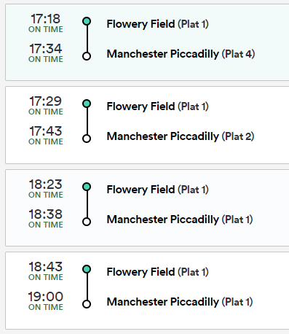
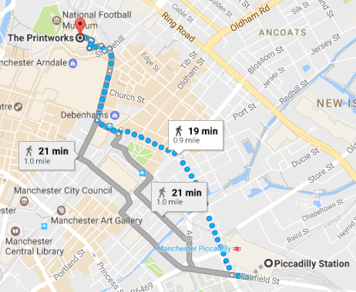
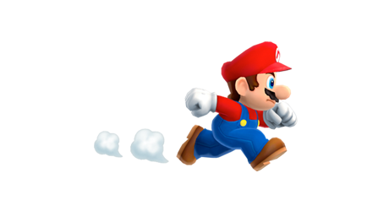
Solving problems with time – Week 1
Mario has booked tickets to see Guardians of the Galaxy 2 at the Printworks at 18 : 45.
He lives 12 minutes walk from Flowery Field station.
What is the latest time he can set off?
What will be his total journey time?

Slide 2
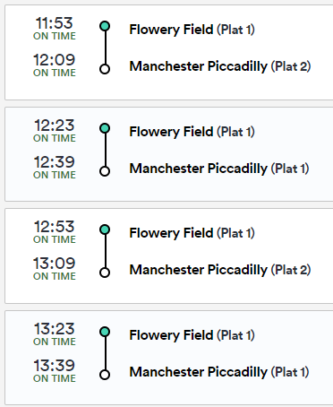
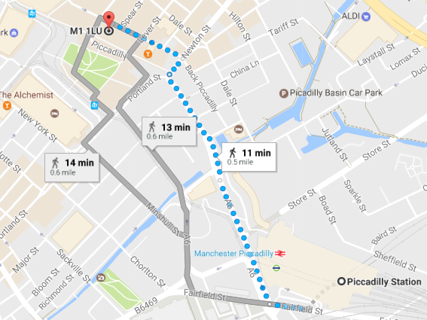
Solving problems with time – Week 2
Mario has booked a table at Nandos at 1.45 pm.
He lives 23 minutes walk from Flowery Field station.
What is the latest time he can set off?
What will be his total journey time?

Slide 3
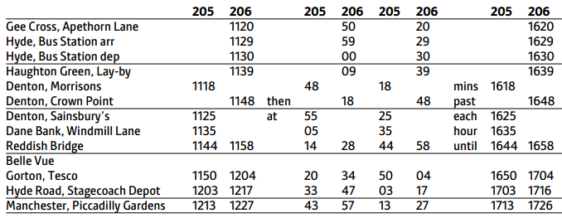
Solving problems with time – Week 3
Adam is going to watch United play at Old Trafford. Kick off is at 15 : 00.
The Old Trafford Stadium is an 11 minute walk from Old Trafford Metrolink.
The Metrolink takes about 13 minutes from Piccadilly Gardens and runs every 12 minutes.
Adam lives 17 minutes walk away from Hyde Bus Station.
What is the latest time he can set off?
What will be his total journey time?

Slide 4
Solving problems with time – Week 4
Syed is going to watch City play at the Etihad. Kick off is at 15 : 00.
He’ll need to allow 15 minutes to get into the stadium once he gets off the Metrolink..
The Metrolink takes about 12 minutes from Piccadilly Gardens and runs every 6 minutes.
Syed lives 7 minutes walk away from Hyde Bus Station.
What is the latest time he can set off?
What will be his total journey time?

Slide 5
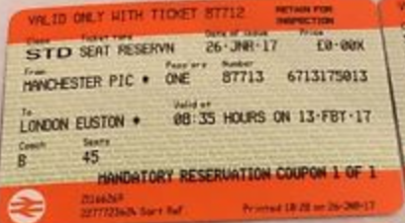
Solving problems with time – Week 5
Farzana is travelling to London to see her cousins.
She has arranged to meet them at Covent Garden at 2.30 pm.
The train journey from Manchester to London Euston takes around 2 hours and 10 minutes.
08 : 35
London Euston
1 minute
She will need to buy a travel card for the Underground at Euston.
Kings Cross St Pancreas (*)
5 minutes
It takes about 5 minutes to exit Covent Garden Station.
* Allow 4 minutes to change platform
Covent Garden
What is the earliest she is able to get for Covent Garden for?

Slide 6
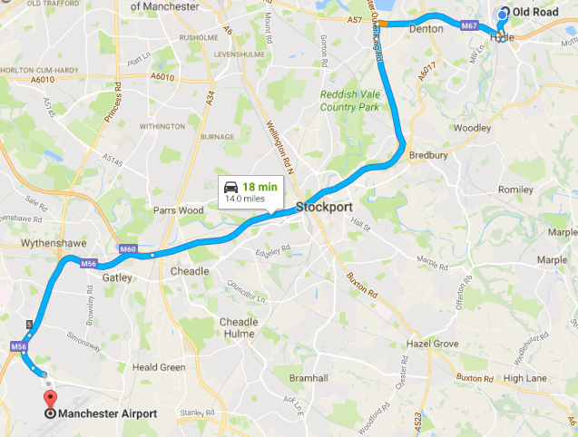
Solving problems with time – Week 6
Bethany is flying to Ibiza in the morning with her family.
They have been told to check in at the airport at least 2 and a half hours before their departure time.
What time should they book their taxi for?

