Slide 1
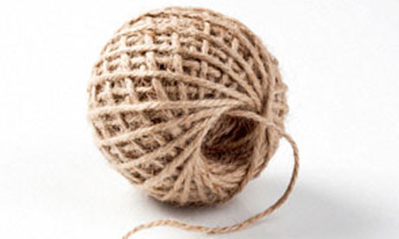
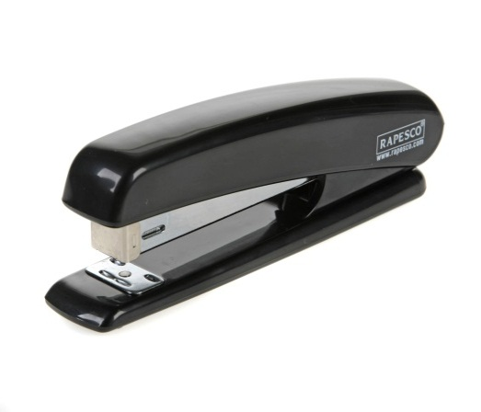
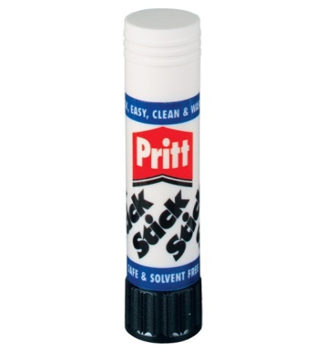
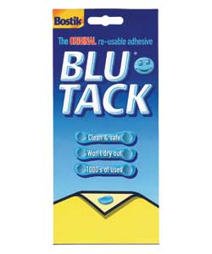
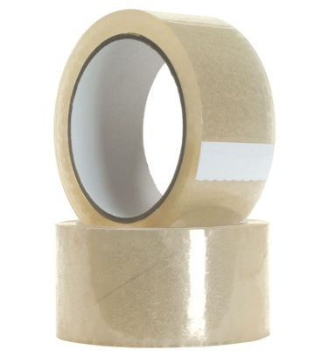
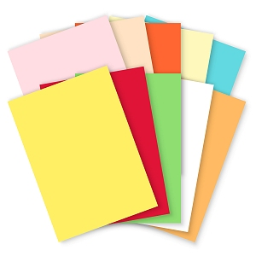
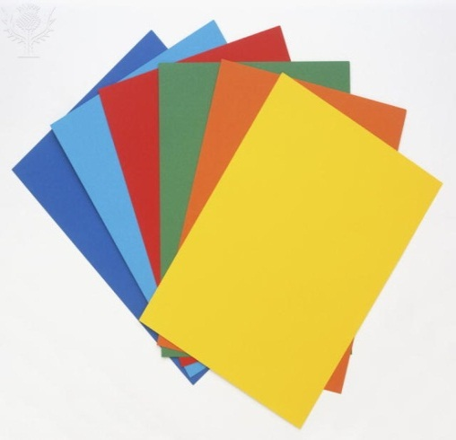
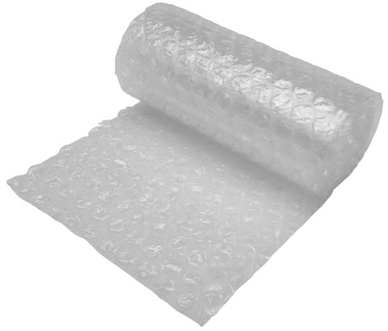
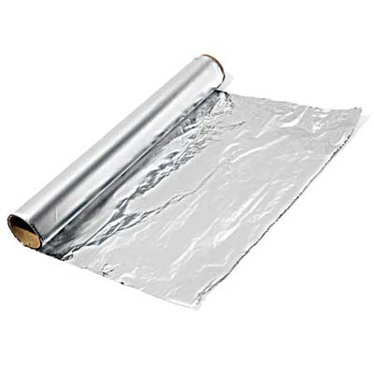
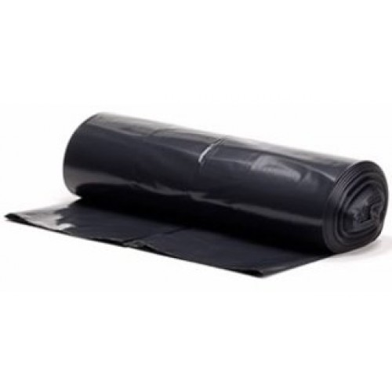
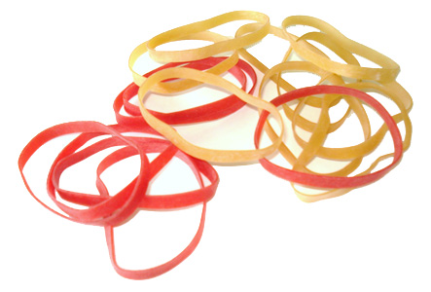
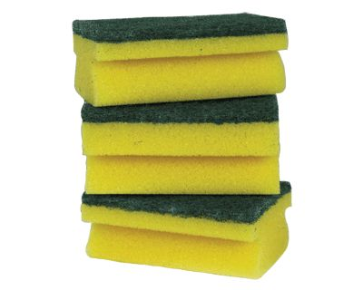
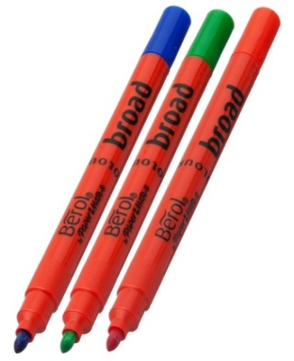
String
(30 cm)
Glue stick
(unlimited use)
Stapler
(unlimited use)
Blue tack
(ball)
£3
£2
£2
£1
£0.25
Tape
(10 cm)
Foil
(One 30x30 cm² sheet)
Bubble
wrap
(One 20x 20 cm² sheet)
Coloured paper
(1 sheet)
£20
£2
£2
Coloured card
(1 sheet)
£2
Sponge
scourer
(1)
£1
£20
£20
Free
Coloured pens
Rubber bands
(per band)
Black bin bag
(1)

