Slide 1

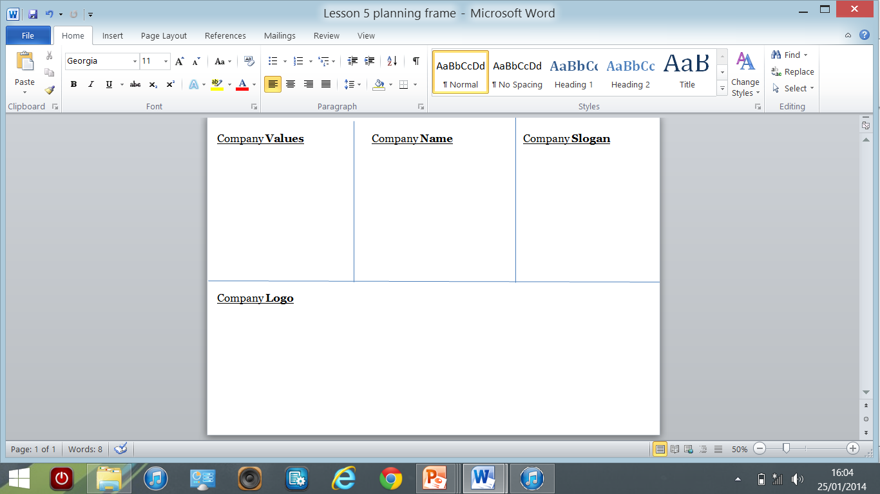
Sit in your teams.
You have some sheets of A3 paper. Put them together and fold them in half to make a booklet. Split up the first page on the inside so it looks like this. Also, write in the sub headings.

Slide 2
First of all…
You are company with nothing. The first thing you need to decide is your company values.
For instance, Google, has a strong belief that their service should be accessible, reliable and innovative – something that has made them incredibly successful.
Considering you need to land an egg onto a new and unknown planet, you have to think about how you can reflect the qualities you might need to succeed in this task.
Try to establish 3 different values. Write this in the correct section.

Slide 3
Task 1 – 5 minutes
Think of a name for your company:
It should be a fairly simple name; something that is memorable and won’t confuse your consumer.
Previous company names have come from many different sources…
Once you have come up with a name, write it on the front of your booklet and in the correct section on the inside page.
Adidas, Hewlett and Packard, Nestle, Renault, Twinings - some come from the name of the person/people founding the company. Adidas is a combination of the founder’s name Adolf ‘Adi’ Dassler.
HSBC, KFC, AOL, WWF – Some use acronyms – the first letter of each word used – for instance, Hong Kong Shanghai Banking Company
Amazon, Pandora, Ajax, Mars, Olympus, Nike – All these are based in mythology, whose Gods often have qualities that reflect the brand.
Compare the market, Go compare, National Rail - Some names simply describe the service of the product or the theme of their industry.

Slide 4
Slogans
Try to work out what company each of these famous slogans is from. (Discuss in your groups – make notes in your booklet if you need to.)
Think different ( _____)
The world’s local bank ( ____)
Taste the rainbow (___________)
Because you are worth it. (______________)
The Power of Dreams (__________)
“Impossible is nothing” (___________)
“Snap! Crackle! Pop!” (__________)
“Finger lickin’ good.” (___________)
“Believe in better” (___________)
“Every little helps” (___________)
"Simples" (____________)
“Once you pop, you just can’t stop” (___________)
Making the unmissable unmissable (___________)
Somethings in life are priceless, for everything else there’s (__________)
Ahhhhhhh (___________)

Slide 5
How did you do?
Companies spend lots of time and invest millions of pounds in making their brand and values recognisable through slogans…have they succeeded?
For each one, think about what message is being conveyed.
What is the slogan trying to say to the consumer?
Think different ( _____) APPLE
The world’s local bank ( ____) HSBC
Taste the rainbow (___________) SKITTLES
Because you are worth it. (______________) LOREAL
The Power of Dreams (__________) HONDA
“Impossible is nothing” (___________) ADIDAS
“Snap! Crackle! Pop!” (__________) RICE KRISPIES
“Finger lickin’ good.” (___________) KFC
“Believe in better” (___________) SKY
“Every little helps” (___________) TESCO
"Simples" (____________) COMPARE THE MARKET
“Once you pop, you just can’t stop” (___________) PRINGLES
Making the unmissable unmissable (___________) BBC IPLAYER
Somethings in life are priceless, for everything else there’s MASTERCARD
Ahhhhhhh BISTO

Slide 6
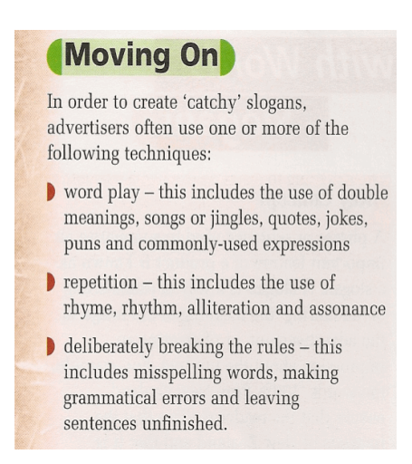
Slogans
Brainstorm as a group
What techniques do slogans use? Did you notice any?
EG. Because you’re worth it uses personal pronouns.
Notes:
Alliteration, rhetorical question, figurative language, short sentences, repetition, rhyme, puns, punctuation changes, unfinished sentences.

Slide 7



Task 2 – 10 minutes
Think of a slogan for your company:
A slogan can use many different language techniques to make it more effective and ultimately more memorable. Many slogans reinforce the values of the company and the service that it offers. Consider the following slogans and the techniques they use.
Once you have a slogan write it in the correct section on the inside page.
1. You'll never put a better bit of butter on your knife. (alliteration of the b sound to make memorable.)
2. Have a break, have a kit-kat. (pun on the word ‘break’.)
4. Taste the rainbow. (Metaphor to emphasise the variety of flavours.)
3. It’s finger lickin’ good!(phonetic spelling to reflect deep south accent.)
5. Snap. Crackle. Pop (Onomatopoeia reflects texture of cereal)

Slide 8

Every company has a logo.
Make a list of features of logos.
Notes:
Font, colour, pictures, size, words,

Slide 9
Task 3 – 10 minutes
Your logo is a symbol of your company and must serve 3 main purposes:
To represent your company;
To distinguish you from competitors;
To communicate to your audience.
Think very carefully about how you can make your logo visually appealing, whilst still reflecting the values of your company. Manipulate the colour, font, size of your logo in order to do this. Make sure you label your drawing.
Draw your logo under your company name on the front of your booklet.

Slide 10
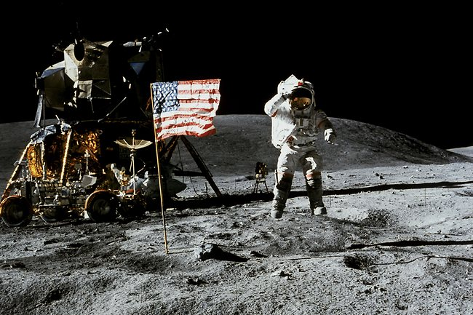

It’s time to design and build your lunar landing module.
You will work in the groups you have already been divided into.
Record your ideas on your i-pad
There are i-pads available for your groups to record photos or videos of your work today.

Slide 11
It’s time to design and build your lunar landing module.
Task 2 (15 minutes)
Use Access FM to get together some ideas (see next slide).
Your lunar landing module needs to land your egg man safely from the top balcony in the school.
It should do this as cheaply as possible.
Egg man likes to travel in style.
Egg man needs to be able to get in and out of the landing module.
Record your ideas on your i-pad

Slide 12
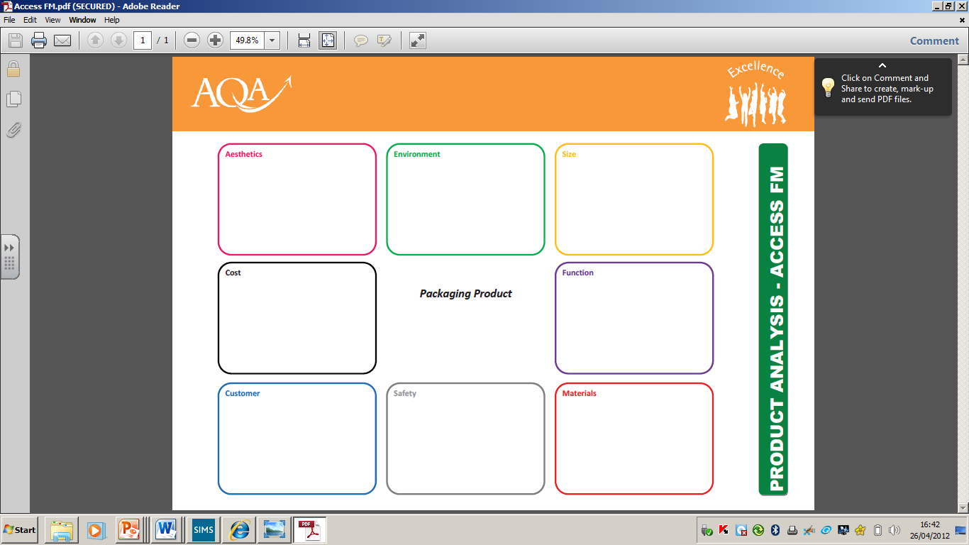
When analysing a product you need to think about certain parts of it. Look at the areas below to guide you to analysing your egg man lunar landing module in detail. Remember… ACCESS FM. Record your ideas in your booklet.
How will it look? The appearance, style?
What can you use or do to make your design environmentally friendly?
How big is it or what
would be the ideal
size and shape?
How much will it cost?
How can you minimise your expenses?
ACCESS FM
What is it meant to do
and will it achieve its
purpose?
Design and Technology
Who is it for?
Who would buy the product?
How will you make it appeal
to this target audience?
What to consider to
make the design safe?
What will it be made from?

Slide 13
Task 3 (2 hours)
You should have already thought about what materials you might like to use for your lunar landing module.
Unfortunately Mrs Elms limited our spending and so the budget is a bit tight.
On the next slide are the materials you will have available to you and their associated costs.
You need to keep to a budget under £45 – but the cheaper you can build your module the better.
Record your ideas on your i-pad

Slide 14

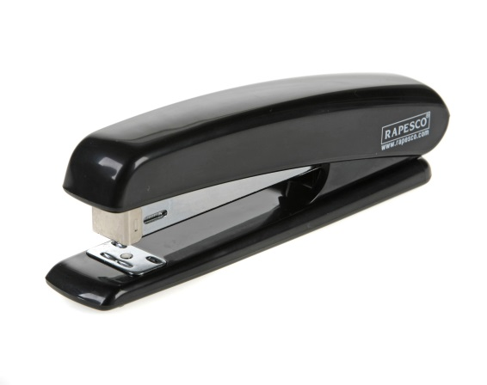
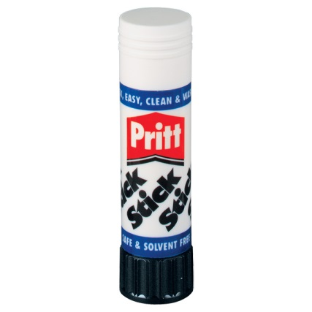
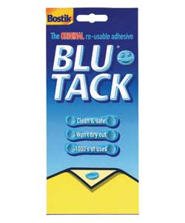
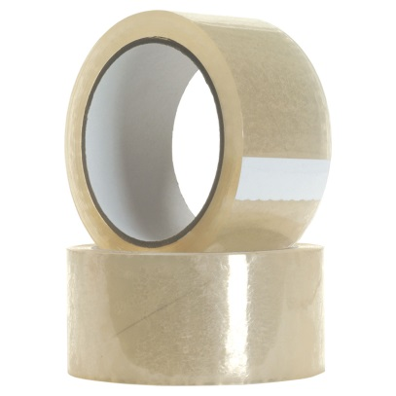

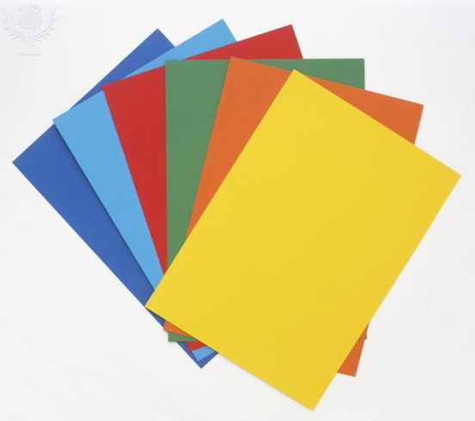

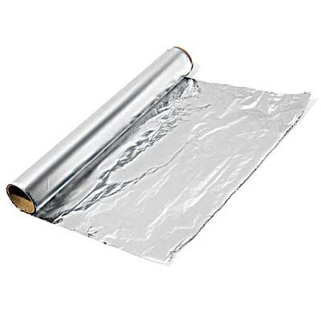
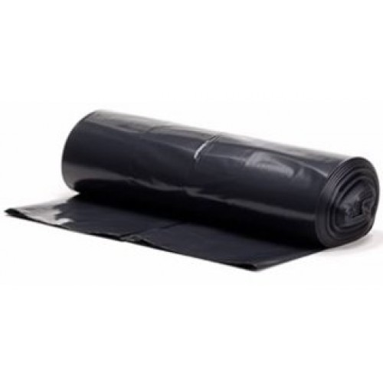
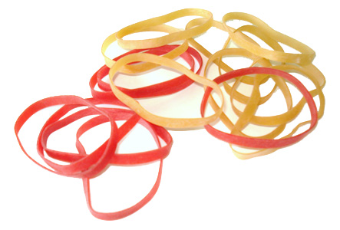
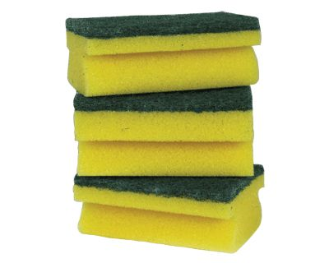
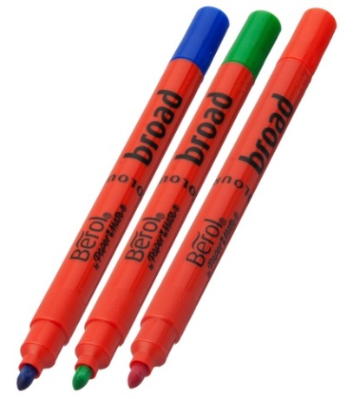
You will need to measure out your own materials
String
(30 cm)
Glue stick
(unlimited use)
Stapler
(unlimited use)
Blue tack
(ball)
£3
£2
£2
£1
£0.25
Tape
(10 cm)
Bubble
wrap
(One 20x20 cm² sheet)
Foil
(One 30x30 cm² sheet)
£2
£2
Coloured card
(1 sheet)
£2
Coloured paper
(1 sheet)
£20
Sponge
scourer
(1)
£1
£20
£20
Free
Coloured pens
Rubber bands
(per band)
Black bin bag
(1)

Slide 15

Task 3 (2 hours)
You have 2 hours to design and build your lunar landing module.
You must submit a design before you start construction – refer to your notes from the previous task when planning out your design. Your final design should have its dimensions clearly marked
It is okay to test, and as a result, modify your design as you go along.
Teachers will be keeping a record of any materials you use and their costs. You must also record your costings in your booklet.
You will need to present your design and its cost to your form at the end of this task. Make sure you have your design clearly outlined in your booklet.
Remember…
Your lunar landing module needs to land your egg man safely from the top balcony in the school.
It should do this as cheaply as possible.
Egg man likes to travel in style.
Egg man needs to be able to get in and out of the landing module.
Record your ideas on your
i-pad

Slide 16
You will need to measure out your own materials
String
(30 cm)
Glue stick
(unlimited use)
Stapler
(unlimited use)
Blue tack
(ball)
£3
£2
£2
£1
£0.25
Tape
(10 cm)
Bubble
wrap
(One 20x20cm² sheet)
Foil
(One 30x30 cm² sheet)
£2
£2
Coloured card
(1 sheet)
£2
Coloured paper
(1 sheet)
£20
Sponge
scourer
(1)
£1
£20
£20
Free
Coloured pens
Rubber bands
(per band)
Black bin bag
(1)

Slide 17
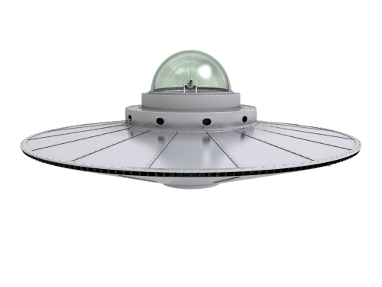

Finished? Check list…
Does your booklet have your team name and logo clearly on the front?
Are your team values outlined at the front of your booklet?
Do you have a team slogan?
Does your booklet have notes (based on ACCESS FM) outlying your design’s key features?
Have you drawn and clearly labelled your design?
Does your design have its dimensions clearly marked?
Are the costings for your design clearly laid out?
Is there a way for egg man to get in and out of your design?
Got extra time?
Weigh your design. Work out the cost/weight ratio.
Make notes on how you could improve your design.
Interview your team members (using an i-pad) about the design.
Google some real landing module pictures on the internet and print them off to add into your booklet.

Slide 18
Task 4 (30 minutes)
You will have 30 minutes to prepare a presentation for the rest of your form, that outlines the key aspects of your brand and design.
Your form will have a vote, and the winner will be the only nomination from your form to have an opportunity to drop their shuttle from the top floor.
If you want to see how successful your shuttle is, then your presentation is a key part of the day to focus on.

Slide 19
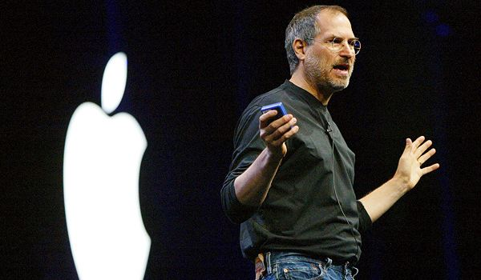
The rules
Stand up at the front
Everyone must say something
Face the class
Speak clearly and confidently
Use hand gestures and body language to express yourselves
Know what you are going to say (roughly) before you present.

Slide 20
Introduce the team and the brand?
Explain how you generated your team name, brand slogan and logo?
Explain how your shuttle will succeed and describe any doubts you might have?
What do we have to say?
Discuss things you might have done differently.
Explain your design choices and how they benefit the task?
Describe any problems you encountered and how you overcame them?

Slide 21
Presentations and Voting
(30 minutes)
Use a page in your booklet to assess each presentation, so that you have something to look over in the final event. You should set it out like this:
Team name | Branding /10 | Design /10 | Shuttle construction /10 | Presentation /10 | Total

Slide 22
Judgement time….
Task 5
Your form’s winning design will be tested after lunch against the other forms.
Meet in the activities studio to hear the presentations.
All the winning designs will first present their ideas and then we will test the landing modules.
If more than one egg survives, the landing module that cost the least to build will win.

