Slide 1
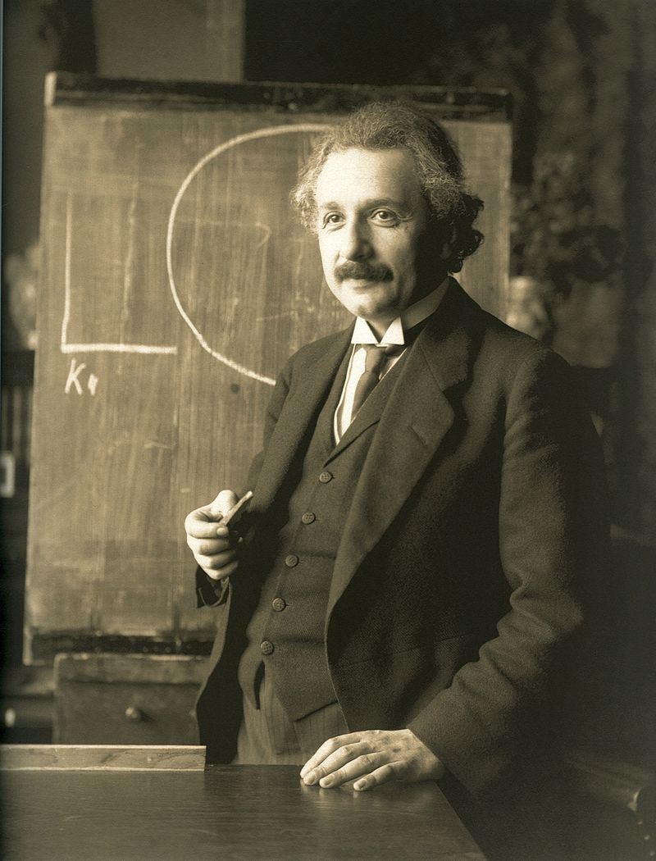
Famous Mathematicians
This half-term the numeracy activities will test what you know about some famous mathematicians.
This week’s mathematician is…
Albert Einstein

Slide 2
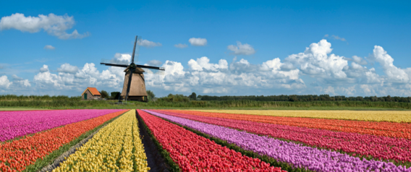
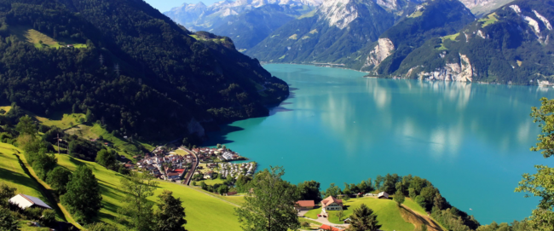
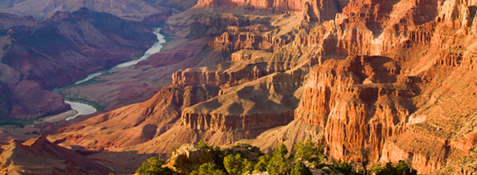
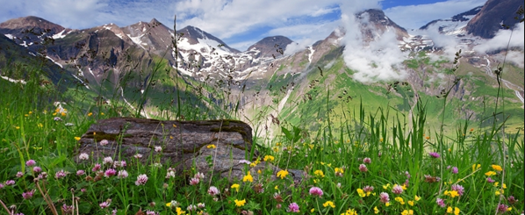
Question 1
Which country was Einstein from?
A: Holland
B: Switzerland
C: U.S.A
D: Germany

Slide 3
Question 2
Having initially only gone there for a visit, where did Einstein decide to stay and spend his life in 1933?
A: Holland
B: Switzerland
C: U.S.A
D: Germany

Slide 4
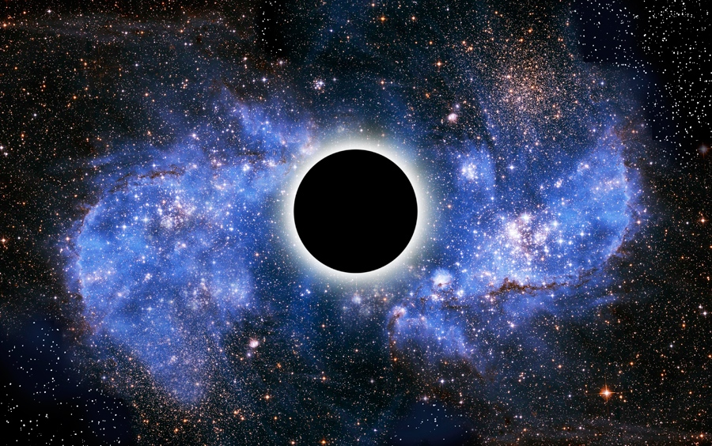
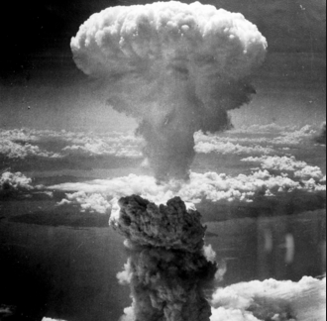
Question 3
Which theory, named as one of the two pillars of modern Physics and based on an understanding of gravity, did Einstein develop?
A: Quantum Mechanics
B: The General Theory of Relativity
C: Heliocentrism
D: Plate tectonics

Slide 5
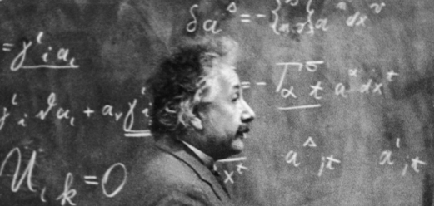
Question 4
In Einstein’s famous equation, E = mc², “E” stands for energy and “m” for mass. What does “c” stand for?
A: Atomic mass units
B: Half life
C: Acceleration due to gravity
D: The speed of light

Slide 6
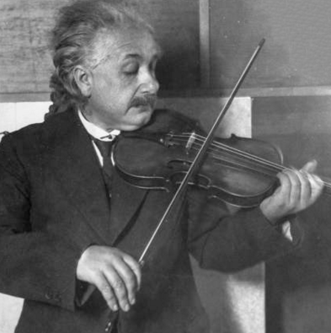
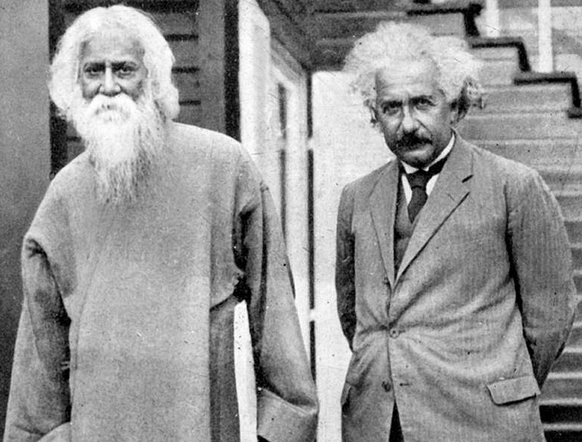
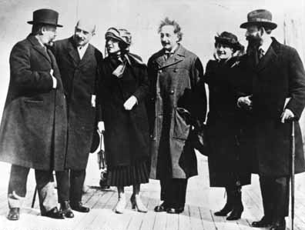
Question 5
Einstein refused surgery to try to prolong his life saying,
“I want to go when I want. It is tasteless to prolong life artificially. I have done my share, it is time to go. I will do it elegantly.”
He died in 1955 at the age of 76. In what year was he born?
A: 1921
B: 1879
C: 1881
D: 1876

Slide 7
Question 1 - ANSWERS
Which country was Einstein from?
A: Holland
B: Switzerland
C: U.S.A
D: Germany

Slide 8
Question 2 - ANSWERS
Having initially only gone there for a visit, where did Einstein decide to stay and spend his life in 1933?
During his visit to the U.S.A in 1933 Einstein learned that Hilter had banned all Jews from academic institutions in Germany. As a Jew, Einstein’s publications and books were being burned in Germany and he would have had no future as an academic had he returned there.
A: Holland
B: Switzerland
C: U.S.A
D: Germany

Slide 9
Question 3 - ANSWERS
Which theory, named as one of the two pillars of modern Physics and based on an understanding of gravity, did Einstein develop?
Einstein’s research led to the development of Nuclear weapons in the U.S.A.
A: Quantum Mechanics
B: The General Theory of Relativity
C: Heliocentrism
D: Plate tectonics

Slide 10
Question 4 - ANSWERS
In Einstein’s famous equation, E = mc², “E” stands for energy and “m” for mass. What does “c” stand for?
A: Atomic mass units
B: Half life
C: Acceleration due to gravity
D: The speed of light

Slide 11
Question 5 - ANSWERS
Einstein refused surgery to try to prolong his life saying,
“I want to go when I want. It is tasteless to prolong life artificially. I have done my share, it is time to go. I will do it elegantly.”
He died in 1955 at the age of 76. In what year was he born?
A: 1921
B: 1879
C: 1881
D: 1876

