Slide 1
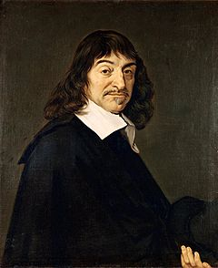
Famous Mathematicians
This half-term the numeracy activities will test what you know about some famous mathematicians.
This week’s mathematician is…
René Descartes

Slide 2
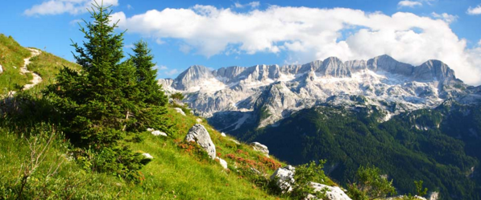
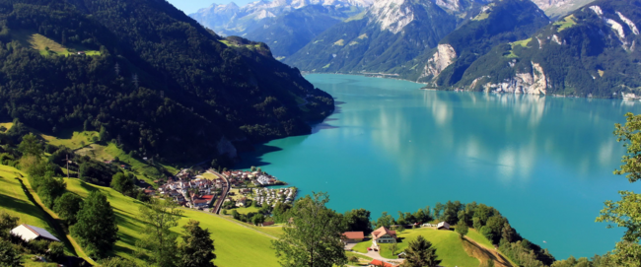
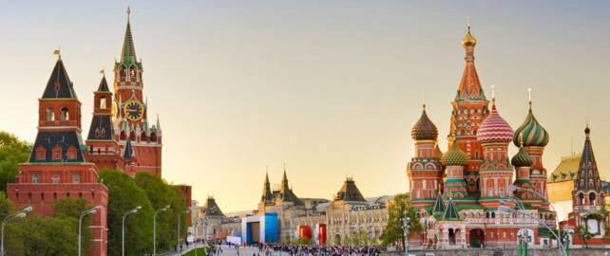
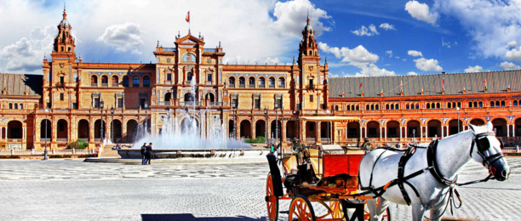
Question 1
Where was René Descartes from?
A: France
B: Switzerland
C: Russia
D: Spain

Slide 3
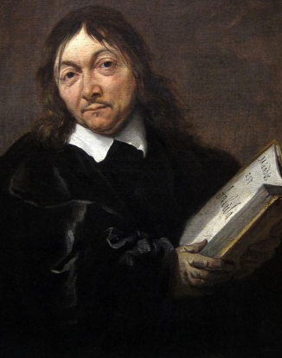
Question 2
Descartes was a famous Mathematician and Scientist.
However, he is also known as ….
A: The father of communism
B: The father of the industrial revolution
C: The father of modern medicine
D: The father of modern Western philosophy

Slide 4
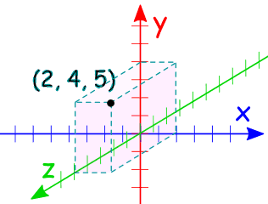
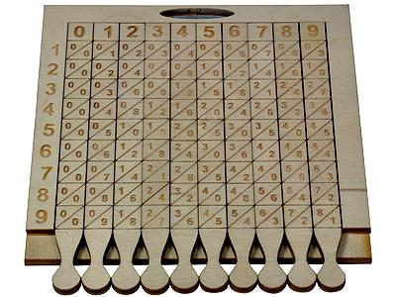
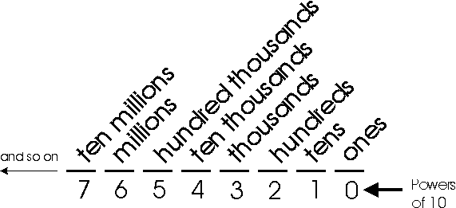
Question 3
One of Descartes most famous achievements was his development of ….
A: The idea of functions
B: The coordinate system
C: Multiplication strategies
D: The decimal system

Slide 5
Question 4
Descartes pioneered the use of…
A: Indices
B: The square root sign
$${x×x×x×x=x}^{4}$$
$$\sqrt{16}=4$$
C: Pi (π)
D: Standard form
$$π=3.14159…$$
$$126800000=1.28 ×{10}^{8}$$

Slide 6
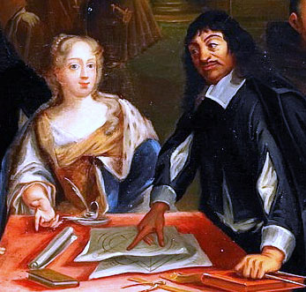
Question 5
Descartes died in 1650, apparently from pneumonia.
What other theory has been suggested for his death?
A: That he was killed by the jealous husband of Queen Christina of Sweden whom he tutored.
B: That he was assassinated on the orders of Queen Christina due to differences between them.
C: That he accidentally drunk poison intended for Queen Christina
D: That he committed suicide due to his unrequited love for Queen Christina.

Slide 7
Question 1 - ANSWERS
Where was René Descartes from?
A: France
B: Switzerland
C: Russia
D: Spain

Slide 8
Question 2 - ANSWERS
Descartes was a famous Mathematician and Scientist.
However, he is also known as ….
A: The father of communism
B: The father of the industrial revolution
C: The father of modern medicine
D: The father of modern Western philosophy

Slide 9
Question 3 - ANSWERS
One of Descartes most famous achievements was his development of ….
A: The idea of functions
B: The coordinate system
C: Multiplication strategies
D: The decimal system
The Cartesian system of coordinates is named after him.

Slide 10
Question 4 - ANSWERS
Descartes pioneered the use of…
A: Indices
B: The square root sign
$${x×x×x×x=x}^{4}$$
$$\sqrt{16}=4$$
C: Pi (π)
D: Standard form
$$π=3.14159…$$
$$126800000=1.28 ×{10}^{8}$$

Slide 11
Question 5 - ANSWERS
Descartes died in 1650, apparently from pneumonia.
What other theory has been suggested for his death?
A: That he was killed by the jealous husband of Queen Christina of Sweden whom he tutored.
B: That he was assassinated on the orders of Queen Christina due to differences between them.
C: That he accidentally drunk poison intended for Queen Christina
Apparently she did not like his Mechanical Philosophy, and he did not appreciate her interest in Ancient Greek.
D: That he committed suicide due to his unrequited love for Queen Christina.

