Slide 1
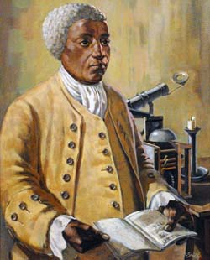
Famous Mathematicians
This half-term the numeracy activities will test what you know about some famous mathematicians.
This week’s mathematician is…
Benjamin Banneker

Slide 2
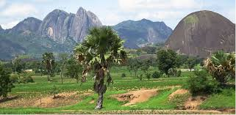
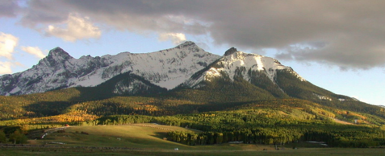
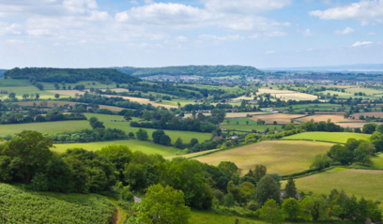
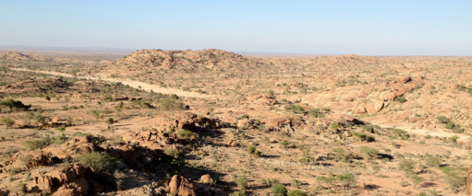
Question 1
Where was Benjamin Banneker from?
A: Nigeria
B: The USA
C: England
D: Somalia

Slide 3
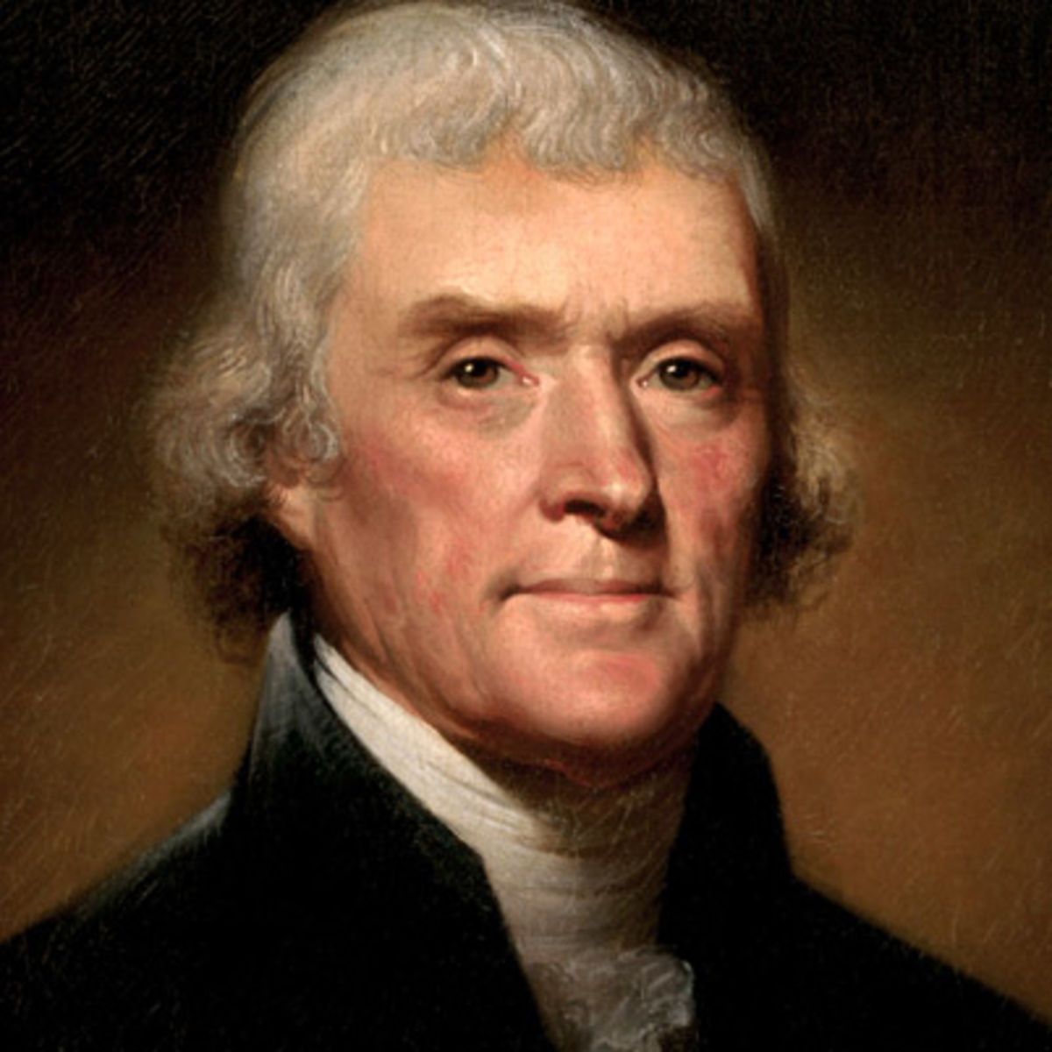
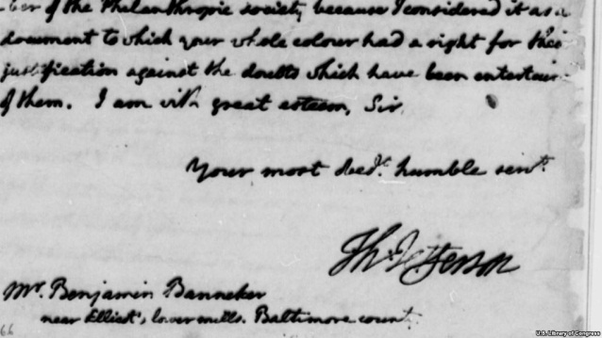
Question 2
Benjamin Banneker lived from 1731 to 1806. Which American president did Banneker correspond with on the topics of slavery and racial equality?
A: George Washington
B: Thomas Jefferson
C: Abraham Lincoln
D: Woodrow Wilson

Slide 4
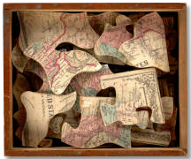
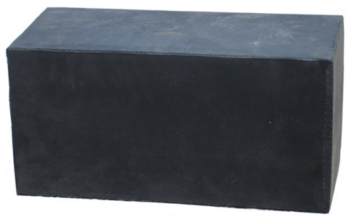
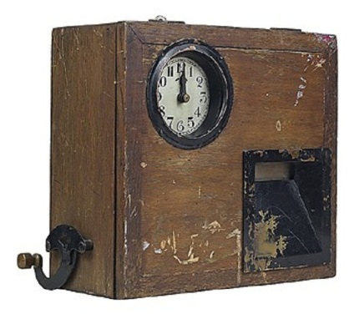
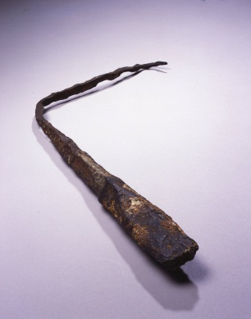
Question 3
At the age of 22, Banneker invented which of the following:
A: The first jigsaw puzzle
B: The first rubber (eraser)
C: A wooden clock that struck on the hour
D: A lightening conductor

Slide 5
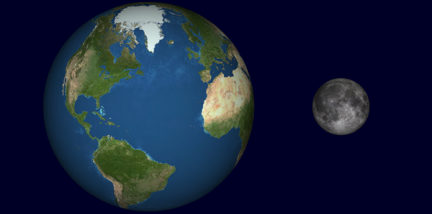
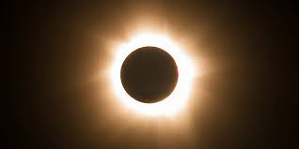
Question 4
Banneker became famous for his Mathematical calculations predicting which of the following…?
A: The speed of light
B: Pi (π)
C: The radius of the Earth
D: Solar and lunar eclipses

Slide 6
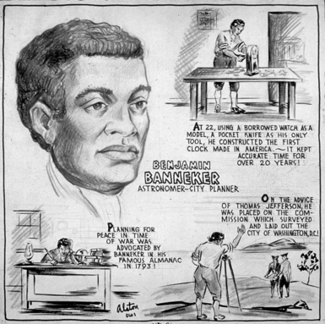
Question 5
Banneker died at the age of 74. Which of the following may well have contributed to his death?
A: Drug abuse
B: Chronic alcoholism
C: Malaria
D: Poor diet

Slide 7
Question 1 - ANSWERS
Where was Benjamin Banneker from?
A: Nigeria
B: The USA
C: England
D: Somalia

Slide 8
Question 2
Benjamin Banneker lived from 1731 to 1806. Which American president did Banneker correspond with on the topics of slavery and racial equality?
A: George Washington
B: Thomas Jefferson
C: Abraham Lincoln
D: Woodrow Wilson
Banneker worked with Jefferson to survey and work out the boundaries of Washington D.C.

Slide 9
Question 3
At the age of 22, Banneker invented which of the following:
A: The first jigsaw puzzle
B: The first rubber (eraser)
C: A wooden clock that struck on the hour
D: A lightening conductor

Slide 10
Question 4
Banneker became famous for his Mathematical calculations predicting which of the following…?
A: The speed of light
B: Pi (π)
Banneker made money by publishing much of his work on astronomy,
C: The radius of the Earth
D: Solar and lunar eclipses

Slide 11
Question 5
Banneker died at the age of 74. Which of the following may well have contributed to his death?
A: Drug abuse
B: Chronic alcoholism
C: Malaria
D: Poor diet

