Slide 1
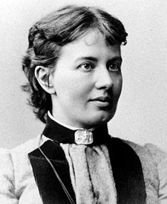
Famous Mathematicians
This half-term the numeracy activities will test what you know about some famous mathematicians.
This week’s mathematician is…
Sophie Germain

Slide 2
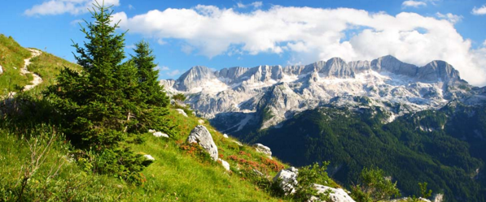
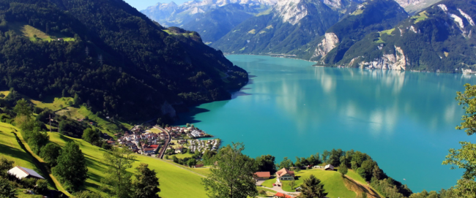
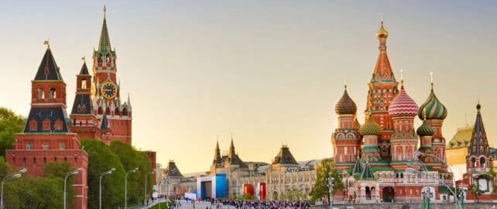
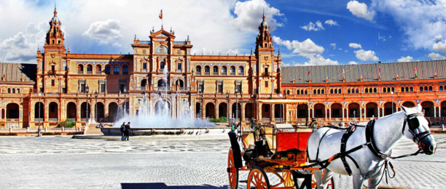
Question 1
Where was Sophie Germain from?
A: France
B: Switzerland
C: Russia
D: Spain

Slide 3
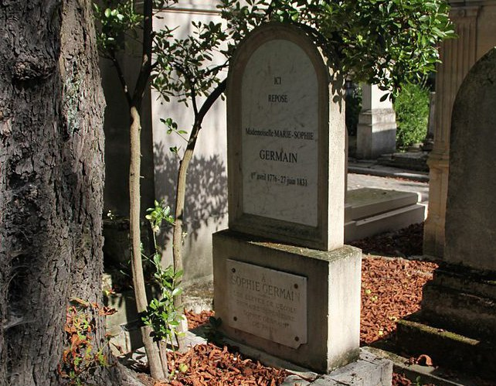
Question 2
Sophie Germain lived from 1776 to 1831. How old was she when she died?
A: 47
B: 45
C: 55
D: 57

Slide 4
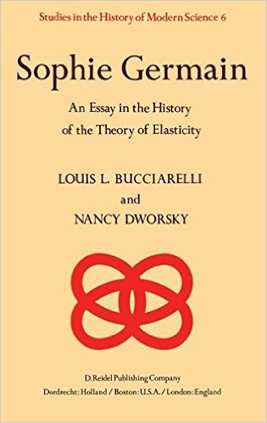
Question 3
Germain was one of the pioneers of “Elasticity theory.”
But what is elasticity?
A: The ability of solid objects to regain their original shape after a force has been removed.
B: A measurement of the height to which objects will bounce when thrown.
C: A measurement of how far an object can be stretched.
D: The ability of objects to attract each other due to their mass.

Slide 5
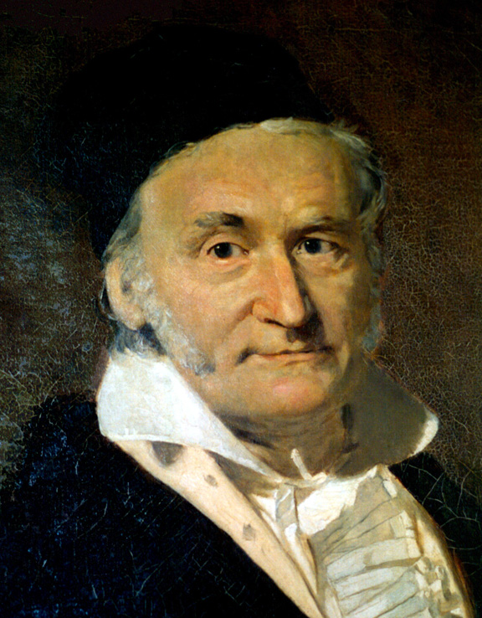
Question 4
Germain was discriminated against during her lifetime because she was a woman. She submitted much of her work under a male pseudonym, Monsier le Blanc. Which Mathematician wrote this about her when he discovered her true identity?
“How can I describe my astonishment and admiration on seeing my esteemed correspondent M leBlanc metamorphosed into this celebrated person. . . when a woman, because of her sex, our customs and prejudices, encounters infinitely more obstacles than men in familiarising herself with [number theory's] knotty problems, yet overcomes these fetters and penetrates that which is most hidden, she doubtless has the most noble courage, extraordinary talent, and superior genius.”
A: Descartes
B: Napier
C: Euler
D: Gauss

Slide 6
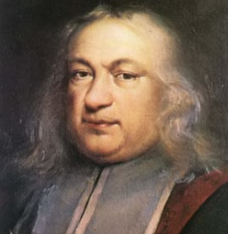
Question 5
Sophie Germain attempted to prove “Fermatt’s Last Theorem”, her work laying the foundation for further study on the subject for hundreds of years to come. Which modern day Mathematician has recently been awarded a prize for his work in proving it?
A: Andrew Wiles
No three positive integers a, b, and c satisfy the equation
a^{n} + b^{n} = c^{n}
for any integer value of n strictly greater than two.
B: Elon Lindenstrauss
C: Yurij Manin
D: Terence Tao

Slide 7
Question 1 - ANSWERS
Where was Sophie Germain from?
A: France
B: Switzerland
C: Russia
D: Spain

Slide 8
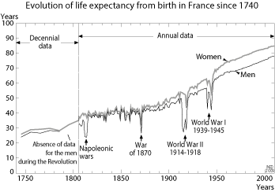
Question 2 - ANSWERS
Sophie Germain lived from 1776 to 1831. How old was she when she died?
A: 47
B: 45
C: 55
D: 57
Not bad considering the average life expectancy for a woman in France was about 40 at the time.

Slide 9
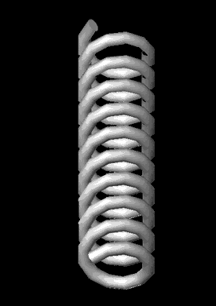
Question 3 - ANSWERS
Germain was one of the pioneers of “Elasticity theory.”
But what is elasticity?
A: The ability of solid objects to regain their original shape after a force has been removed.
B: A measurement of the height to which objects will bounce when thrown.
C: A measurement of how far an object can be stretched.
D: The ability of objects to attract each other due to their mass.

Slide 10
Question 4 - ANSWERS
Germain was discriminated against during her lifetime because she was a woman. She submitted much of her work under a male pseudonym, Monsier le Blanc. Which Mathematician wrote this about her when he discovered her true identity?
“How can I describe my astonishment and admiration on seeing my esteemed correspondent M leBlanc metamorphosed into this celebrated person. . . when a woman, because of her sex, our customs and prejudices, encounters infinitely more obstacles than men in familiarising herself with [number theory's] knotty problems, yet overcomes these fetters and penetrates that which is most hidden, she doubtless has the most noble courage, extraordinary talent, and superior genius.”
A: Descartes
B: Napier
C: Euler
D: Gauss
Carl Gauss was a German Mathematician (1777-1855)

Slide 11
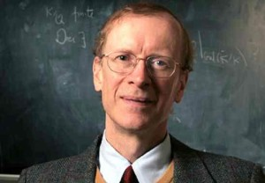
Question 5 - ANSWERS
Sophie Germain attempted to prove “Fermatt’s Last Theorem”, her work laying the foundation for further study on the subject for hundreds of years to come. Which modern day Mathematician has recently been awarded a prize for his work in proving it?
A: Andrew Wiles
No three positive integers a, b, and c satisfy the equation
a^{n} + b^{n} = c^{n}
for any integer value of n strictly greater than two.
B: Elon Lindenstrauss
C: Yurij Manin
D: Terence Tao
Fermatt, A French lawyer and Mathematician (1607-1665)
Andrew Wiles, a British Mathematician. (1953 – )

