Slide 1
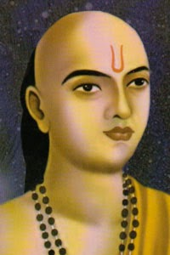
Famous Mathematicians
This half-term the numeracy activities will test what you know about some famous mathematicians.
This week’s mathematician is…
Aryabhata

Slide 2
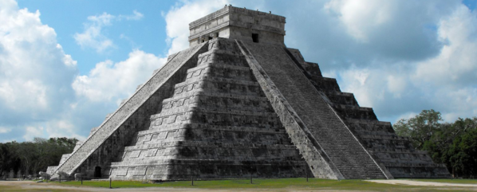
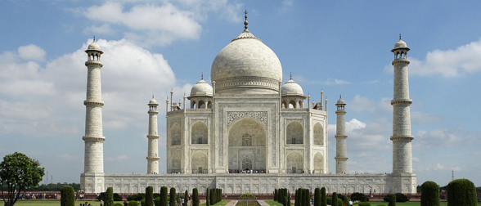

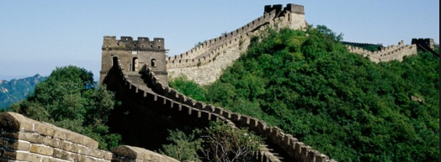
Question 1
Born about 476, which country was Aryabhata from?
A: Mexico
B: India
C: China
D: Thailand

Slide 3
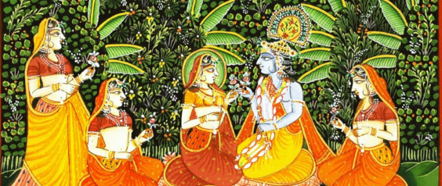
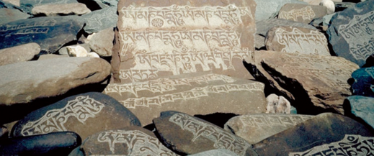
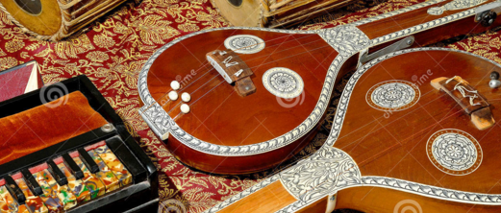
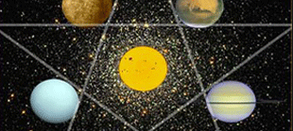
Question 2
Aryabhata is well known for his work on Mathematics.
What other subject is he well known for?
A: Art
B: Science
C: Music
D: Astronomy

Slide 4
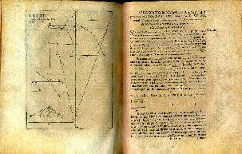
Question 3
Aryabhata wrote,
“Add four to 100, multiply by eight, and then add 62,000. By this rule the circumference of a circle with a diameter of 20,000 can be approached."
What number does this help us gain an approximate value for?
A: The golden ratio, ϕ
B: Pi, π
C: Euler’s number, e
D: The square root of 2

Slide 5
Question 4
Aryabhata also wrote,
“for a ___________, the result of a perpendicular with the half-side is the area.“
What is the missing word?
A: Parallelogram
B: Rhombus
C: Triangle
D: Trapezium

Slide 6


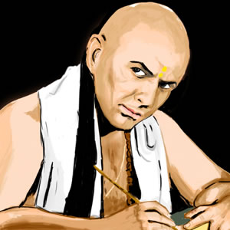
Question 5
Aryabhata provided results for the summation of square and cube numbers. What is the sum of the first four square numbers?
A: 576
B: 100
C: 10
D: 30

Slide 7
Question 1 - ANSWERS
Born about 476, which country was Aryabhata from?
A: Mexico
B: India
C: China
D: Thailand

Slide 8
Question 2 - ANSWERS
Aryabhata is well known for his work on Mathematics.
What other subject is he well known for?
A: Art
B: Science
C: Music
D: Astronomy

Slide 9
Question 3 - ANSWERS
Aryabhata wrote,
“Add four to 100, multiply by eight, and then add 62,000. By this rule the circumference of a circle with a diameter of 20,000 can be approached."
What number does this help us gain an approximate value for?
A: The golden ratio, ϕ
B: Pi, π
C: Euler’s number, e
D: The square root of 2
π = circumference ÷ diameter

Slide 10
Question 4
Aryabhata also wrote,
“for a ___________, the result of a perpendicular with the half-side is the area.“
What is the missing word?
A: Parallelogram
B: Rhombus
C: Triangle
D: Trapezium
Area (triangle) = ½ base x height

Slide 11
Question 5
Aryabhata provided results for the summation of square and cube numbers. What is the sum of the first four square numbers?
A: 576
B: 100
C: 10
D: 30
1 + 4 + 9 + 16 = 30

