Slide 1
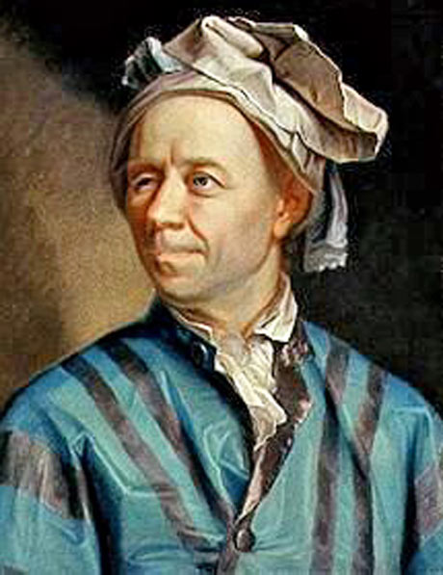
Famous Mathematicians
This half-term the numeracy activities will test what you know about some famous mathematicians.
This week’s mathematician is…
Leonard Euler

Slide 2
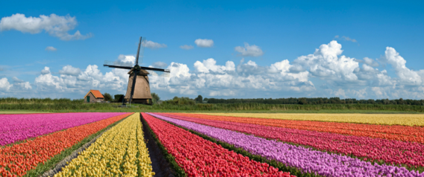
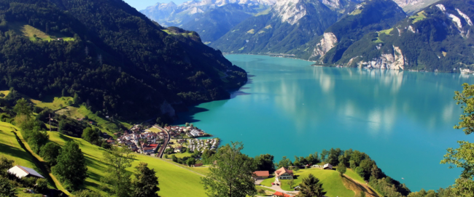
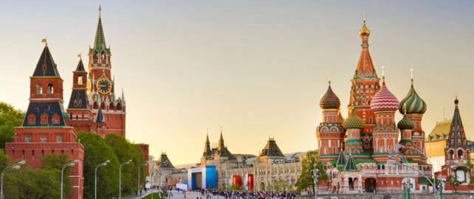
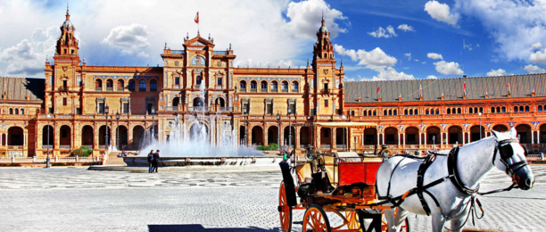
Question 1
Which country was Euler from?
A: Holland
B: Switzerland
C: Russia
D: Spain

Slide 3
Question 2
Where did Euler carry out much of his Mathematical research, getting very well paid in the process?
A: Holland
B: Switzerland
C: Russia
D: Spain

Slide 4
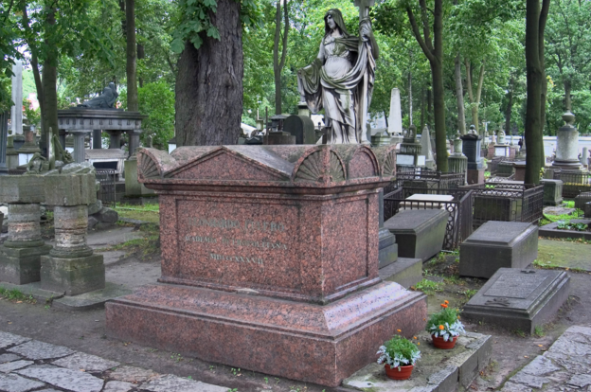
Question 3
Euler lived from 1707 to 1783. What caused his death at the age of 76?
A: Suicide
B: A heart attack
C: A brain haemorrhage
D: Poisoning

Slide 5
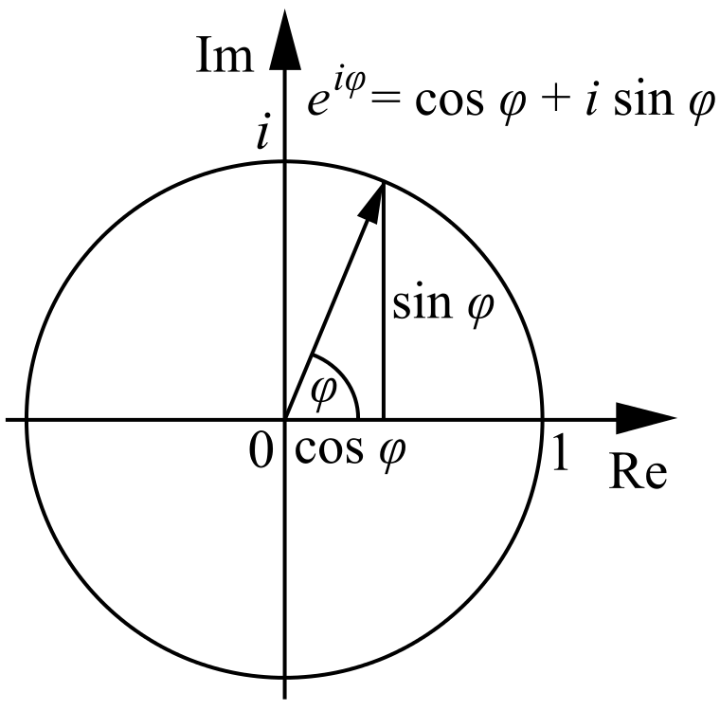
Question 4
Euler is known as one of the greatest Mathematicians of all time.
He is the only Mathematician to have two numbers named after him.
One of these is the Euler–Mascheroni constant (approximately 0.57721). The other is Euler’s number, “e”.
What is the approximate value of “e”?
A: 2.71828…
B: 1.41421…
C: 3.14159….
D: 1.61803…

Slide 6
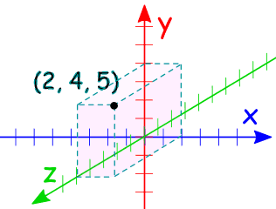
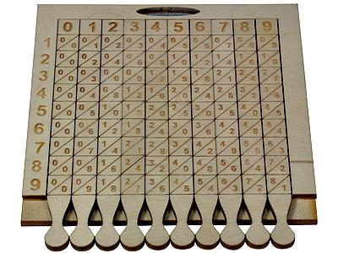
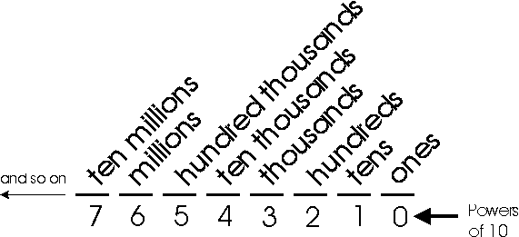
Question 5
Euler is famous for developing several branches of Mathematics. Which one of these did he develop?
A: The idea of functions
B: The coordinate system
C: Multiplication strategies
D: The decimal system

Slide 7
Question 1 - ANSWERS
Which country was Euler from?
A: Holland
B: Switzerland
C: Russia
D: Spain

Slide 8
Question 2 - ANSWERS
Where did Euler carry out much of his Mathematical research, getting very well paid in the process?
A: Holland
B: Switzerland
C: Russia
D: Spain

Slide 9
Question 3 - ANSWERS
Euler lived from 1707 to 1783. What caused his death at the age of 76?
A: Suicide
B: A heart attack
C: A brain haemorrhage
D: Poisoning
He had just had a very nice lunch and was discussing the discovery of the planet Uranus at the time.

Slide 10
Question 4 - ANSWERS
Euler is known as one of the greatest Mathematicians of all time.
He is the only Mathematician to have two numbers named after him.
One of these is the Euler–Mascheroni constant (approximately 0.57721). The other is Euler’s number, “e”.
What is the approximate value of “e”?
A: 2.71828…
B: 1.41421…
√2
C: 3.14159….
π (Pi)
D: 1.61803…
Φ (Golden ratio)

Slide 11
Question 5 - ANSWERS
Euler is famous for developing several branches of Mathematics. Which one of these did he develop?
A: The idea of functions
B: The coordinate system
Descartes, a French Mathematician, developed the cartesian coordinate system.
C: Multiplication strategies
D: The decimal system
Napier developed this calculating machine, known as Napier’s bones.
The decimal system was developed in the Middle East and then India.

