Slide 1
Numbers in sport

Slide 2
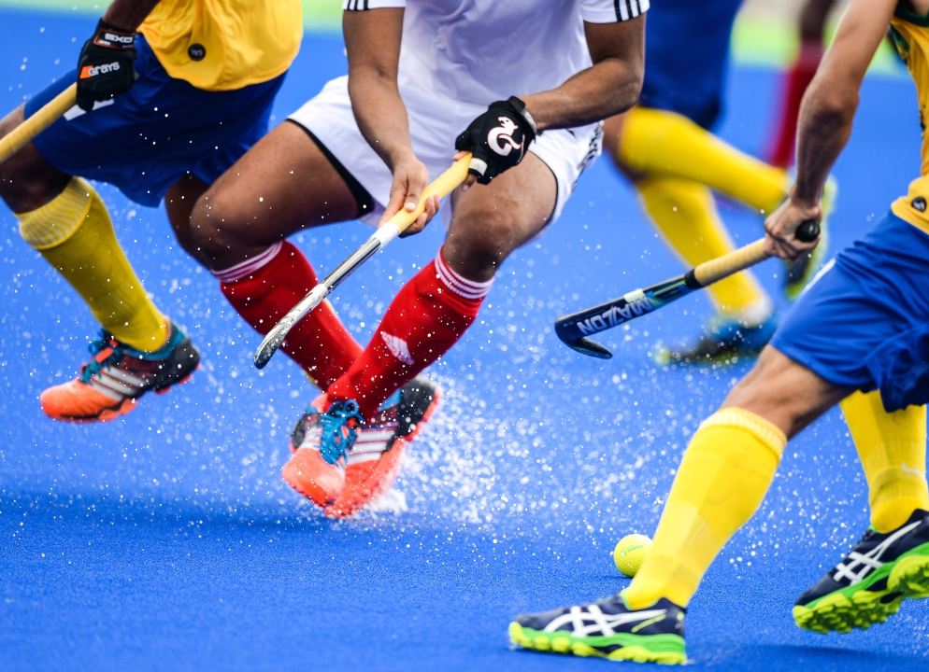
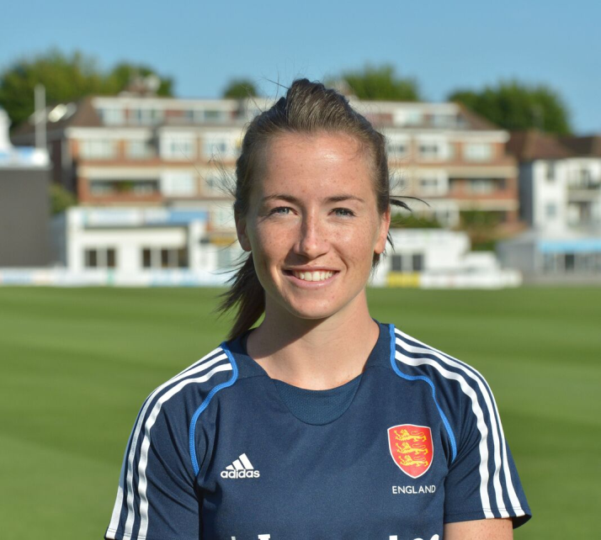
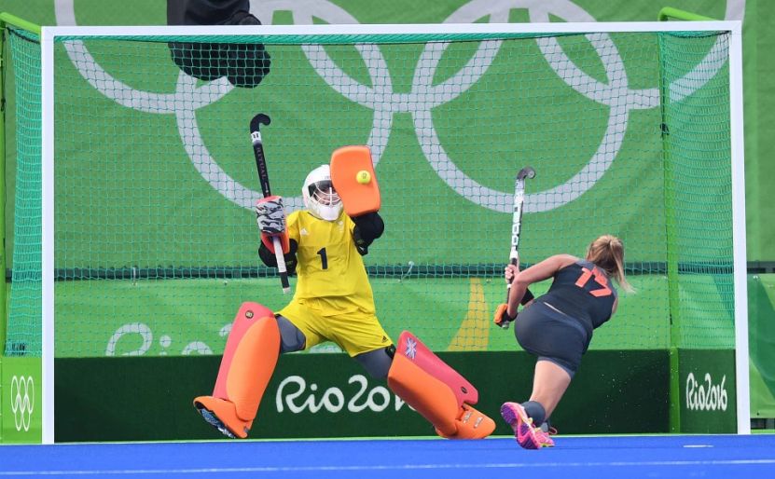
Hockey – the importance of probability
A surprise medal for Team GB in the Rio 2016 Olympics was the Women’s Gold.
While the focus on team sports such as hockey is often on who scores the goals, one of the real heroes of the women’s team was their Goal Keeper, Maddie Hinch, who used probability to secure victory in the penalty shoot out.
Maddie had a little black book, which analysed how each player in the opposing Dutch team had taken penalty shots in the past.
This allowed her to predict how they would take the shots in the penalty shoot out. She ended up saving all the shots at goal. In her words,
“The notebook is purely for the shoot-out. In there I have the players that I think will step up and for each of those players I have a plan of what I will do against them. Under pressure players tend to resort to what they know best, so I come up with a plan and that gives me confidence.”

Slide 3







Hockey – the importance of probability
The table shows how many goals some of the GB players have scored for their team internationally, and how many international matches they have played in.
(August 2016 data)
Based on this, what is an estimate for the probability of each player scoring a goal in an international match they play in?
Player | Position | Matches played (caps) | Number of goals | Prob. scoring a goal
Sophie Bray | Forward | 37 | 14
Giselle Ansley | Defender | 34 | 3
Hannah Macleod | Forward | 65 | 8
Lily Owlsley | Forward | 39 | 9
Helen Richardson-Walsh | Midfielder | 127 | 20
Kate Richardson-Walsh | Defender | 149 | 10
Hollie Webb | Defender | 48 | 2
$$\frac{14}{37}$$
$$\frac{3}{34}$$
$$\frac{8}{65}$$
$$\frac{9}{39}$$
$$\frac{20}{127}$$
$$\frac{10}{149}$$
$$\frac{2}{48}$$

Slide 4







Hockey – the importance of probability
These probabilities are quite hard to compare, by converting the fractions to decimals it is easier to compare the probability of each player scoring a goal in any given match.
Can you estimate who has the greatest chance of scoring a goal in a match?
Who has the least chance of scoring a goal?
 | Probability of scoring a goal
Player | Fraction | Decimal | Percentage
Sophie Bray |  | 0.378 | 37.8 %
Giselle Ansley |  | 0.088 | 8.8%
Hannah Macleod |  | 0.123 | 12.3%
Lily Owlsley |  | 0.231 | 23.1%
Helen Richardson-Walsh |  | 0.157 | 15.7%
Kate Richardson-Walsh |  | 0.067 | 6.7%
Hollie Webb |  | 0.042 | 4.2%
$$\frac{14}{37}$$
Sophie Bray
$$\frac{3}{34}$$
$$\frac{8}{65}$$
Hollie Webb
(Scored one of the penalties in the final)
$$\frac{9}{39}$$
$$\frac{20}{127}$$
To convert a fraction to a decimal, just divide the numerator by the denominator:
14 = 14 ÷ 37 = 0.378...
37
$$\frac{10}{149}$$
$$\frac{2}{48}$$

