Slide 1
Numbers in sport

Slide 2
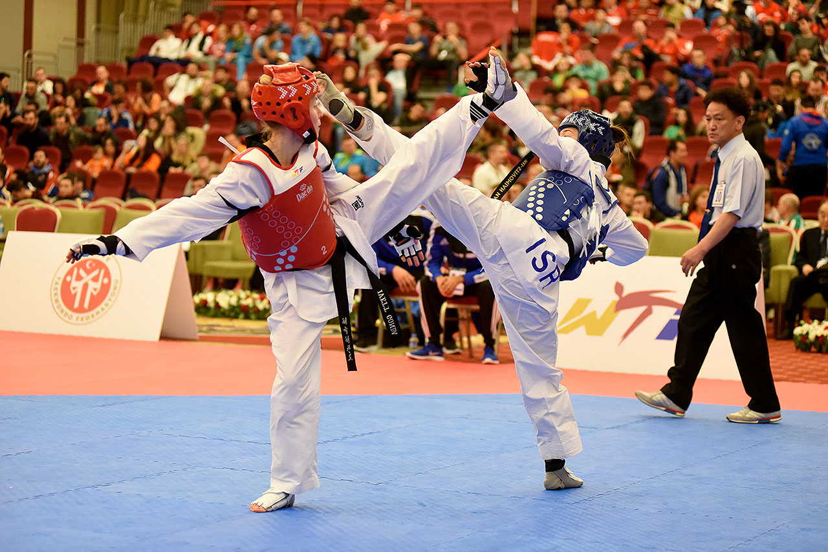
Taekwondo – Scoring a match
Taekwondo is a martial art. There are 4 men’s and 4 women’s events at the Olympics:
Men’s 58kg, Men’s 68kg, Men’s 80kg, Men’s over 80kg, Women’s 49 kg, Women’s 57kg, Women’s 67 kg, Women’s over 67 kg.
How many medals are on offer for Taekwondo at each Olympics?
Here are what points can be scored for in Taekwondo:
Points | Technique
1 | Foot or fist attack that strikes trunk protector
3 | Spinning or back kick that strikes the body
3 | Kick to head
4 | Spinning kick to head
8 events, 3 medals for each event
In Rio 2016, Jade Jones won the gold medal for the women’s 57kg event with a total score of 16. How many different ways can you think of that she could have achieved this score?
8 x 3 = 24 medals
So how is Taekwondo scored?
Actual result: 4 x 3 points + 4 x 1 point

