Slide 1
Numbers in sport

Slide 2
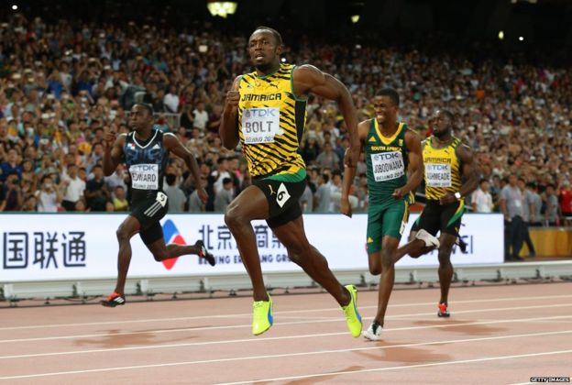
Track – The fastest man alive
Usain Bolt is considered the greatest short distance runner ever. In the past 3 Olympics at Rio 2016, London 2012 and Bejing 2008 he won gold in both the 100m and 200m sprints.
Look at Usain Bolt’s 100m times below.
When was his fastest time?
How much faster was this than his slowest time?
Was he right to make Rio 2016 his last Olympics?
2009 – when he ran 100m in 9.58 s, setting the current World record
9.81 – 9.58 = 0.23 s (What could you do in 0.23 s?)
He was also part of the gold medal Jamaican relay team that won the 4 x 100m relay in all 3 Olympics.
Justin Gatlin (USA) got the silver medal in Rio with a time of 9.89s.
If Usain’s time increased by 0.2 seconds over the next 4 years, it would be slower than this…
9.81 + 0.2 = 10.81 seconds
..making him unlikely to win a medal in 2020 in Tokyo.
100m international events | Time (s) | WR? OR?
Bejing Olympics 2008 | 9.69 | WR & OR
World Championships 2009 | 9.58 | WR
London Olympics 2012 | 9.63 | OR
World Championships 2013 | 9.77
World Championships 2015 | 9.79
Rio Olympics 2016 | 9.81
But how have his times changed over the years? Was he right to make Rio 2016 his last Olympics?

