Slide 1
Numbers in sport

Slide 2
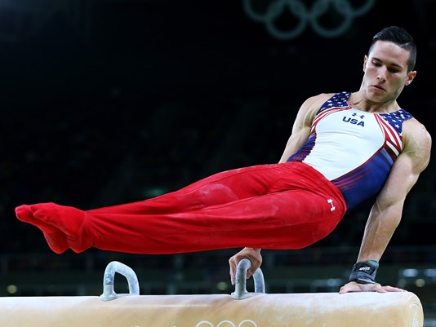
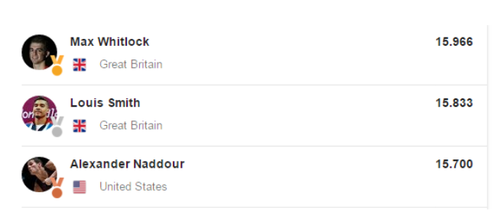
Men’s gymnastics – scoring the Pommel Horse
At the Olympics men can compete in the floor, pommel horse, rings, vault, parallel bars and horizontal bar
The top eight scorers for each apparatus qualify for the individual apparatus final. No more than 2 competitors from each country can be in each final.
In Rio 2016, Team GB did particularly well on the Pommel Horse, finishing with the gold and silver medals.
Each competitor is scored by 2 sets of judges. The first set judge the difficulty rating while the second set score, out of 10, the execution, composition and artistry.

Slide 3
Men’s gymnastics – scoring the Pommel Horse
So how is the difficulty score calculated?
There are 5 possible skill categories:
Single leg swings and scissors
Circles and flairs
Side and cross support travels
Kehrswings, wendeswings, flops and combined elements
Dismounts
For each of these skill categories fulfilled, the gymnast scores an extra 0.5 points.
The most difficult 9 elements of the routine are scored along with the dismount.
No more than 4 elements can be from the same skill category.
The following levels of difficulty are possible:
scores 0.1
scores 0.2
scores 0.3
scores 0.4
scores 0.5
scores 0.6
Can you work out the difficulty score for a routine that scored the following…?
Difficulty | D | D | D | B | B | C | C | A | C | D
Category | I | IV | II | III | II | IV | I | I | IV | V
What is the maximum possible score?

Slide 4
Men’s gymnastics – scoring the Pommel Horse
Difficulty score A:
1 x 0.1 = 0.1
Difficulty score B:
2 x 0.2 = 0.4
Difficulty score C:
4 x 0.3 = 1.2
Difficulty score D:
2 x 0.4 = 0.8
Difficulty score F:
1 x 0.6 = 0.6
Total:
0.1
0.4
1.2
0.8 +
0.6
3.1
All 5 skill categories covered:
Add on 5 x 0.5 = 2.5
3.1 + 2.5 = 5.6 (Final difficulty score)
Maximum possible difficulty score:
(0.6 x 10) + 2.5 = 6 + 2.5 = 8.5
There are 5 possible skill categories:
For each of these skill categories fulfilled, the gymnast scores an extra 0.5 points.
The following levels of difficulty are possible:
scores 0.1
scores 0.2
scores 0.3
scores 0.4
scores 0.5
scores 0.6
Can you work out the difficulty score for a routine that scored the following…?
Difficulty | C | D | F | B | B | C | C | A | C | D
Category | I | IV | II | III | II | IV | I | I | IV | V
What is the maximum possible score?

