Slide 1
Numbers in sport

Slide 2
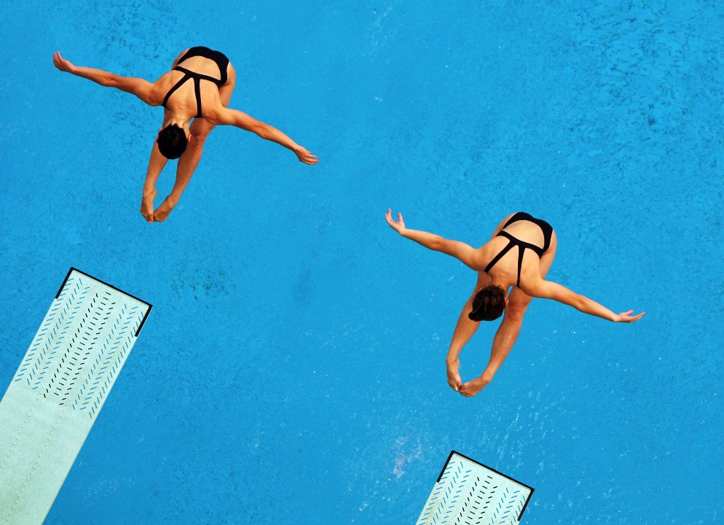
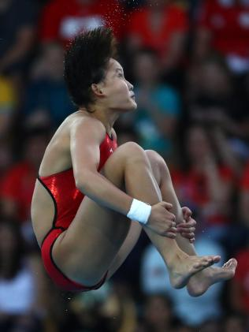
Diving – how does the scoring work?
China dominated the medals table for diving in Rio 2016, but how exactly are dives scored?
Qian Ren won the women’s 10m platform diving at Rio this year. Here are the judges scores for one of her dives, with the difficulty rating. Can you work out her total score?
For each dive, seven judges score the dive out of 10.
The two highest and the two lowest scores are discarded, then the remaining three scores are added together.
This total is then multiplied by the difficulty tariff to give a final score.
Difficulty | J1 | J2 | J3 | J4 | J5 | J6 | J7
3.0 | 8.5 | 9.0 | 9.0 | 9.0 | 8.5 | 8.5 | 8.5
Ignore J1, J3, J4 & J5
9.0 + 8.5 + 8.5 = 26.0
26 x 3 = 78

Slide 3
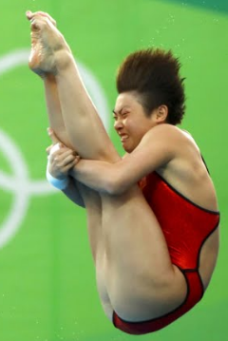
Diving – how does the scoring work?
China dominated the medals table for diving in Rio 2016, but how exactly are dives scored?
How about these scores for one of Yajie Si’s dives, also from China. She ended up with the silver medal.
For each dive, seven judges score the dive out of 10.
The two highest and the two lowest scores are discarded, then the remaining three scores are added together.
This total is then multiplied by the difficulty tariff to give a final score.
Difficulty | J1 | J2 | J3 | J4 | J5 | J6 | J7
3.0 | 9.0 | 9.0 | 8.5 | 9.0 | 9.0 | 9.0 | 9.0
Ignore J1, J3, J6 & J7
9.0 + 9.0 + 9.0 = 27.0
27 x 3 = 81
Though this score was higher than Qian’s, it was only one of 5 scores that went on to decide the medals.

Slide 4
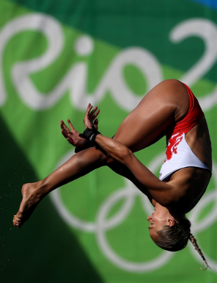
Diving – how does the scoring work?
China dominated the medals table for diving in Rio 2016, but how exactly are dives scored?
Tonia Couch from Team GB also made it to the final. She finished 12th in the end, but what did she score for this dive?
For each dive, seven judges score the dive out of 10.
The two highest and the two lowest scores are discarded, then the remaining three scores are added together.
This total is then multiplied by the difficulty tariff to give a final score.
Difficulty | J1 | J2 | J3 | J4 | J5 | J6 | J7
3.0 | 7.0 | 8.0 | 7.0 | 7.5 | 7.0 | 7.5 | 7.0
Ignore J1, J2, J3 & J6
7.5 + 7.0 + 7.0 = 21.5
21.5 x 3 = 64.5
Tonia also finished 5th in the women’s synchronised 10m platform.

