Slide 1
Numbers in sport

Slide 2
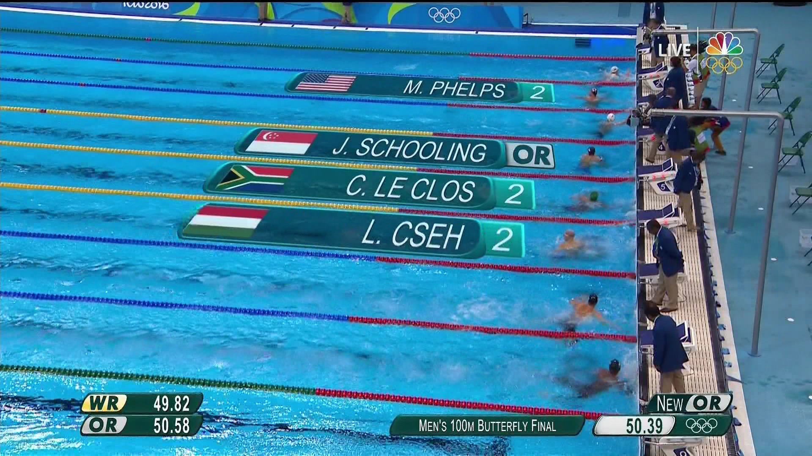
Swimming – and the relevance of rounding
An Olympic swimming pool is fifty metres long, but can only be guaranteed to be constructed to the nearest three centimetres.
What does this mean the greatest length of a lane could be?
What does this mean the least length of a lane could be?
50 m + 3 cm = 50.03 m
50 m - 3 cm = 49.97 m

Slide 3
Swimming – and the relevance of rounding
So the length of each lane could be different, meaning some swimmers have further to swim than others.
How can we make sure the race is fair?
Rounding!
By rounding each swimmers time to 2 decimal places any differences in the length of each lane become irrelevant.

Slide 4
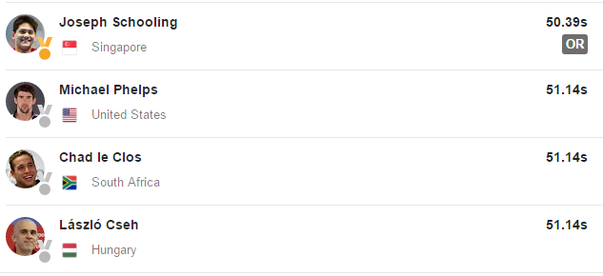
Swimming – and the relevance of rounding
Here are the results from the men’s 100m butterfly final at the Rio Olympics 2016. Notice how each time has two numbers after the decimal point – the times have been rounded to 2 decimal places.
The times could have been measured to more decimal places, but any differences in timings could then have been due to the lengths of each lane being different.
Rounding to 2 decimal places meant that 3 swimmers came in the silver medal position.
How many different times can you think of that round to 51.14 seconds to 2 decimal places?
51.143 s
51.139 s
51.1421 s…

