Slide 1
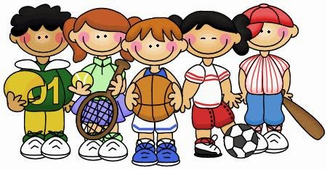
A Mathematical Question of Sport
Having good numeracy skills can help you excel at sport.
Today you will be taking part in a series of challenges to help you develop some of these skills.
Whether it’s estimating distances if you’re doing the high jump, pacing yourself in a race or keeping track of your score in darts, being able to use mathematics in physical education can help you do well.

Slide 2

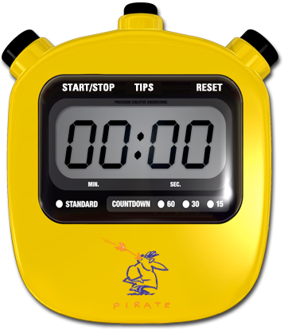
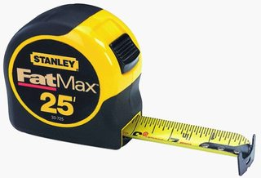
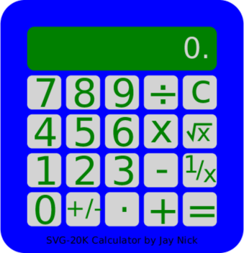
A Mathematical Question of Sport
Instructions
Get yourself into teams. Choose a team name.
For each challenge you will need to choose a volunteer. There are six challenges in total. Each team member should compete in at least one challenge.
During the challenges you will need to keep track of the results in the data collection sheet provided.
After the challenges you will need to analyse your results.
You will need tape measures, post-its, paper, stop watches and calculators.

Slide 3
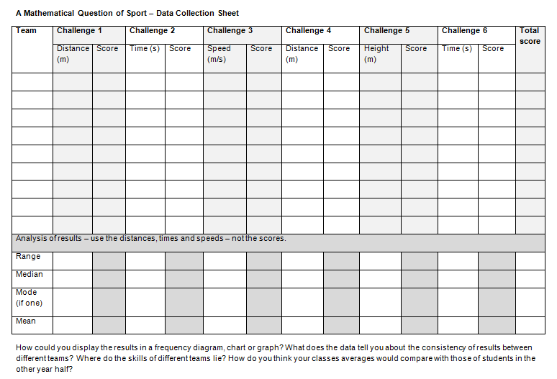
A Mathematical Question of Sport

Slide 4

A Mathematical Question of Sport - Challenge 1
Choose a volunteer from your team.
The team member should choose another student who is sitting as close to 2.5 metres away from them as possible.
Let all teams make and communicate their decisions before measuring.
10 points for finding someone exactly 2.5 metres away.
-1 point for each 0.1 metres you are out.

Slide 5

A Mathematical Question of Sport - Challenge 2
Choose a volunteer from your team.
The team member will have to stand on one leg for exactly 15 seconds.
All teams will compete before the times they got are revealed.
10 standing on one leg for exactly 15 seconds.
-1 point for each second you are out.

Slide 6

A Mathematical Question of Sport - Challenge 3
Choose a volunteer from your team.
The team member will try to travel the length of the classroom at exactly 0.5 metres per second.
All teams will compete before the speeds they got are revealed.
10 standing for travelling at exactly 0.5 metres per second.
-1 point for 0.5 metre per second they are out.

Slide 7


A Mathematical Question of Sport - Challenge 4
Choose a volunteer from your team. Label a ball of paper with your team name.
The team member will try to throw the paper ball exactly $\frac{2}{3}$of the length of the classroom.
All teams will compete before the distances they got are revealed.
10 points for which ever team gets closest .
8 points for the next team, 6 for the following one and so on.

Slide 8

A Mathematical Question of Sport - Challenge 5
Choose a volunteer from your team. Give the team member a post-it and write your team name on it.
The team member will try to jump and stick the post it exactly 2.2 metres from the ground.
All teams will compete before the distances they got are revealed.
10 points for which ever team gets closest .
8 points for the next team, 6 for the following one and so on.

Slide 9

A Mathematical Question of Sport - Challenge 6
Choose a volunteer from your team.
The team member will try to hold their breath for exactly 20 seconds.
All teams will compete before the times they got are revealed.
10 points for any team that manages exactly 20 seconds.
-1 point for each second out.

Slide 10
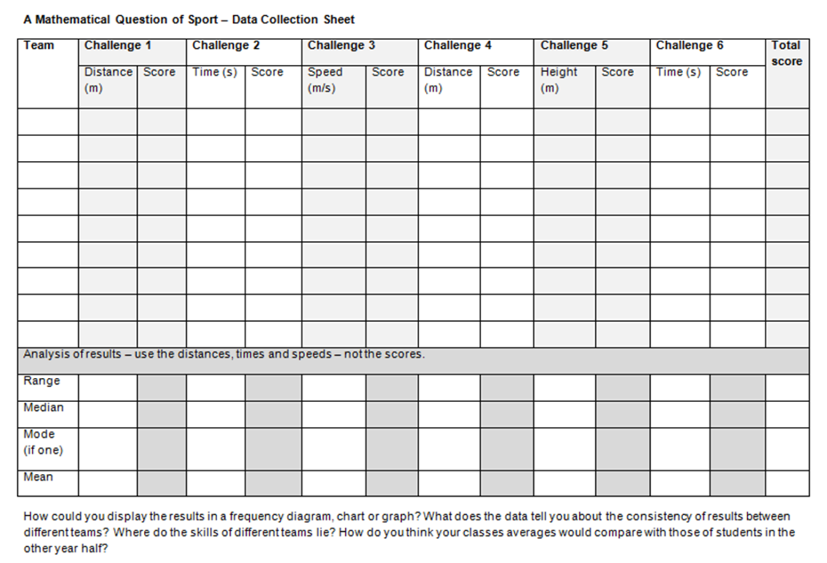
A Mathematical Question of Sport - Analysis
Analyse the results.
Work out the different averages and the range of results for each challenge.
Discuss the results.
Present the results.
Move onto the questions at the bottom of the sheet.

