Slide 1
Football – a game of chance
How do managers choose which players they’ll buy for their teams?
You can estimate the probability, or chance, of something happening using this formula:
There are a mixture of factors they consider. For a striker one of the main ones is the chance of them scoring a goal.
But can this be worked out?
Estimate of = Number of times something occurs
Probability Total number of trials

Slide 2
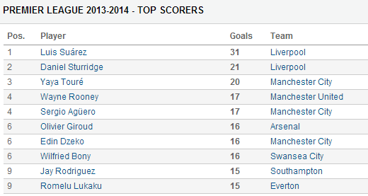
Premier League Top Scorers 2013-2014
Each premier league team plays 38 matches a season.
What is an estimate for the probability Rooney will score a goal in a match this season?
17
38

Slide 3
Premier League Top Scorers 2013-2014
Each premier league team plays 38 matches a season.
What is an estimate for the probability Dzeko will score a goal in a match this season?
16
38
Would you want Dzeko on your team if you were a manager?

Slide 4
Premier League Top Scorers 2013-2014
If you pick one of the top ten scorers at random, what is the probability they scored 16 goals last season?
3
10

Slide 5
Premier League Top Scorers 2013-2014
If you pick one of the top ten scorers at random, what is the probability they didn’t score 15 goals last season?
8
10

