Slide 1



Year 7 Numeracy Awards

Slide 2

Year 7
This is a special announcement….
From next week you will be given the opportunity to win a numeracy award.
But how can I win these awards I hear you ask….
Get your planners out.
Look at the numeracy pages.

Slide 3
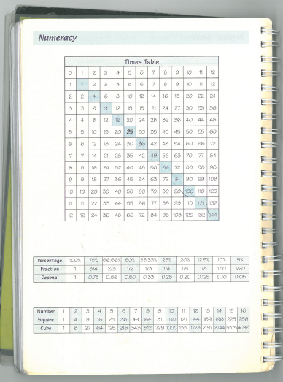
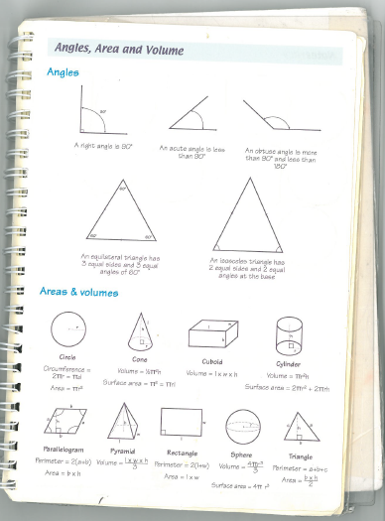
Found them?

Slide 4

Bronze Award
Know your 2, 3, 4, 5 & 10 times tables.
Know how to find the perimeter and area of a rectangle.
Know your angle facts about right, acute and obtuse angles.
Know the names of all your 2D shapes.
Know your equivalent fraction, decimal and percentages for 100%, 50%, 25% and 75%.

Slide 5
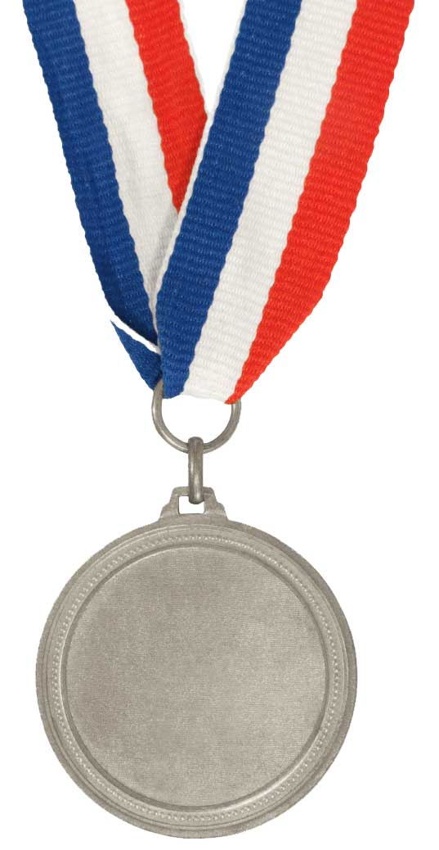
Silver Award
Know all your times tables.
Know how to find the perimeter and area of a rectangle, a parallelogram and a triangle - and the volume of a cuboid!
Know all your angle facts.
Know the names of all your 2D & 3D shapes.
Know all your equivalent fractions, decimals and percentages.
Know all your square numbers.

Slide 6

Gold Award
Know all your times tables.
Know how to find the perimeter and area of all your 2D shapes!
Know how to find the volume of all your 3D shapes!
Know all your angle and FDP facts.
Know all your square and cube numbers – and your square and cube roots!

Slide 7
How do we get a badge?
The Maths Prefects will be in room 1.03 every
Thursday lunchtime.
They will quickly test your skills to see what badge you can receive.
You get one chance to win an award each week. If you don’t manage one week, you can try again the next.
You must get a bronze badge before you get a silver one, and a silver one before you get a gold one.

