Slide 1
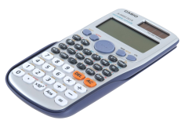
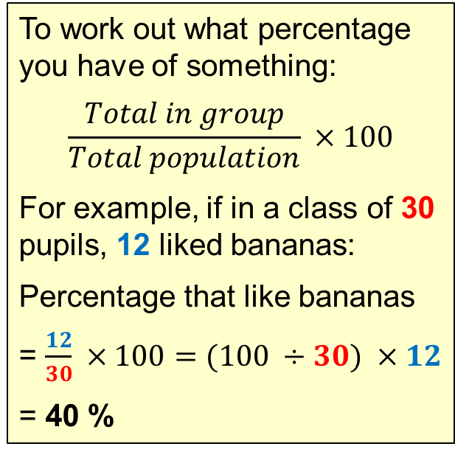
Predicting percentages
Percentages are good ways of comparing groups within a population.
They are always out of 100, so 100% would mean the whole amount.
To work out what percentage you have of something:
$$\frac{Total in group}{Total population} ×100$$
For example, if in a class of 30 pupils, 12 liked bananas:
Percentage that like bananas
= $\frac{12}{30} ×100=(100 ÷30) ×12$
= 40 %
Predict:
What percentage of your form are Manchester United fans?
HINT
If you think more than half are MU fans, predict higher than 50%.
If you think almost everyone is a MU fan, predict close to 100%.
If you think hardly anyone is a MU fan, predict close to 0%.
Now ask your form and calculate the percentage
Whose prediction was closest?
If you have time repeat the process for other teams.

Slide 2
Predicting percentages
Percentages are good ways of comparing groups within a population.
They are always out of 100, so 100% would mean the whole amount.
To work out what percentage you have of something:
$$\frac{Total in group}{Total population} ×100$$
For example, if in a class of 30 pupils, 12 liked bananas:
Percentage that like bananas
= $\frac{12}{30} ×100=(100 ÷30) ×12$
= 40 %
Predict:
What percentage of your form have a dog?
HINT
If you think more than half have dogs, predict higher than 50%.
If you think almost everyone has a dog, predict close to 100%.
If you think hardly anyone has a dog, predict close to 0%.
Now ask your form and calculate the percentage
Whose prediction was closest?
If you have time repeat the process for other pets.

Slide 3
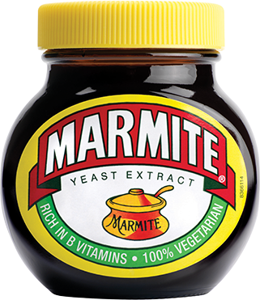
Predicting percentages
Percentages are good ways of comparing groups within a population.
They are always out of 100, so 100% would mean the whole amount.
To work out what percentage you have of something:
$$\frac{Total in group}{Total population} ×100$$
For example, if in a class of 30 pupils, 12 liked bananas:
Percentage that like bananas
= $\frac{12}{30} ×100=(100 ÷30) ×12$
= 40 %
Predict:
What percentage of your form like marmite?
HINT
If you think more than half like marmite, predict higher than 50%.
If you think almost everyone likes marmite, predict close to 100%.
If you think hardly anyone likes marmite, predict close to 0%.
Now ask your form and calculate the percentage
Whose prediction was closest?
If you have time repeat the process for other foods.

Slide 4
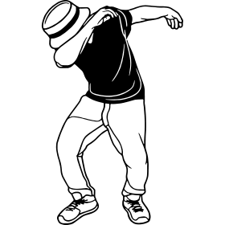
Predicting percentages
Percentages are good ways of comparing groups within a population.
They are always out of 100, so 100% would mean the whole amount.
To work out what percentage you have of something:
$$\frac{Total in group}{Total population} ×100$$
For example, if in a class of 30 pupils, 12 liked bananas:
Percentage that like bananas
= $\frac{12}{30} ×100=(100 ÷30) ×12$
= 40 %
Predict:
What percentage of your form like to dab?
Miss Yordanova likes a good dab – just saying
HINT
If you think more than half like to dab, predict higher than 50%.
If you think almost everyone likes to dab, predict close to 100%.
If you think hardly anyone likes to dab, predict close to 0%.
Now ask your form and calculate the percentage
Whose prediction was closest?
If you have time repeat the process for other strange actions.

Slide 5
Predicting percentages
Percentages are good ways of comparing groups within a population.
They are always out of 100, so 100% would mean the whole amount.
To work out what percentage you have of something:
$$\frac{Total in group}{Total population} ×100$$
For example, if in a class of 30 pupils, 12 liked bananas:
Percentage that like bananas
= $\frac{12}{30} ×100=(100 ÷30) ×12$
= 40 %
Predict:
What percentage of your form can bottle flip?
Miss Willis can bottle flip - fact
HINT
If you think more than half can bottle flip, predict higher than 50%.
If you think almost everyone can bottle flip, predict close to 100%.
If you think hardly anyone can bottle flip, predict close to 0%.
Now ask your form and calculate the percentage
Whose prediction was closest?
If you have time repeat the process for other talents.

