Slide 1
Averages
This half term we will be analysing data – and working out different averages for each form. Averages tell you a typical value for a set of data.
You will need to know the different types of averages:
MEDIAN
MODE
MEAN
Which of these do you know already?
Choose the activity
1
2
The middle value once the data has been put in order
3
4
The most common value in the data (there can be more than one mode)
5
What you get when you find the total of the data and then share it back out. (That is divide it by the number of values)
6
7
8

Slide 2
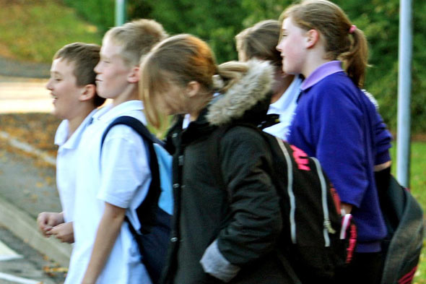
Challenge 1
How long on average do you think it takes students in your form to get to school? [Have a guess and write it down]
Record how long it takes 11 students to get to school.
Put the data in ascending order.
What is the median time?
Is there a modal time?
Can you work out the mean time?
Whose guess was closest to one of the averages?
How could I make my averages more accurate?
Back to start

Slide 3
Challenge 2
How long on average do you think students in your form spend doing their Maths homework each week (in minutes)?
[Have a guess and write it down]
Record how long 11 students spend doing their Maths homework.
Put the data in ascending order.
What is the median time?
Is there a modal time?
Can you work out the mean time?
Whose guess was closest to one of the averages?
How could I make my averages more accurate?
Back to start

Slide 4
Challenge 3
How long on average do students in your form sleep each night (in hours)?
[Have a guess and write it down]
Record how long 11 students sleep each night.
Put the data in ascending order.
What is the median time?
Is there a modal time?
Can you work out the mean time?
Whose guess was closest to one of the averages?
How could I make my averages more accurate?
Back to start

Slide 5
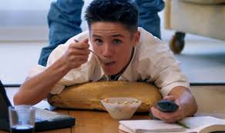
Challenge 4
How long on average do students in your form watch TV for on a week day (in minutes)?
[Have a guess and write it down]
Record how long 11 students watch TV for on a week day.
Put the data in ascending order.
What is the median time?
Is there a modal time?
Can you work out the mean time?
Whose guess was closest to one of the averages?
How could I make my averages more accurate?
Back to start

Slide 6
Challenge 5
How long on average do students in your form spend on the computer a week (in hours)?
[Have a guess and write it down]
Record how long 11 students spend on the computer a week. (An estimate is fine)
Put the data in ascending order.
What is the median time?
Is there a modal time?
Can you work out the mean time?
Whose guess was closest to one of the averages?
How could I make my averages more accurate?
Back to start

Slide 7
Challenge 6
How long on average do students spend on their phones a day? (in hours) [Have a guess and write it down]
Record how long 11 students spend on their phones each day. An estimate is fine.
Put the data in ascending order.
What is the median time?
Is there a modal time?
Can you work out the mean time?
Whose guess was closest to one of the averages?
How could I make my averages more accurate?
Back to start

Slide 8
Challenge 7
How long on average do students in your form play sport for a week? (in hours) [Have a guess and write it down]
Record how long 11 students play sport for a week.
Put the data in ascending order.
What is the median time?
Is there a modal time?
Can you work out the mean time?
Whose guess was closest to one of the averages?
How could I make my averages more accurate?
Back to start

Slide 9
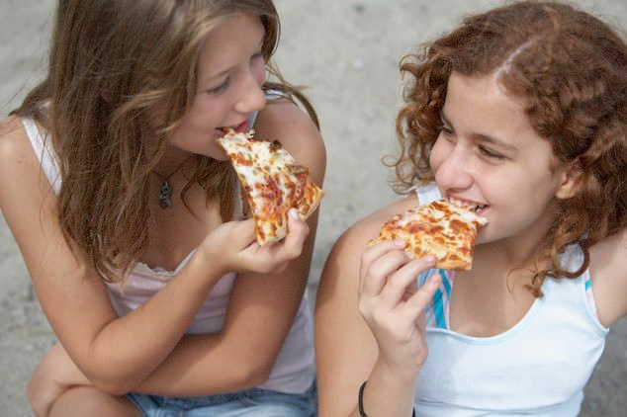
Challenge 8
How long on average do students take to eat dinner (in minutes)?
[Have a guess and write it down]
Record how long 11 students take to eat their dinner.
Put the data in ascending order.
What is the median time?
Is there a modal time?
Can you work out the mean time?
Whose guess was closest to one of the averages?
How could I make my averages more accurate?
Back to start

