Slide 1
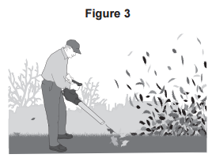
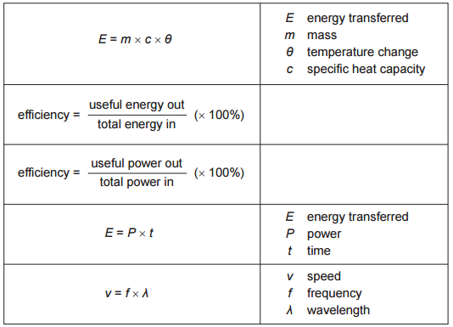
GCSE Subject Area – Physics
Find the correct equation:
The total power input to the leaf blower is 750 W.
The useful power output of the leaf blower is 360 W.
Calculate the efficiency of the leaf blower.
Use the correct equation from the Physics Equations Sheet.
Substitute into the equation:
Efficiency = Useful power out
Useful power in
= 360
750
= 0.48
Convert to a percentage:
0.48 x 100 =
48 %
AQA June 2015 Unit 1

Slide 2
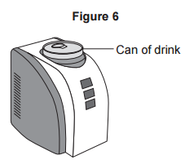
GCSE Subject Area – Physics
Find the correct equation:
The can-chiller decreases the temperature of the liquid in the can by 15 °C.
The mass of liquid is 0.33 kg.
The specific heat capacity of the liquid is 4200 J/kg °C.
Calculate the energy transferred from the liquid as it cools.
Use the correct equation from the Physics Equations Sheet.
Substitute into the equation:
E = m x c x θ
= 0.33 x 4200 x 15
= 20790 J
Always remember to include your units
AQA June 2015 Unit 1

