Slide 1
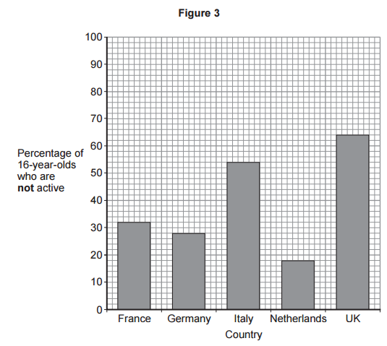
GCSE Subject Area – Biology
People who are not active may have health problems.
Figure 3 shows the percentage of 16-year-olds in some countries who are not active.
What percentage of 16-year-olds in the UK are not active?
What percentage of 16-year-olds in the UK are active?
Work out how much each square is worth
70 – 60 = 10
10 ÷ 5 = 2
Then read off the value
64 %
60 + (2x2)
= 64
Percentages must sum to 100%
36 %
100 % - 64 % = 36 %
AQA June 2015 Unit 1

Slide 2
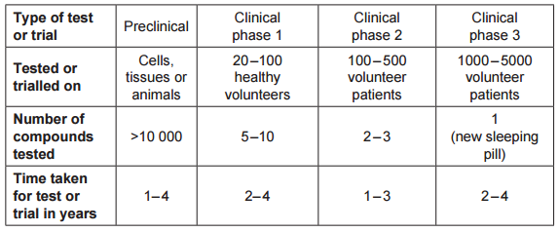
GCSE Subject Area – Biology
The table shows information about the development of a new sleeping pill.
While this is acceptable as a final answer in Biology, when finding the range in Mathematics you must then find the difference between the values:
5600 – 1120 = 4480
You are also allowed to give this as the answer in a Biology paper.
What is the shortest time taken to develop a new sleeping pill?
Use the shortest times for each phase:
1 + 2 + 1 + 2 = 6 years
What is the range for the number of volunteers needed to complete all the clinical trials for the new sleeping pill?
20 + 100 + 1000 = 1120
The range is from 1120 to 5600
100 + 500 + 5000 = 5600
AQA June 2015 Unit 1

